Slide 1
NorDig HEVC questionnaire
Telco 10th February 2016
18 answers (so far)
9 from members (broadcasters & operators)
9 from manufacturers

Slide 2
Timing
Introducing a new HEVC capable NorDig IRD including HEVC decoding offers a number of possibilities. As well as offering bitrate reduction due to the high compression efficiency of HEVC, higher video resolutions (up to 2160p) can be reached. In addition to this, new features as higher dynamic range and more vivid colors as well as higher frame rate could be utilized to improve the viewing experience.
Regardless the motive you see for an introduction of HEVC based services in your market, when do you feel the need to have NorDig HEVC IRDs available?

Slide 3
Lifespan
What lifespan do you expect for the NorDig HEVC IRD requirements?

Slide 4
Broadcaster / operator perspective
A TV service encoded with HEVC is expected to consume approximately half the bitrate than using MPEG-4 AVC reaching the same quality. This is of course a strong motive for using the HEVC codec. As already mentioned, the introduction of HEVC also makes a new video toolset available, comprising higher resolutions than HD, video with higher dynamic range including a larger color space than today and also frame rates >50Hz.
What is the main reason to adopt HEVC in NorDig?

Slide 5
Introduction and migration
As was the case going from MPEG-2 to MPEG-4, the introduction of and migration to HEVC may differ greatly from country to country and platform to platform depending on local circumstances.
How do you expect the introduction of and migration to HEVC will happen in your market / platform? Please tick the option closest to your opinion.

Slide 6
Viewer perspective
The technology evolution steps of TV transmissions has so far been accompanied by features bringing added value to the viewers. The transition from analogue to digital television, using MPEG-2, offered more channels. The introduction of MPEG-4 AVC gave access to HDTV.
Is it possible to convince the viewers to invest in new HEVC capable receiver equipment without offering them some added value compared to existing TV services?

Slide 7
Resolution
Even though HDTV sets will dominate the homes for quite some time, Ultra HD television sets with the ability to reproduce image formats up to 3840x2160 pixels are now introduced in the market. In addition to this, Ultra HD content has already been available for a while on streaming services like Netflix and Amazon and are now followed by Ultra HD Blu-ray discs.
In this environment still dominated by HDTV equipment and services in SD and HD but with Ultra HDTV gaining terrain, what resolution should a NorDig HEVC IRD be able to receive and decode?

Slide 8
High Dynamic Range (HDR) plus Wide Color Gamut (WCG)
Independent of the resolution, an increased dynamic range accompanied by a wider color gamut for the video will offer the viewers an enhanced experience. Subjective tests are showing that the perceived improvement is significantly larger increasing the dynamic range and color gamut than stepping up the resolution from Full HD to Ultra HD. Although improvements with HDR+WCG are resolution independent, the use of HDR+WCG is by DVB mandated to be linked to encoding of produced 2160p-video. (HDR+WCG could though be transmitted via the, during encoding downscaled, sub-resolutions 1800p, 1440p, 1080p, 900p, 720p and 540p as well as the originally produced ‘full’ 2160p.)
High Dynamic Range content with WCG is now becoming available on streaming services as Netflix and on Ultra HD Blu-ray discs.
Is it important to include High Dynamic Range accompanied by Wide Color Gamut in the NorDig HEVC IRD capabilities?
HDR+WCG
- new TV format with
”better” pixels

Slide 9
High Frame Rate (HFR)
Increasing the frame rate from 50 to 100 Hz will improve the perceived image quality by reducing motion blur or jerky motion portrayal on scenes with fast movements. HFR can be used for any resolution, but is increasingly important with higher resolutions and larger screen sizes. There are however a concern that the combination of doubled frame rate and increased image resolution will cause data volumes that are complex and costly to handle in production and will add complexity and cost to consumer equipment.
Should the NorDig HEVC IRD be capable of handling High Frame Rate?
HFR
- new TV format with
”better” pixels

Slide 10
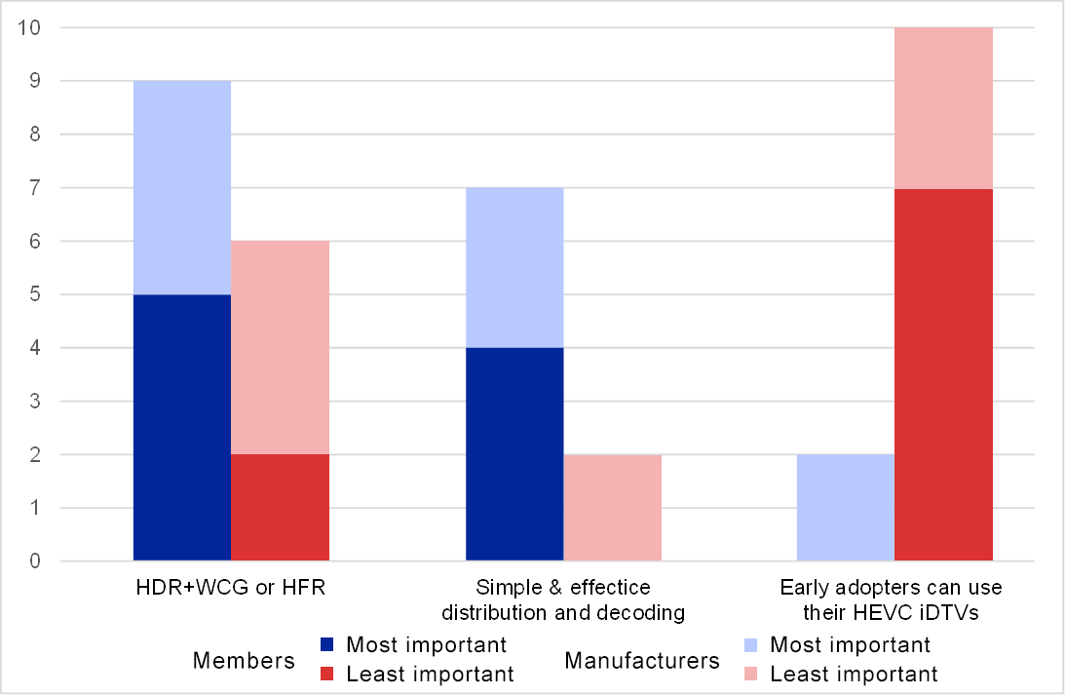
Compatibility of existing HEVC iDTVs
iDTVs, capable of receiving, decoding and displaying 10-bit HEVC encoded video, have already found their way into consumer homes. Many of these iDTVs lack the ability to present HDR, WCG or HFR. Addressing these receivers requires some compromises to be made. The compromise might be to avoid the use of HDR, WCG or HFR altogether, to tolerate additional cost and complexity in distribution and decoding or to simply avoid addressing these HEVC iDTVs directly by requiring viewers to add a set-top box.
From the following three requirements, please indicate the most important and least important to your business:
Requirement 1. Ability to make use of HDR, WCG or HFR
Requirement 2. Simplicity and cost effectiveness in distribution and decoding
Requirement 3. Early-adopting consumers being able to make full use of their investment in HEVC
decoding iDTVs

Slide 11
Compatibility of existing HEVC iDTVs
Preference for ”Backward Compatibility”
(Compiled from the answers of the previous question.)

Slide 12
Next Generation Audio
Incorporating HEVC as a video codec in the NorDig IRD specification also means an opportunity to include additional audio functionality. The “Next Generation Audio” codecs (as defined by DVB) are offering broadcasters the possibility to deliver improved audio experiences and will handle object and scene based as well as channel based audio streams. The NGA codecs have an extensive set of features including handling of multiple audio tracks (multiple languages, audio description, spoken subtitles and so on), handling of production metadata, good control of loudness and down-mix, the possibility for the listener to personalize the listening experience, support for binaural stereo and more… The performance of NGA codecs that are candidates to be included in the TS 101154 specification are now evaluated by DVB.
Should we consider adding one or more of the “Next Generation Audio” codecs to the HEVC version of the NorDig specification?

Slide 13
Additional or refined audio functionalities
If yes or maybe to the previous question, which additional/refined functionalities would you intend to leverage? (Several options can be marked).

Slide 14
Removal of “legacy” functions/requirements
By the time HEVC is introduced in NorDig, some of the functional requirements in the current version of the specification may have lost their importance. Such requirements could then be made optional or be totally removed from the specification.

Slide 15
Removal of “legacy” functions/requirements

Slide 16
Updates and additions to other IRD functionality
Making a new NorDig version is also an opportunity to update and add specifications covering other IRD functionality.
Please tick the parts you think should be updated or added?
(Several options can be marked)

