Slide 1
HbbTV 2.0
Providing tools for improved accessibility

Slide 2


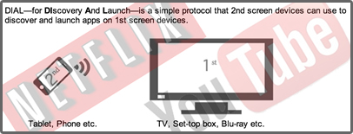
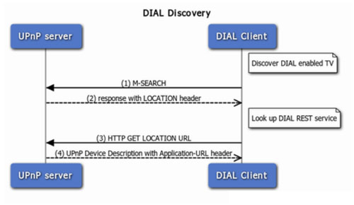
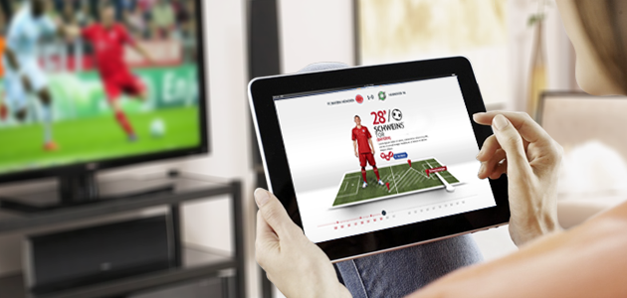
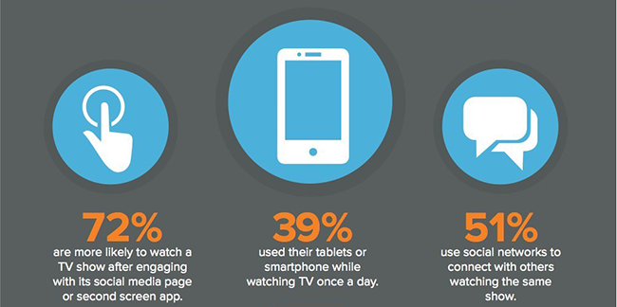
Pairing & app2app communication across devices
2.0

Slide 3
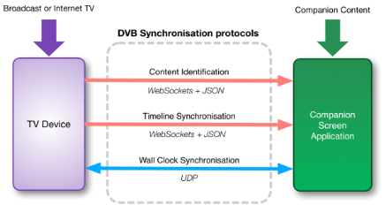
Frame accurate synchronization

Slide 4
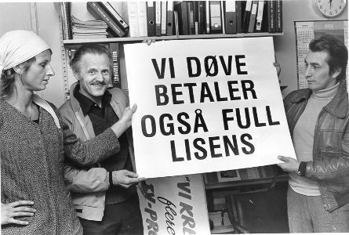


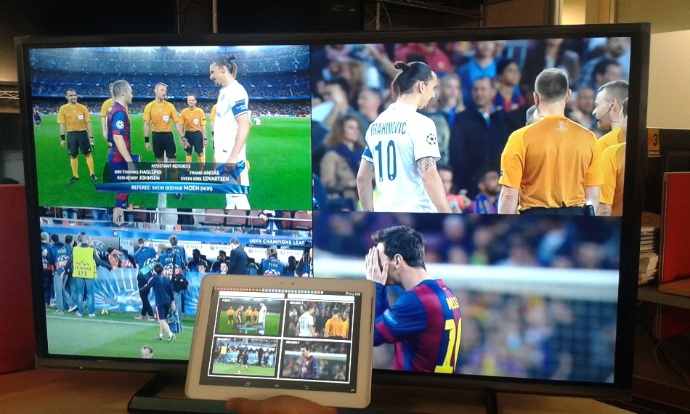

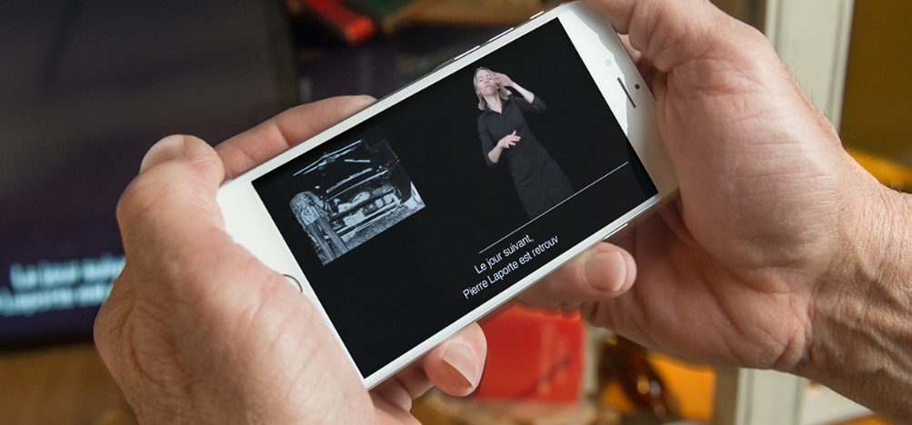

Frame accurate synchronization
Frame accurate sync of mediastreams
Sync mob+TV:
-Spoken/big
subtitles
-Sign language
2.0

Slide 5
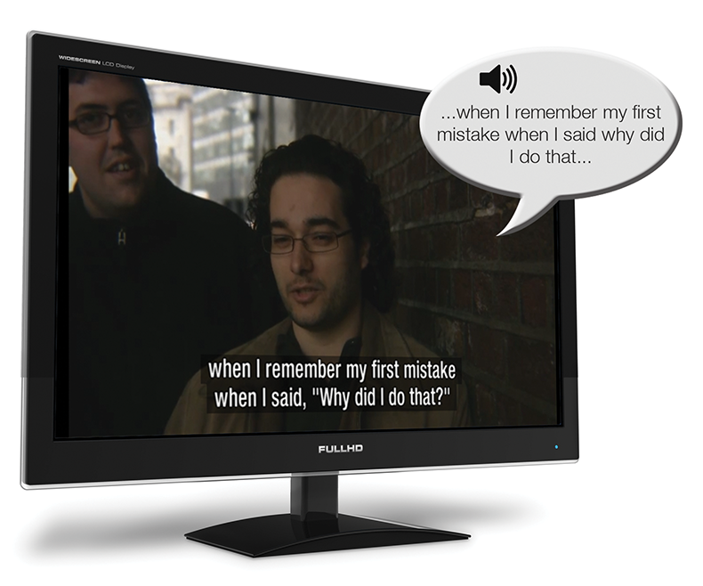

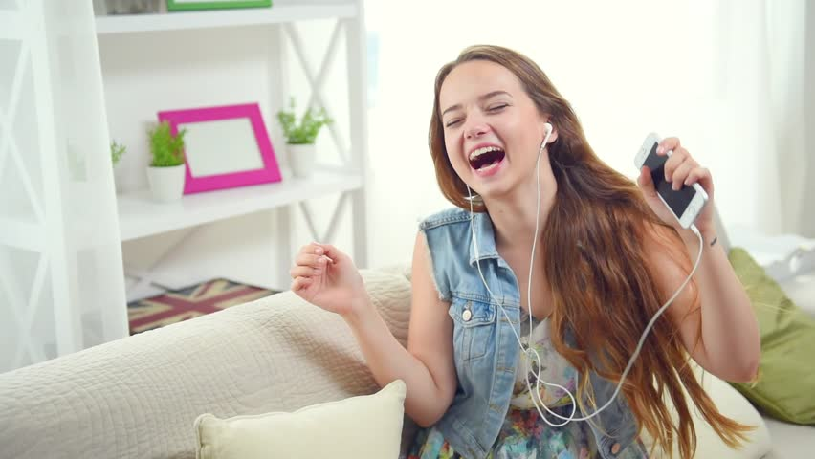
Spoken subtitles on mobile rather than on shared TV
-Individually adapted for the visually impaired
-Not distrubing the shared experience on TV
-Could also be used for enhancing dialogue

Slide 6
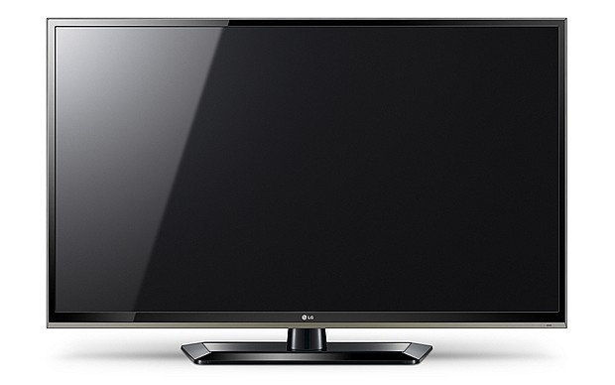
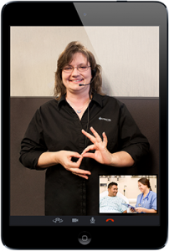
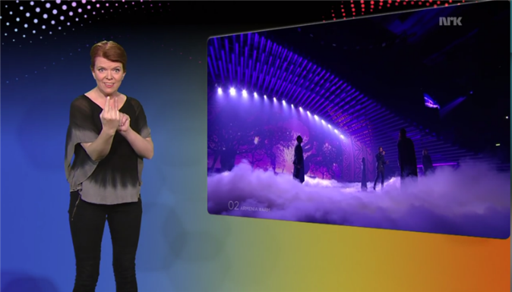
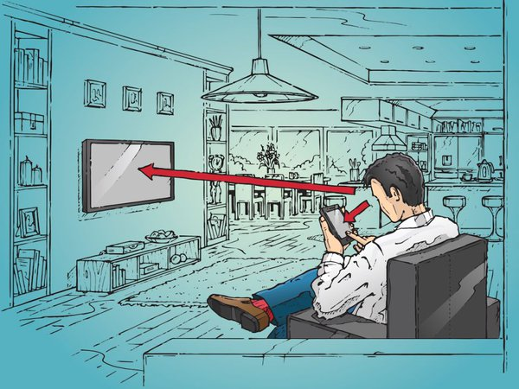
Sign language on mobile in sync with TV
-Mandatory support for only one decoder
does not result in a separate TV channel
-The interpreter on second screen can be
individually adapted
-Not disturbing the shared experience on TV
-Could be an issue with sign language app
drawing attention away from TV screen
-Issue with one decoder on TV could also
be solved with a precomposed stream
including the interpreter.
The stream does not require capacity from
the TV nework and could easily be made
available with HbbTV.

Slide 7
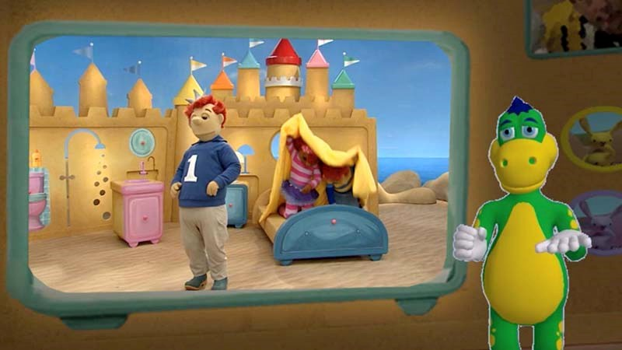



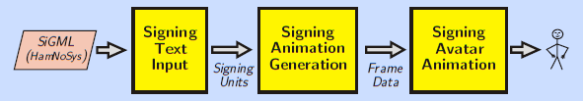
Sign language with avatars?
Sign language for young children:
-Can’t read text; dependent on avatar/interpreter
-Autotranslation difficult but possible (out of scope)
https://tech.ebu.ch/docs/tech-i/0790%20Tech-i%20issue%2026_for%20web.pdf

Slide 8
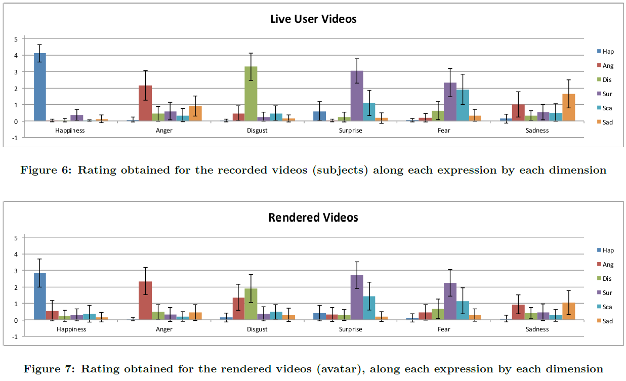
Real interpreters rate higher than avatars
http://www.dfki.de/~fanu01/articoli_miei/2013/heloir-sltat13.pdf

Slide 9
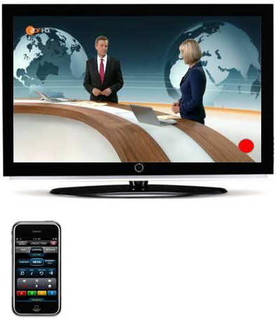
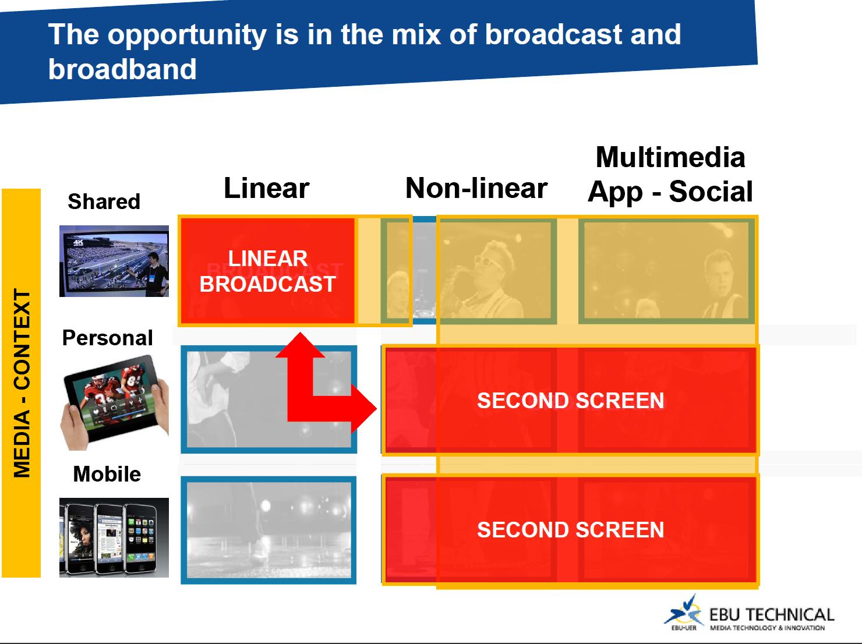
Second screen as accessibility remote?

