Slide 1
New frequency allocations for mobile
World Radio Conference 2015
PTS at NorDig, 26th of May 2015

Slide 2





Presenting PTS
The Swedish Post and Telecom Authority (PTS) monitors the electronic communications and postal sectors in Sweden.
We shall:
work to ensure that everyone has access to good telephony, broadband and postal services
work to achieve functioning competition in the market, resulting in a good range of options and low prices for consumers
ensure that limited resources, such as frequencies and numbers, are assigned and managed efficiently
ensure that networks and services are reliable and secure

Slide 3
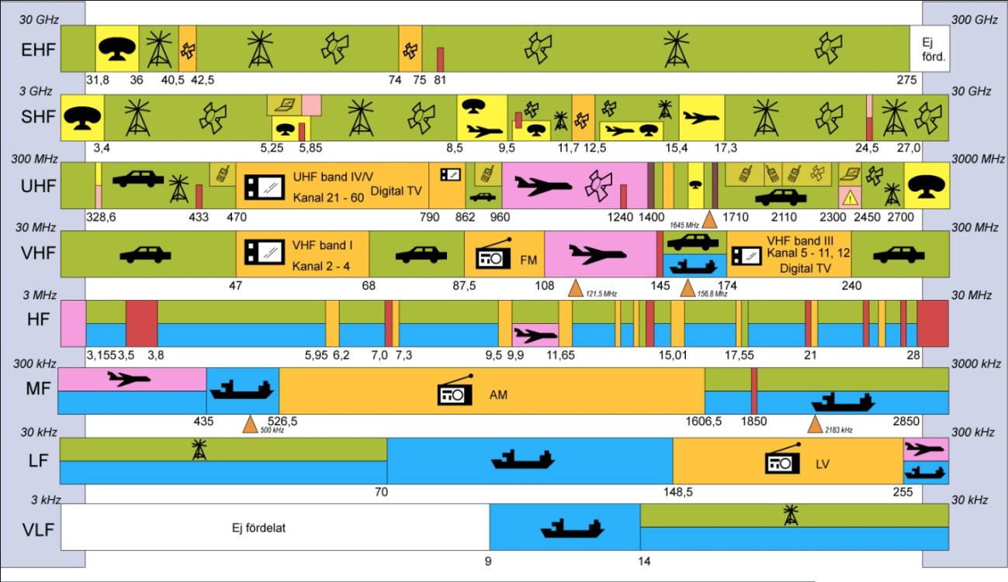
Radio spectrum is a limited resource

Slide 4

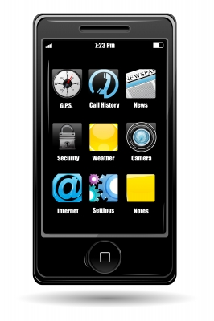
PTS
INVENTORY
Primary or exclusive use
300 MHz - 6 GHz

Slide 5



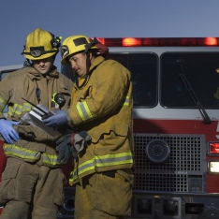

Radio spectrum is a scarce resource
Increased demand for wireless services and spectrum
Allocation a result of our heritage
Technical development – will not solve all problems
Spectrum Strategy - for long term and transparent spectrum management
Make spectrum available
Use spectrum efficiently
Maximise the economic
benefit of spectrum
for society
Give the market better
chances to fulfill the increasing
demand for wireless services
Meet the needs of society,
e.g. defense and
safety-of-life services

Slide 6

Spectrum management in the international context
Allocations; use determined by ITU that has to be protected at the country border
Decisions or guidelines for harmonised usage (EU-Commission and CEPT*)
*European Conference of Postal and Telecommunications Administrations
Standardisation of equipment is based on allocations, decisions and future usage (ETSI*)
*European Telecommunications Standards Institute
National decision on use/assignment, technical conditions etc.

Slide 7
WRC-15 preparations
WRC-15
2-27 nov 2015
Geneve
ITU-R
CEPT ECC
PTS, Sweden

Slide 8
New frequency allocations for mobile WRC-15 AI 1.1 and AI 1.2
AI 1.1
to consider additional spectrum allocations to the mobile service on a primary basis and identification of additional frequency bands for International Mobile Telecommunications (IMT) and related regulatory provisions, to facilitate the development of terrestrial mobile broadband applications, in accordance with Resolution 233 (WRC-12)
AI 1.2
to examine the results of ITU-R studies, in accordance with Resolution 232 (WRC‑12), on the use of the frequency band 694-790 MHz by the mobile, except aeronautical mobile, service in Region 1 and take the appropriate measures;

Slide 9
AI 1.1 – frequency bands for allocation to mobile services and IMT identification
Frequencies between 450 MHz and 6 GHz
F_{min} [MHz] | F_{max} [MHz] | Motivation | CEPT Brief | CPM
470 | 694 | Coverage | no
1 300 | 1 350 | Coverage/Capacity | no | X
1 350 | 1 375 | Coverage/Capacity | no
1 375 | 1 400 | Coverage/Capacity | no
1 427 | 1 452 | Coverage/Capacity | yes
1 452 | 1 492 | Coverage/Capacity | yes
1 492 | 1 518 | Coverage/Capacity | yes
1 518 | 1 525 | Coverage/Capacity | no | X

Slide 10
Frequencies between 450 MHz and 6 GHz
F_{min} [MHz] | F_{max} [MHz] | Motivation | CEPT Brief | CPM
2090 | 2110 | Capacity | no | X
2200 | 2215 | Capacity | no | X
2 700 | 2 900 | Capacity/Performance | no
2 900 | 3 100 | Capacity/Performance | no | X
3 400 | 3 600 | Capacity/Performance | yes
3 600 | 3 800 | Capacity/Performance | yes
3 800 | 4 200 | Performance | no
5 350 | 5 470 | Performance | no
5 725 | 5 850 | Performance | no
5 925 | 6 425 | Performance | no

Slide 11
AI 1.2 – co-primary allocation of 694-790 MHz for mobile services and IMT identification
Issue A: lower edge
694 MHz
Issue B: Protection of broadcasting under 694 MHz
GE06 applies
Issue C: Protection of ARNS
Method ”CEPT minus Russia” or Method ”Russia”
Issue D: SAB/SAP
Solutions for SAB/SAP
  European position is in line with African Telecommunication Union and Arab Spectrum Management Group.

Slide 12


Protection of terrestrial television under 694 MHz
Global harmonisation ITU
European cooperation, CEPT, ECC
ECC Decision, March 2015 (Band plan, OOBE)
The channelling arrangement for MFCN in the 700 MHz band

Slide 13
700 MHz band in the near future
2015
2016
2017
2020
ECC Decision on technical conditions, EC Decision on harmonisation (?)
700 MHz auctions in Germany and France
700 MHz auction in Finland
700 MHz auction in Sweden (?)
No DTT above 694 MHz in Finland and Sweden
RSPG:s target year for finalisation of cross-border coordination
RSPG:s target year for making the band available for WBB
(+ 2 years if needed)

Slide 14
Thank you!
amela.hatibovic-sehic@pts.se

