Slide 1
NorDig T report to Excom
NorDig Excom meeting 29th September 2015 Stockholm, Sweden
Mandates related to Accessibility
- IRD:
  Maintain and update current Accessibility requirements for NorDig IRDs. (all minor)
  Update guidelines wordings in GUI and translations
  Recommendation Remote Control related to accessibility settings, check if possible to get a RC key for changing Accessibility setting or modify current requirements and recommendations. (Ensure RC can be via Smartphones etc)
Test Plan
  Support Test group to review test cases related to Accessibility
RoO
  Support RoO and come with proposals related to Accessibility
Others and info
  Work with harmonization of broadcast and better describe current broadcast for IRD manufactures
  Advanced Clean Audio / Dialogue Enhancement - investigate members interest for this and if they are able to broadcast this
  Spoken subtitling, investigate how NorDig broadcasters today broadcast this and how much difference there is around this in NorDig broadcast.
  HbbTV for Accessibility services – investigate how HbbTV can be used for Accessibility and if needed propose changes to IRD and RoO requirements
  Investing new technology and equipment for accessibility services.
  Look more in to adjusting volume for receiver mixing (if needed)

Slide 2
NorDig T Accessibility
NorDig Excom meeting 29th September 2015 Stockholm, Sweden
Important issues:
Easy to use services for those who are dependent of help to get the full benefit of television viewing. It includes :
subtitling (open and closed caption)
spoken subtitles and audio description
sign language

Slide 3
NorDig T Accessibility
NorDig Excom meeting 29th September 2015 Stockholm, Sweden
Accessibility in NRK http://nrk.no/tilgjengelighet
Hard-of-hearing subtitling
On the three main-channels. Prepared and live. TTV + DVB
Live subtitling for news programs all day.
Live subtitling for all big live events.
Live subtitling for live and near live programs in the evening.
Sign language
Normal five to six hours in the afternoon.
One channel. A mix of the other three channels, but most NRK1.
Spoken subtitles
On the three main channels 24-7. Transmitted as separate channels with premixed original audio and spoken subtitle audio.
Audio description
Can be transmitted on the same audiotrack as spoken subtitles.
Not a service in NRK at the moment.
Example (not NRK): https://www.youtube.com/watch?v=O7j4_aP8dWA

Slide 4
NorDig T Accessibility
NorDig Excom meeting 29th September 2015 Stockholm, Sweden
Subtitling – hard of hearing
Teletext
Only correctly timed at satellite SD.
Have to send “Clear screen” between every word when “writing on the fly” to have special Norwegian characters deleted from old subtitlies on some TVs.
NRK tried to stop transmission of teletext subtitles last spring. Trouble because the viewers did not find DVB hard-of-hearing subtitles.

Slide 5
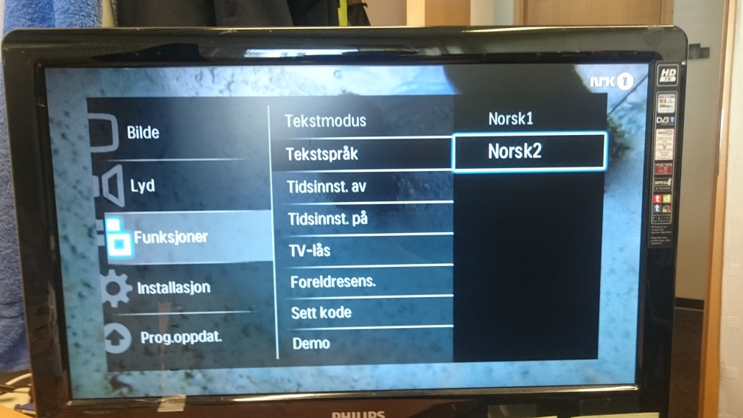
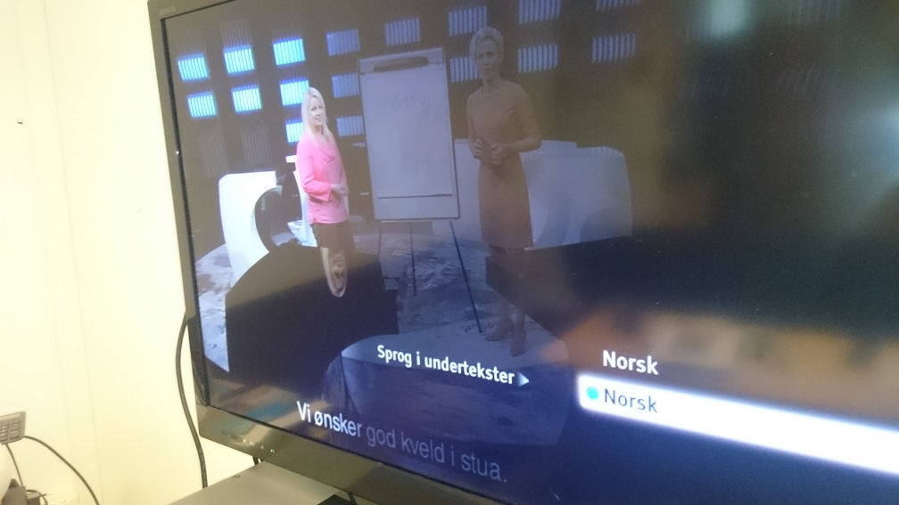
NorDig T Accessibility
NorDig Excom meeting 29th September 2015 Stockholm, Sweden
Subtitling – hard of hearing
DVB
Difficult setup, viewers can’t find them. TV-example: Menu – select "System setup" among 11 choices – select "Digital setup" among 9 choices – select "Subtitle setup" among 11 choices.
Other examples:
Settings may be permanent or temporary. Some IRDs in Norway even change back to what is permanent setting when EIT information changes.

Slide 6
NorDig T Accessibility
NorDig Excom meeting 29th September 2015 Stockholm, Sweden
Subtitling – hard of hearing
DVB
Some old satellite IRDs does not support DVB-subtitles.
Some satellite IRDs does not support HH-subtitles, so the distributors must transmit them as another language, some use Finish. OK if You only look Norwegian TV, but not OK to have finish subtitles on other foreign channels.
Difficult setup, viewers can’t find them. TV-example: Menu – select "System setup" among 11 choices – select "Digital setup" among 9 choices – select "Subtitle setup" among 11 choices.
Subtitles are pictures, so when “writing on the fly” only the last word will be transmitted due to transmission capacity. Not all IRDs handle this correct, they show only the last word in the subtitle.
Show example.

Slide 7
NorDig T Accessibility
NorDig Excom meeting 29th September 2015 Stockholm, Sweden
Accessibility plans in NRK
Clear audio
Wants to split main sound into dialogue (microphone) and background and transmit them as separate tracks so the viewer can decide the levels.
Implements on all productions of programs
May be selected instead of multichannel
Feature, accessibility over HBBTV
Subtitles received via network can be resized and placed individually. Must be synchronized with TV-program.
Sign language can be received via network and displayed on a pad. Must be synchronized with TV-program.

Slide 8
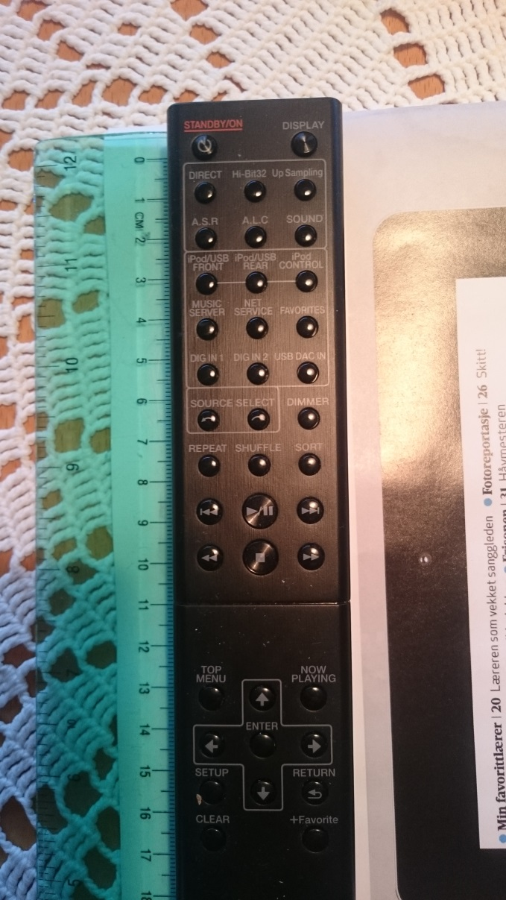
NorDig T Accessibility
NorDig Excom meeting 29th September 2015 Stockholm, Sweden
Remote controls
Remote Control specification
Broadcasters wants strict specification, manufacturers does not.
Describing functions, no buttons.
Table with functions, IRD-profile and mandatory or optional.
In addition to old type remote-controls
pad and mobile applications
voice control
gestures.

Slide 9
NorDig T Accessibility
NorDig Excom meeting 29th September 2015 Stockholm, Sweden

