Slide 1
LTE700 and LTE800 MHz requirement proposal
2015-05-13

Slide 2
Background (LTE700 MHz)
Some countries will re-allocate 700MHz TV broadcast frequencies for mobile telephone network use
Decision is taken by national administration. E.g. In Finland and Sweden re-allocation will be on effect during 2017
It is expected that mobile telephone network operators will use the LTE technology for 4G mobile telephone systems on this frequency range like it happened on 800 MHz frequencies
The downlink of the base station (BS) and user equipment (UE) uplink frequency occupation is different compared to LTE800MHz.

Slide 3
LTE800 MHz freq occupation recapture
1 MHz
5 MHz
2 x 5 MHz = 1 x 10 MHz
DTT
(DVB-T/-T2)
FDD1
FDD2
FDD3
FDD4
FDD5
FDD6
FDD1
FDD2
FDD3
FDD4
FDD5
FDD6
. .
CH59
CH60
Downlink (BS -> UE)
Uplink (UE -> BS)
f/MHz
6 x 5 MHz = 3 x 10 MHz
11 MHz
6 x 5 MHz = 3 x 10 MHz
790 MHz
791 MHz
821 MHz
832 MHz
862 MHz

Slide 4
LTE700 MHz frequency allocation
2 x 5 MHz = 1 x 10 MHz
9 MHz
5 MHz
5 MHz
DTT
(DVB-T/-T2)
FDD1
FDD2
FDD3
FDD4
FDD5
FDD6
SDL1
SDL2
SDL3
SDL4
FDD1
FDD2
FDD3
FDD4
FDD5
FDD6
. .
CH47
CH48
Supplemental
Downlink (BS -> UE)
f/MHz
Uplink (UE -> BS)
Downlink (BS -> UE)
6 x 5 MHz = 3 x 10 MHz
20 MHz
6 x 5 MHz = 3 x 10 MHz
694 MHz
703 MHz
733 MHz
738 MHz
758 MHz
788 MHz

Slide 5



Worst case from Basestation
690MHz
(CH48)
743MHz (SDL)
763MHz (FDD)

Slide 6
Worst case scenario from User Equipment
690MHz
(CH48)
708MHz

Slide 7
Work done so far…
As a part of the CE marking European Union has replaced the Radio & Telecommunication Terminal Equipment Directive 1999/5/EC (RTTED) with The Radio Equipment Directive 2014/53/EU (RED). It will be in effect 13 June 2016.
One of the changes is that TV receivers will be included
Directive presumes there exists a harmonised standard which is the base for fullfilling the directive
Requirements in standard are based on current receiver performance verified through measurements for implementation on 700MHz
”Limitations” of the standard are:
  Only receiver performance defined, i.e. no antennas/preamplifiers
  Only roof-top reception use case taken account
  Requirement only for first adjacent channel interference
  Fullfilling the requirement is linked to certain type of LTE signal charasteristics
  Only one DVB-T and DVB-T2 broadcast mode parameter settings included

Slide 8
Therefore …
Proposal to NorDig is to have a slightly more stringent requirement
Proposal for the requirement is more generic (as it is for LTE800MHz)
  All allocated on-air frequencies for terrestrial broadcasts frequencies are included
  Requirement is independent of the LTE characteristic (however, test plan defines the LTE signal characteristics)
  Indoor reception using passive antenna ”included”

Slide 9
LTE700MHz proposal
Band | Channel | DVB-T or DVB-T2 System | Signal Bandwidth and Channel frequency raster (MHz) | Minimum I/C (dB) for NorDig IRDs that are launched before 1 July 2017. |  |  | Minimum I/C (dB) for NorDig IRDs that are launched after 1 July 2017.
 |  |  |  | 10 MHz Uplink, (FDD1&2) | 10 MHz Uplink (FDD3&4, FDD5&6) | 10 MHz Downlink (FDD1&2, FDD3&4, FDD5&6, SDL1&2, SDL3&4) | 10 MHz Uplink, (FDD1&2) | 10 MHz Uplink (FDD3&4, FDD5&6) | 10 MHz Downlink (FDD1&2, FDD3&4, FDD5&6, SDL1&2, SDL3&4)
VHF III, | K5-K12 | DVB-T | 7 | 43 | 43 | 43 | 50 | 50 | 50
UHF IV, | K21-K37 | DVB-T | 8 | 43 | 43 | 43 | 50 | 50 | 50
UHF V, | K38-K47 | DVB-T | 8 | 43 | 43 | 43 | 50 | 50 | 50
UHF V, | K48 | DVB-T | 8 | 33 | 43 | 43 | 45 | 50 | 50
VHF III, | K5-K12 | DVB-T2 | 7 | 48 | 48 | 48 | 50 | 50 | 50
UHF IV, | K21-K37 | DVB-T2 | 8 | 48 | 48 | 48 | 50 | 50 | 50
UHF V, | K38-K47 | DVB-T2 | 8 | 48 | 48 | 48 | 50 | 50 | 50
UHF V, | K48 | DVB-T2 | 8 | 38 | 48 | 48 | 45 | 50 | 50
{FFT=8K, M=64-QAM, CR=2/3, GI =1/8, B=8MHz},
{FFT=8K, M=64-QAM, CR=2/3, GI =1/4, B=8MHz} and
{FFT=8K, M=64-QAM, CR=3/4, GI =1/4, B=8MHz}
{FFT=32KE, M=256-QAM R, PP=4, CR=2/3, GI =1/16, 8MHz},
{FFT=32KE, M=256-QAM R, PP=2, CR=3/4, GI =1/8, 8MHz},
{FFT=32KE, M=256-QAM R, PP=4, CR=3/5, GI =19/256, 8MHz},
{FFT=32KN, M=256-QAM R, PP=4, CR=2/3, GI =19/256, 7MHz} and
{FFT=32KN, M=256-QAM R, PP=2, CR=3/4, GI =1/8, 7MHz}
Interfering licensed power level signal level is in the range of -15 to -25 dBm at the input of the IRD

Slide 10
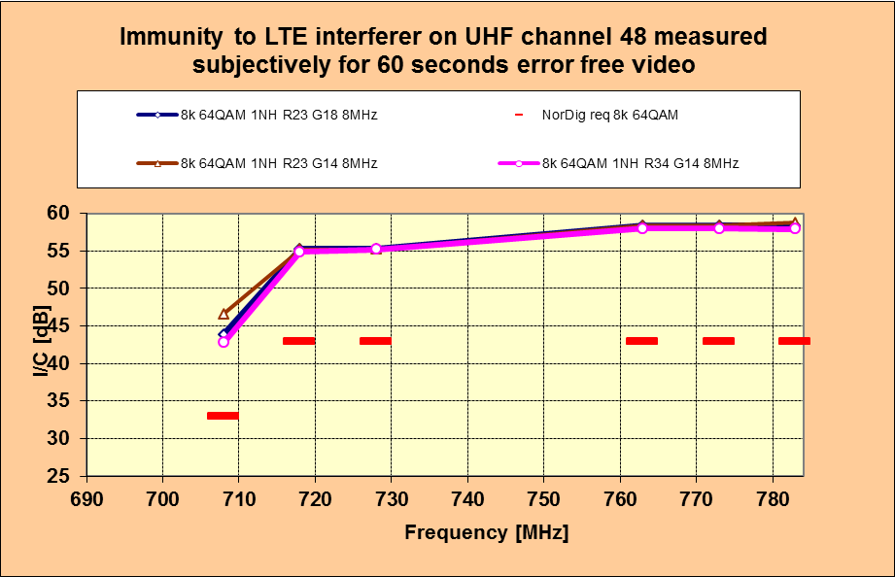
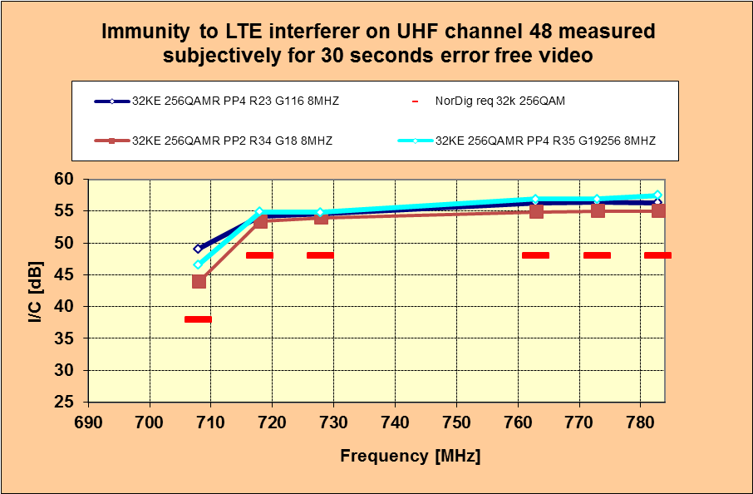
Tests and test plan for LTE700
New requirement needs a new test procedure in NorDig Test Plan. That is not yet defined
Preliminary tests according to harmonised standard against proposed NorDig requirement (I=-25dBm) show it is not difficult to fullfill the NorDig requirement
Figures below show the NorDig requirement in red dotted line.

Slide 11
LTE800 MHz proposal
To update current requirement to more stringent because receivers seem to have a good margin against current requirement.
Band | DVB-T/ DVB-T2 channel | Signal Bandwidth and Channel frequency raster (MHz) | Channel frequency raster (MHz) | Minimum I/C (dB) for NorDig IRDs that are launched before 1 July 2017. |  |  | Minimum I/C (dB) for NorDig IRDs that are launched after 1 July 2017.
 |  |  |  | 10 MHz Downlink, (FDD1&2) | 10 MHz Downlink (FDD3&4, FDD5&6) | 10 MHz Uplink (FDD1&2, FDD3&4, FDD5&6) | 10 MHz Downlink (FDD1&2) | 10 MHz Downlink (FDD3&4, FDD5&6) | 10 MHz Uplink (FDD1&2, FDD3&4, FDD5&6)
VHF III | K5-K12 | 7 | 7 | 40 46 | 40 46 | 40 46 | 50 | 50 | 50
UHF IV | K21-K37 | 8 | 8 | 40 46 | 40 46 | 40 46 | 50 | 50 | 50
UHF V | K38-K59 | 8 | 8 | 40 46 | 40 46 | 40 46 | 50 | 50 | 50
UHF V | K60 | 8 | 8 | 30 36 | 40 46 | 40 46 | 45 | 50 | 50

Slide 12
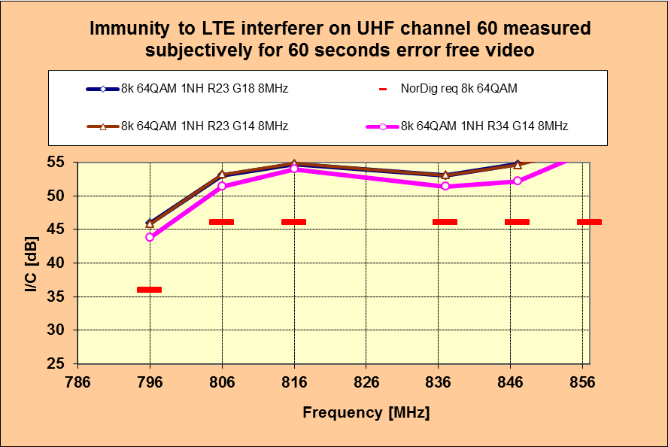
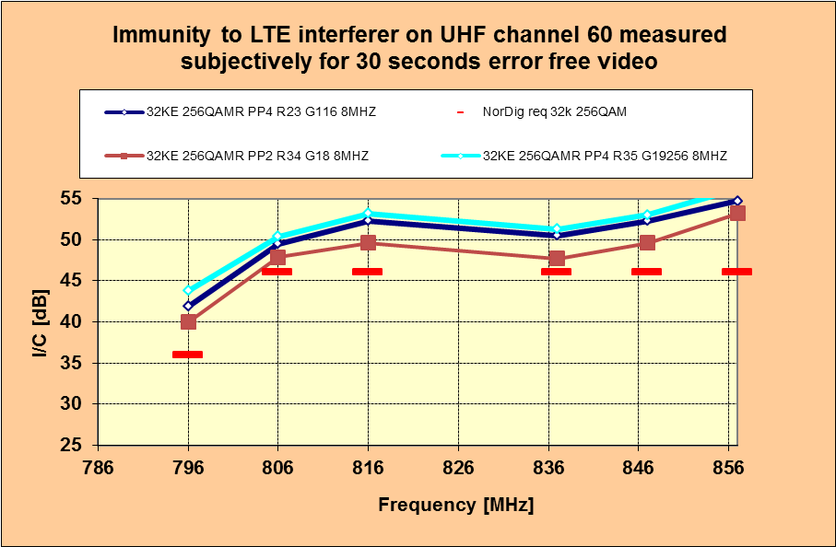
LTE800 MHz tests
Current test results show that the new proposal is not difficult to fullfill (I=-15dBm)
Figures below show the new requirement in red dotted line.

