Slide 1
NorDig T report to Excom
NorDig Excom meeting 13th October 2016 Stockholm, Sweden
Report back from NorDig Excom
Marked as “Excom” in blue text is outcome from this Excom meeting (decision, comments, tasks, feedback etc)
NorDig T (Per Tullstedt) extra report back from NorDig Excom meeting, mainly NorDig T related issues, not the official NorDig Excom report (which will come from our Excom secretary)
Report from NorDig T up to Excom
NorDig Excom Agenda 13th October 2016:
1. Agenda and report from previous meeting
2. Organizational matters
  Membership situation
  Finance matters
  Future Chairman NorDig Excom
3. Report from NorDig/T
  Specification and work status
  RoO new version waiting approval from Excom
  IRD spec update plan
  Special issues, result HbbTV v2 questionnaire among members (separate presentation)
  New NorDig Website design
  NorDig Liaison letter to DVB
  Proposal commercial requirements for NorDig HEVC IRD profile (separate presentation)
4. Report from Industry
  Report from Nordic Product Manager meeting
  Report from industry members
6. Reports from members, DVB and other organizations
7. Any other business
8. Date and place for the meetings in 2017
Green Text: text highlighted for Excom (waiting Excom decision/approval)

Slide 2
NorDig T report - Overview specification work
NorDig Excom meeting 13th October 2016
Overview NorDig T specification work :
Rules of Operation
  v2.5.1 stable version, agreed within NorDig T, proposed to be published, waiting approval fr Excom
Unified IRD specification
  v2.5.1 has been published July/Aug 2014 (v2.5 and then correction to v2.5.1)
  New proposed release plan (Excom view?):
    v2.6 (fast track) end 2016 incl changes to existing requirements
      DVB-T/T2, RemoteControl, SSU and corrections
      Presenting today intension of changes, when spec text ready could Excom approval via e-mail?
    v3.0 mid 2017 mid 2017 incl of HEVC IRD profile (depending on Excom approval Commercial Requirements)
Commercial Requirements for NorDig HEVC IRD profile
    Proposal ready for Commercial Requirements for HEVC IRDs (waiting Excom decision)
Test Plan
  Test Plan v2.5.0 published (28 Jan 2016)
  Addendum to Test Plan v2.5.0 for HbbTV (NorDig Hybrids) planned for Q4.2016 (originally Nov/Dec 2015)
HbbTV
  Maintenance of NorDig’s HbbTV test cases
Website and admin
  new structure and new host (WorldPress) released May/June 2016

Slide 3
NorDig T report - consultancy & costs 2016
NorDig Excom meeting 13th October 2016
NorDig T, consultancy and costs 2016:
Previous planning consultancy
  Technical secretary – Peter Mølsted, shared w Labwise 350kSEK/~38kEUR
    Updated workplan 2016 (from 2015), continue work as 2015 with following update of mission:
    (a) Maintaining and running the NorDig.org web site
      - Remake of NorDig Website, design+impl new structure, e-mail reflector, member groups, calendar, templates for NorDig T, contact with external companies for hosting and impl.
    (b) Acting as the main editor for the NorDig Specifications, initially mainly referring to Unified IRD and companion Rules of Operation (RoO)
    (c) Maintaining and release management of the NorDig Specifications (Unified IRD and RoO specifications).
    - RoO, common NorDig EPG metadata interchange format, API help w mix broadcast & OTT, support Test group.
    (d) Support and compile result from NorDig/T investigations and questionnaires among NorDig members and others.
    (e) Participation to the NorDig/T and relevant sub-group meetings
  Editor & Test Plan – Labwise (Pasi Toiva), shared w Peter M 350kSEK/~38kEUR
    Test group, test plan, editor etc
  HbbTV test cases, maintenance – SofiaDigital, 70kSEK/~7kEUR
    Continue update & correction of our NorDig created HbbTV test cases
  Website upgrade (according to 2015 proposal)
    Alt 1: hosted by Labwise (as today)
    Alt 2: hosted by external professional CMS: WorldPress 50kSEK/~5kEUR and then yearly costs of 280EUR/year (porting and basic setup by ST Digital 3.35kEUR, WorldPress CMS hosting 2016: 0.28 kEUR/year, any other related 1.5kEUR, text content and daily updates included in Peter Mølsted assignment/costs above for 2016)
Status report Oct 2016:
  Most time (cost) that NorDig has budget for consultancy now used (Oct 2016)
  Remaining/not finished: IRD v2.6, EPG format
  Question from webmaster: “klippekort” (discount cards) for web expert support ST Digital (10x30min 3750DKK instead of minimum 1 hour a 750DKK) – Excom view?
  2017 consultancy? NorDig T estimate/interest for same amount for editor, secretary work. Excom view?

Slide 4
NorDig T report - mandates for 2016
NorDig Excom meeting 13th October 2016
NorDig T mandates:
Mandates established for 2015-2016 (Excom approved Jan 2015, minor updated Sep 2015)
  See Annex for details
New additional – NorDig HEVC IRD Commercial Requirements
  was approved by Excom with some remarks and a number of decisions (see separate updated commercial requirement document version 1.0)
Plan to propose new mandates for 2017/2018 to next NorDig Excom meeting March 2017. Excom: OK

Slide 5
NorDig T report - RoO
NorDig Excom meeting 13th October 2016
Rules of Operation – status report
v2.5.0 ready for publication, major improvement
Final version v2.5.0 “approved” at NorDig T level and recommending Excom to approve and publish on website
Final draft uploaded for all to scrutinize at NorDig website, member section http://nordig.org/?get_group_doc=13/1473924156-NorDigRulesofOperation_ver_2.5.doc
Excom decision on approval of new RoO spec?
Excom approved RoO spec as proposed
Future planning:
  Continue updating
  Adding/updating RoO for new SSU requirements

Slide 6
NorDig T report - Test plan
NorDig Excom meeting 13th October 2016
Test Plan
Test Plan v2.5.0 published (28 Jan 2016)
Test Plan v2.5.0 addendum - NorDig HbbTV test requirement,
  still drafting, coming soon (originally plan Nov/Dec 2015) .
  Proposal: approval by Excom via e-mail (Nov/Dec) (Feb/March), otherwise next Excom (March’17)
  Excom OK to approve Test plan addendum for HbbTV via e-mail in nov/dec.
After Test Plan v2.5.0 - debugging/corrections, make tests more efficient to test etc, review audio test cases (“no” new missing test cases planned for IRD spec v2.5.1).
Future, goal is to publish IRD and Test specs at the same time or at least Test Plan short after new IRD spec.
  Note: NorDig HbbTV test requirements intended to describe that HbbTV testing based on HbbTV organisation test suits, describe which tests are mandatory, describe NorDig specific test cases are mandatory and maybe incl 1-2 NorDig classical test cases. Similar as already described in IRD spec but more detailed.

Slide 7
NorDig T report - API/HbbTV and PVR
NorDig Excom meeting 13th October 2016
HbbTV and PVR - status report
HbbTV 2.0 NorDig survey – result
  Result from survey amongst NorDig members interest for HbbTV v2 (HTML5 etc), separate presentation from Erik Vold (NRK)
  Proposal that NorDig migrate to HbbTV v2
  Excom: update IRD spec HbbTV v1.5 to v2 (2.0.1) with reasonable grace period (18 month)
HbbTV test cases
  Maintenance now ongoing
  Preparing to publish info about &/or actual test cases at NorDig website
RoO input related to HbbTV made
Test Plan addendum - HbbTV test cases
(PVR – nothing new to report, PVR lite closed since earlier)

Slide 8
NorDig T report - Unified IRD spec
NorDig Excom meeting 13th October 2016
NorDig Unified IRD spec
Release plan new NorDig Unified IRD spec – proposal:
  v2.6 (“fast track”) end 2016 incl changes to existing requirements (original plan mid 2016)
    DVB-T/T2 (700+800MHz immunity), RemoteControl, SSU and corrections
    Presenting today intension of changes, when spec text ready could Excom approval via e-mail?
  v3.0 mid 2017 mid 2017 incl of HEVC IRD profile (depending on Excom approval Commercial Requirements)
  Excom OK for two releases v2.6 end 2016 and v3.0 (incl HEVC) mid 2017
v2.6 – Bug list, maintain and update current requirements & referenced standards (today ~25 items in “bugzilla” list).
v2.6 – FE (DVB-T/-T2) review if 800MHz scanning can be removed (NRK) and add optional requirements for 700MHz LTE immunity (hopefully via reference to ITU/ETSI) - text proposal ready & agreed inside NorDig T (separate slide)
v2.6 – SSU, add SSU notification & if Excom approve add new SSU for only OverTheNetwork/Internet - work started (not ready), waiting Excom decision for allowing new SSU alt (separate slide)
v2.6 – Remote Control (RC), Review/modernize RC requirements (changing from mandating keys to mandating functions, similar/harmonise w DTG D-book, table based look) - almost stable text proposal inside NorDig T/Access (separate slide)
v2.6 – HbbTV, reference to latest HbbTV v1.5 (errata) update/migrate to HbbTV v2.0.1 w 18 month grace period
v3.0 – NorDig HEVC IRD profile (UHD, HEVC, audio, HMDI, SI, CA, FE etc according w Commerical Requirements)
v2.6/3.0 – HbbTV v2, if Excom approve migrate to HbbTV 2.x - separate presentation from Erik Vold
v2.6/3.0 – Update guidelines wordings in GUI and translations (mainly related Accessibility and Audio)
v2.6/3.0 – Review and improve IRD’s auto update for network changes (low prio)
IPTV – ComHem launching IPTV and has some interest to updated current IPTV IRD requirement - not started
IRD surveillance (like using TR069), some interest to investigate this more - not started
Mix of broadcast and OTT (common channel list of broadcast and broadband/OTT services) - not started
Excom OK
OK for Excom to approve v2.6 with these proposed changes via e-mail in Dec2016
Excom OK
Excom OK
Excom OK
Excom remarks
Excom OK
Excom
Excom OK
Excom OK

Slide 9
NorDig T report - IRD: 700MHz LTE interference
NorDig Excom meeting 13th October 2016
Update of “LTE” immunity requirements for DTT IRDs
Teracom presented early spring 2015 proposal for updating DTT IRD requirement for immunity against other signals (typically LTE signals)
  800MHz LTE signal – strengthen NorDig’s current low requirement values
  add 700MHz LTE signal
  Keep NorDig’s requirement even though ETSI RED requirements
  Necessary now when mobile networks start transmitting in 700+800MHz bands
Industry has earlier complain about too high/strict values and too short time to impl
Now agreement within NorDig T after updating proposal some
  Slightly lower values
  Longer grace period (July 2017 → 1 Jan 2019)
  http://nordig.org/?get_group_doc=13/1473953900-NorDig-Unifiedver_2.6_ch3.4.10.6_Terrestrial_Immunity_proposal_800MHz_and_700MHz_LTE_v005.docx
Excom OK
700MHz requirement
800MHz requirement

Slide 10
NorDig T report – SSU, IRD sw update (1/3)
NorDig Excom meeting 13th October 2016
SSU update of requirements
Plan to update System Software Update (SSU) requirements for Unified IRD spec v2.6
Add of new SSU Notification (as earlier presented to Excom)
  Sending notification message via broadcast chain, reaching all receivers of a model, but actual SW size too big to transmit over classical broadcast networks, instead typical using Internet to download.
  Draft text started (not ready), plan to be ready end November 2016
  Excom OK
New (Oct 2016)
Industry asking NorDig to open up for new SSU alternative, see next slides
  allow connectable IRD to only rely upon updating via Internet (Over-The-Network)
  Several are positive inside NorDig T but a number of operators are a bit doubtful/uncertain
  Excom, not agreed, manufactures/industry should give more background/reasons, new presentation next Excom meeting, not incl in IRD spec v2.6 maybe in release after that “v3.0”
Clean up/removal old obsolete requirements and text, assumption is that these are likely no longer used for new IRDs :
  telephone descriptor for modem etc.
  update via return channel (update type 2).
  Excom OK
  IRD’s which do not support OTA search + OTA download shall also support a fall back mechanism such as local download (option 5).

Slide 11
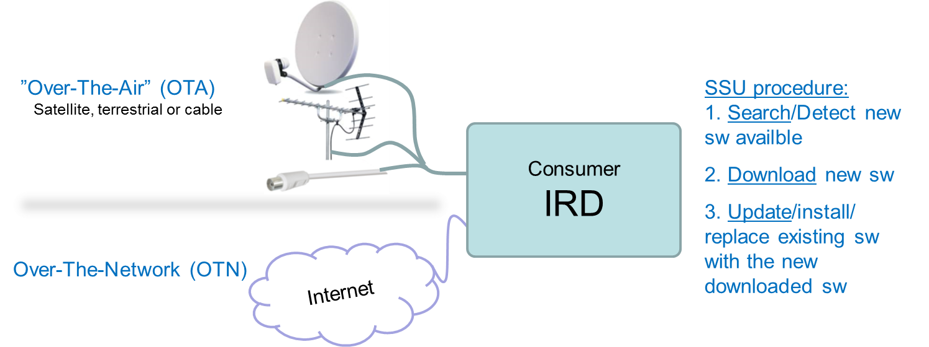
NorDig T report – SSU (2/3)
NorDig Excom meeting 13th October 2016
Complete presentation of SSU alternatives (16 slides) background info etc in Annex of this presentation
Status today
NorDig Unified IRD spec
  NorDig (Unified 2.5.1) mandates support for:
    Complete SSU over OTA (OTA search/SI + OTA download) AND/OR
    OTA search/SI + return channel download (e.g. modem/PSTN/ISDN, now proposed to be removed)
  Operators are not keen on transmitting OTA SSU image sizes >100MB (more precise timeout and similar issues due to restriction in capacity/bitrate for these services, typically max 50-200kbps)
  OTA is not used in reality for iDTV (since ~ 2011/2012)
    Operators still report frequent use for STB/PVR (especially operator branded devices)
    We understand that as more IRDs include connectivity functionality the image size is increasing, hence, in the long term OTA SSU usage will decrease.
DTG D-book spec
  Allows Notifications for image sizes >100MB
  OTA is still mandatory but can be implemented with either
    OTA Notification only (leading to Network and/or USB download) and/or
    Complete SSU over OTA (OTA search/SI + OTA download)

Slide 12
NorDig T report – SSU alternatives (3/3)
NorDig Excom meeting 13th October 2016
Device Manufacturers’ Proposal
All IRDs shall still support Software Update, behaviour still according w NorDig
Proposal is to have different requirements depending on if the IRD support (Internet) connection: connectable IRD and non-connectable IRD.
No longer mandate Over-the-Air SSU for connectable IRDs (allow other options)
Remove option 2, as no one is using this anymore, clean-up of unused options in NorDig (so far no report of anyone using this anymore for new IRDs)
Non-connectable IRD’s no change is proposed
Connectable IRD’s shall be allowed to implement at least one of the following options (#1 to #4):
Excom: not agreed to allow
option 4 only impl
# | Proposal: NorDig IRD’s shall implement at least one of the following options | Connectable IRD (e.g. hybrid IRD) | Non connectable IRD | NorDig IRD spec (current)
1 | OTA search + OTA download (update_type 1 or 2) | Option | Mandatory | Specified
2 | OTA search + OTN download (update_type 3) very old modem alt, proposed to be removed | Option (remove?) | N/A | Specified but old
3 | OTA Notification (OTA search) + OTN/local update (update_type 4) SSU via Internet connection | Option | N/A | Not specified but proposed
4 | OTN search + OTN download | Option (Preferred) | N/A | Not currently specified
5 | Local (e.g. USB) mandatory for IRDs implementing option #3 and/or #4 | Optional | Optional | Not/limited specified
new
  IRD’s which do not support OTA search + OTA download shall also support a fall back mechanism such as local download (option 5).

Slide 13
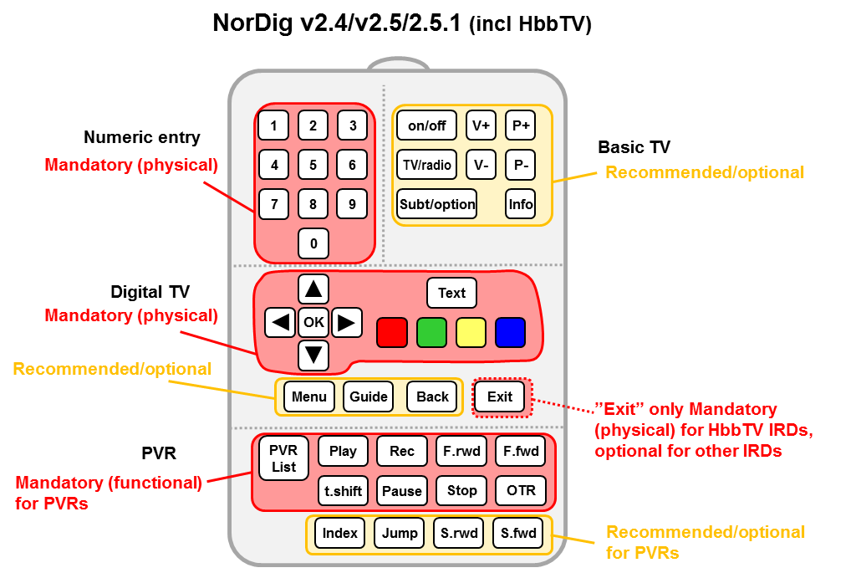

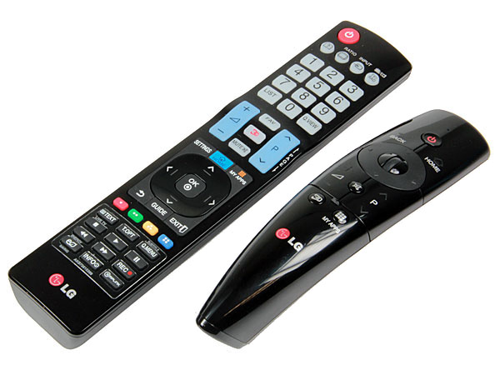

NorDig T report - IRD: Remote Control (RC)
NorDig Excom meeting 13th October 2016
Remote Control (RC) – status:
Preparing proposal for update old text, 90% ready (prepared inside Accessibility subgroup)
Proposal (so far) incl:
  changing from mandates physical keys to instead mandate RC functions (to allow new/modern RC impl e.g. via smartphones, “magic wands” etc).
  change layout in chapter from subchapters to a list (similar as DTG D-book)
  add some new functions and raise some optional to mandatory (e.g. Power on/off for iDTVs) , separate requirements into IRD types: STBs and iDTVs.
  still struggles some with Persistent and Temporary settings
  accessibility settings (if possible collect all accessibility settings: HoH subtitling, AD audio etc)
  Latest draft: http://nordig.org/?get_group_doc=9/1475226141-NorDigIRDRemoteControl-proposalforupdatev014.docx
Other NorDig T members view:
  No disagreement for changing to functions (responses from RTENL, LG, Sony, TP/Vision, Samsung and Teracom).
  Some worries from API group related to HbbTV
Excom OK continue drafting
Background Remote Control (RC)
Review Remote Control (very old text 1997/1998, some text unclear, update recommended):
  Accessibility, to make it easier for these viewer to access these settings.
  Requirements today for physical keys (arrows, numeric, OK etc…).
NorDig Excom Feb 2016: propose new up to date RC requirement and that is based on functions instead of mandating keys

Slide 14
NorDig T report - EPG interchange format
NorDig Excom meeting 13th October 2016
Common EPG/Event interchange delivery file format – status report:
Interest among members, invited/participants also external (Nordic and Irish) broadcasters and operators (Viasat, Telia, SBS, TV4, June etc).
Intension/idea has been to base it upon one existing common used format.
Compare and evaluation of the various solutions / candidates:
  (Swedish) Public Schedule format
  TV Anytime
  XMLTV
  EBU Core (more for broadcaster’s internal usage &/or exchange w other broadcasters)
First draft of comparison and evaluation document
Functional requirements was reviewed and edited
Remaining: to choose one format and to add/update format with NorDig identified missing things in current format.
Some interest around unique program ids.
Some interest also for Shared metadata/EPG repository: Shared metadata repository to which everyone could send their data and from which it can be made available to third parties, only NorDig members or all globally.

Slide 15
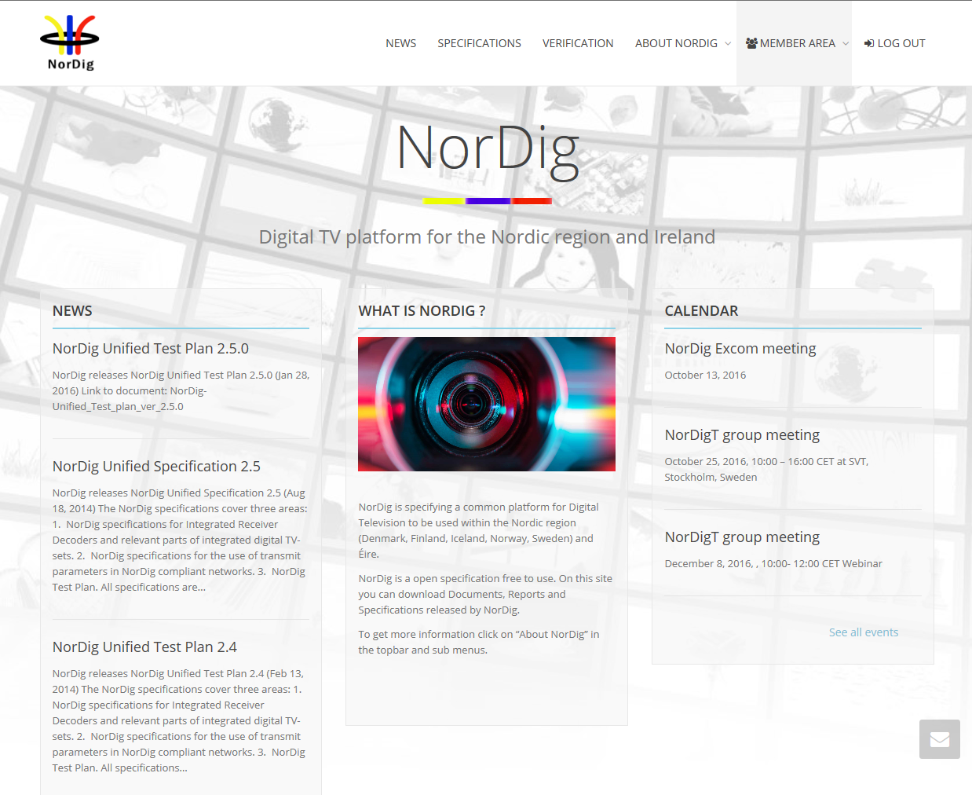
NorDig T report – website update
NorDig Excom meeting 13th October 2016 (slide 1/2)
Informative New NorDig website (design & host)
Launched May 2016 (individual members’ login June 2016), approx. 2-3 month from Excom decision.
Based/hosed by WorldPress (ported from Labwise to WorldPress)
New design and functions, made by Peter Mølsted (our NorDig techn consultant) with help from ST Digital (web expert WorldPress)
Public area (specs, info, news, public calendar, newsletters…)
Member area (individual login, draft documents, minutes of meetings etc)
Cost: within budget (so far)
Webmaster: Peter Mølsted (for text content, login etc)
However: so far no internal mail reflector (too complex), basic calendar (good enough?)
Remaining: update text (info), guideline/templates for contribution/work.
Experience: so far very positive feedback, quite many activities on website, quite many visitors, several subgroups now uploading documents/minutes into website instead of e-mailing (members receive notification via e-mail).
  Question from webmaster:
    “klippekort” (discount card) for web expert support ST Digital (10x30min 3750DKK instead of minimum 1 hour a 750DKK) – Excom view for “discount card”?
Excom: no request for any more, no immediate need for discount card
Snapshot example public area

Slide 16
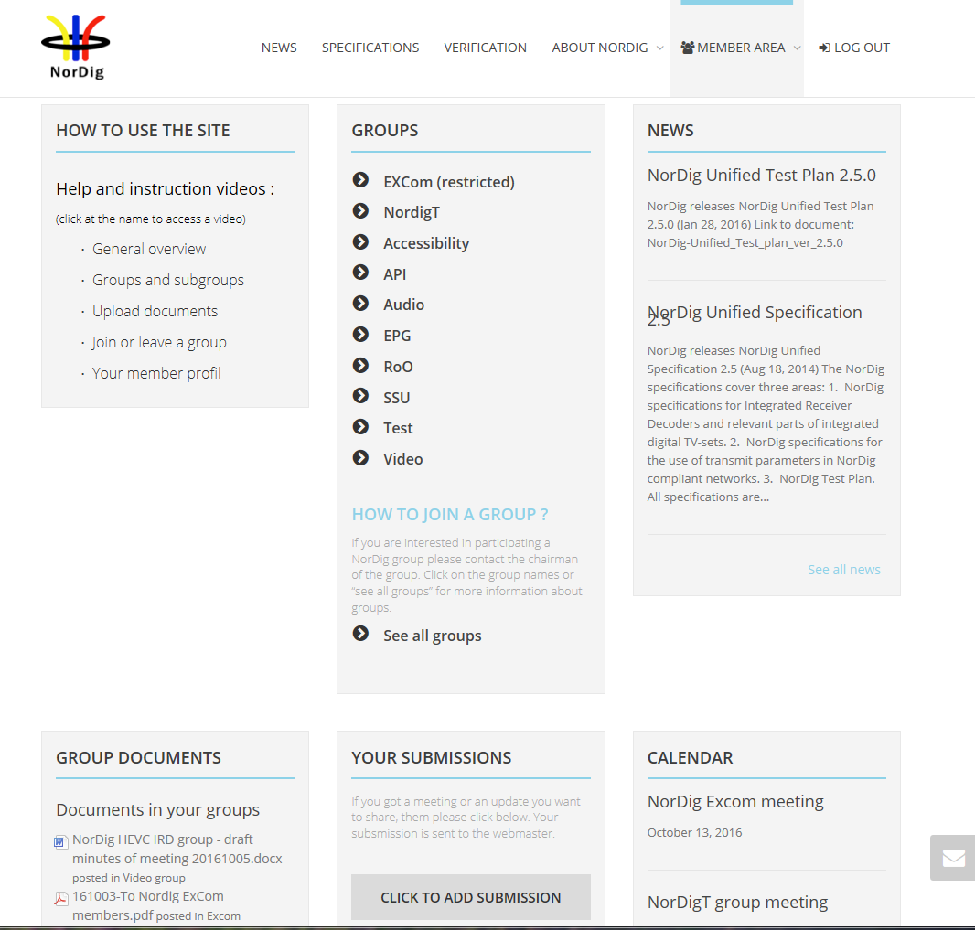
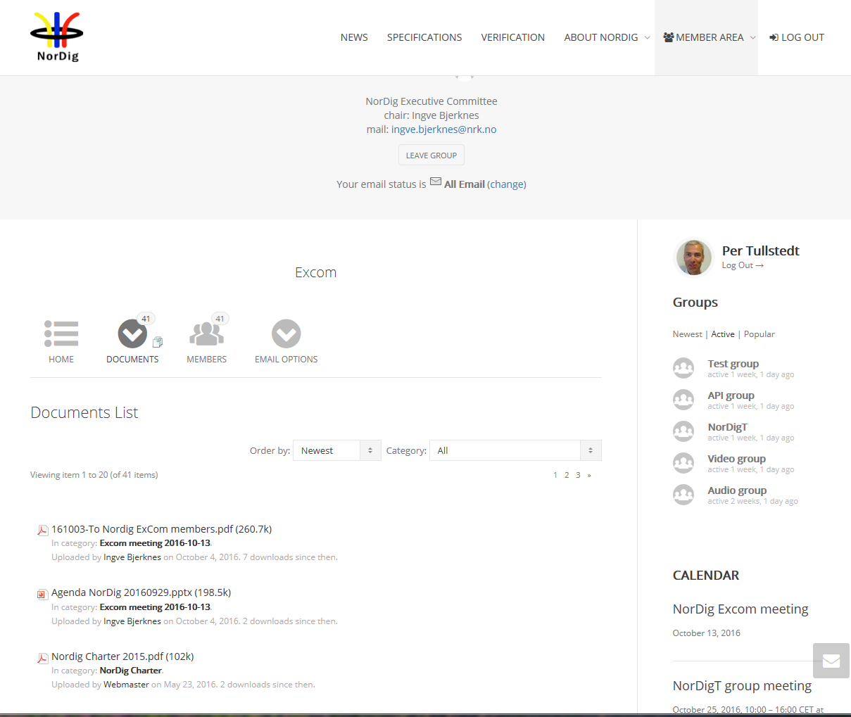
NorDig T report – website update
NorDig Excom meeting 13th October 2016 (slide 2/2)
Informative New NorDig website (design & host)
Cost (hosting & managing):
old site: webmaster time + hosting Labwise “0” EUR/y,
new site: webmaster time (Peter M, consultant) + hosting WorldPress 280 EUR/y
Snapshot example member’s area (starting page member area)
Snapshot example member’s area (Excom group page/documents)

Slide 17
NorDig T report – NorDig and DTG
NorDig Excom meeting 13th October 2016
Harmonise NorDig Unified IRD spec and DTG D-book spec
Nothing new to report - since earlier NorDig T tries where possible to harmonise with DTG and Digital Europe. Some contact with DTG since last NorDig Excom.
From earlier report:
DTG shown interest to harmonise with NorDig. Propose regular meetings to identify and share information/work.
Both NorDig and DTG will benefit corporation, examples from past
  DTG > NorDig: PVR, SSU
  NorDig > DTG: FrontEnd
  Simultaneous: MPEG4, SSU
DTG (due to their financial model) can only share chapter-by-chapter (after DTG board approval)

Slide 18
NorDig T report – Digital Europe letter
NorDig Excom meeting 13th October 2016
DigitalEurope (DE) has sent letter in 28th June 2016 to most TV organisations and TV forums incl NorDig T and NorDig API about Connected TVs:
Letter: DIGITALEUROPE Policy Statement on Connected TV within the Global Media Value Chain, see separate pdf document.
DigitalEurope would like to share their position paper on ConnectedTV and the Global Media Value Chain… They hope it is a useful input to you and your organisation, on the developments in the global television manufacturer landscape.
No concert request for NorDig to respond on this letter.
DE see issues with more and more advanced functions are required to be added into this type of products by broadcasters and operators (adding more cost into connectable TV set).
DE reports that consumers/viewers still buy TV set mainly upon display quality (pixels etc) and size, difficult to cover costs for adv smart-TV functions (like HbbTV).
DE asking broadcasters, organisation, forums to:
  Not add requirements or expect advanced functions on connected TVs without concrete assurance that services will be used.
  Where advanced features are being used to generate additional revenues on top of the core DTV offering, then fair and appropriate on-going remuneration will be due
  No responsibility in regards to data protection compliance can be simply transferred to manufacturers when broadcasters launch new services.
  Provision and exchange of data will be subject to commercial or bi-lateral agreement.
NorDig T: one of the reasons why manufactures shall participate in NorDig work and difficult/impossible for NorDig to sign agreement,
Excom: noted, no reply
Digital Europe: TV manufactures organisation (similar as NorDig & DTG), has their E/C-book and HD Ready logo

Slide 19
NorDig T report – NorDig countries/networks
NorDig Excom meeting 13th October 2016
List of Countries using NorDig specifications (outside NorDig members),
Nothing new to report
Several IRD manufactures and other mentions that several other territories and DVB networks refers or uses NorDig as basis for their IRD specs (especially “newer” networks). Among reasons seems open spec and content (T2, HbbTV, subtitling etc).
First list:
Country / Network | Status
Turkey DTT | Confirmed via Vestel
Several eastern Europe countries | Indications, not confirmed
Malaysia (blue copy) | Digita
Germany DTT (Media broadcast/TDF) | Based on/reference to NorDig IRD
Georgia DTT | Based on/reference to NorDig IRD (v2.2)

Slide 20
NorDig T report - HEVC
NorDig Excom meeting 13th October 2016
HEVC and TV format – report:
earlier
HEVC Questionnaire NorDig members & manufactures, made Dec-Feb 2016
  Outcome: Excom asked NorDig T to prepare/propose NorDig Commercial Requirements for HEVC IRDs
  NorDig T expects quite long time to draft NorDig HEVC IRD profile, ~12 months (if nothing is prepared inside NorDig before DVB finalise specs for phase 2).
New (Oct 2016):
NorDig T HEVC/video subgroup (re)-started, 8-9 meetings since last Excom (members+industry)
Prepared proposal for Commercial Requirement for NorDig HEVC IRDs (separate presentation)
Not started work around NorDig Unified IRD spec for adding HEVC (all time/efforts has been spent of commercial requirements)
NorDig send Liaison letter to DVB
  NorDig HEVC/video subgroup identified need to standardize IRD behavior around mixing/blending/composition of HDR video and SDR content (HbbTV, subt, etc).
  Group propose that NorDig send Liaison letter to DVB to start task around this, (see proposal as separate word document).
  Excom approved Liaison letter and to send it to DVB (incl cc to HbbTV), OK for DR, RTÉ and YLE to be listed as supporters of letter.
DVB (and MPEG) still working UHD phase 2 (quite stabile)
  DVB has decided for HDR&WGC, two alt: (MPEG) PQ + (BBC) HLG.
  (subtitling for HDR?)

Slide 21
NorDig T report - CR for HEVC IRDs
NorDig Excom meeting 13th October 2016
HEVC IRD commercial requirements (CR) - walkthrough during Excom of proposal
proposal NorDig T HEVC IRD - CR for HEVC draft 010 2016-10-07 (Anders Berglund, Teracom, made a powerpoint presentation of the main decissions points). Below Excom comments for proposal
General 1 to 5: Excom OK
Video 1 to 3: Excom OK
Video 4 (resolution): Excom OK
Video 5 to 6 (HDR&WCG): Excom OK
Video 7 to 9: Excom OK
Video 10 (HFR): Excom Alternative C (incl SFR in IRD spec v3.0, plan to incl HFR 2years later)
Audio (NGA or stay w old audio codecs): Excom the incl of NGA shall be studied more (report back next Excom meeting March 2017, try to figure out IRD license costs and feasibility)
IRD 1 to 7: Excom OK
Signaling (SI) 1 to 4: Excom OK
CA&CI 1 to 2: Excom OK
Subtitling 1 to 5: Excom OK
HbbTV: Excom HbbTV shall be studied/considered to be included as mandatory for HEVC IRDs (decided upon at March 2017 meeting).
HbbTV 1 to 3: Excom OK (incl HbbTV v2.0.1)
FrontEnd, satellite: Excom needs more arguments for accepting this (check w Telenor/CanalDigital and Industry, report back next Excom meeting March 2017)

