Slide 1

NorDig T report to Excom
NorDig Excom meeting 9th March 2017 Stockholm, Sweden
NorDig Excom Agenda 9th March 2017:
Place: Arlanda Hotel, Arlanda in Stockholm, Time: 10:00 to approx. 16:00
Agenda and report from previous meeting
Organizational matters
2.1 membership situation
2.2 Finance matters, budget 2017
2.3 Organizational matters
3. Report from NorDig/T
3.1 Mandates for coming period
3.2 Status and report from NorDig/T general
3.3 HEVC IRD specification work including HbbTV
3.4 Next generation Audio, Johan Lindros
3.5 EPG exchange file format, Peter Mølsted
3.6 SSU/SW Update alternatives (continued discussion from October 2016, input from Industry)
5. Report from Industry
5.1 Report from Nordic Product Manager meeting
5.2 Report from industry members
6. Reports from members, DVB and other organizations
7. Any other business, including DTT beyond 2020
8. Date and place for the meetings in 2017
Green Text: text highlighted for Excom (waiting Excom decision/approval)

Slide 2
NorDig T report to Excom
NorDig Excom meeting 9th March 2017 Stockholm, Sweden
NorDig Excom Agenda 9th March 2017:
Place: Arlanda Hotel, Arlanda in Stockholm, Time: 10:00 to approx. 16:00
Agenda and report from previous meeting
Organizational matters
2.1 membership situation
2.2 Finance matters, budget 2017
2.3 Organizational matters
3. Report from NorDig/T 10:30-14:15
3.1 Mandates for coming period 10:30
3.2 Status and report from NorDig/T general 10:50
3.3 HEVC IRD specification work including HbbTV 11:00
3.4 SSU/SW Update alternatives (continued discussion from October 2016 from Industry) 11:30
Lunch break 12:00-13:00
3.5 EPG exchange file format, Peter Mølsted 13:00
3.6 Next generation Audio, Johan Lindros 13:30-14:15
5. Report from Industry
5.1 Report from Nordic Product Manager meeting
5.2 Report from industry members
6. Reports from members, DVB and other organizations
7. Any other business, including DTT beyond 2020
8. Date and place for the meetings in 2017
Green Text: text highlighted for Excom (waiting Excom decision/approval)

Slide 3
NorDig T report - mandates for 2017-2018
NorDig Excom meeting 9th March 2017 Stockholm, Sweden
NorDig T mandates and work items:
Guidelines what Excom wants the Technical group to work with and prepare.
Mandates used inside Technical group and subgroups for planning and what to prepare.
In addition to mandates: Commercial Requirements (now for HEVC)
OLD Mandates was for 2015-2016 (Excom approved Jan 2015, minor updated Sep 2015, see Annex for OLD mandates)
Today: Proposal from Technical group of new mandates for 2017-2018
  Based upon updating old mandates from 2015-2016.
  waiting Excom decision

Slide 4
NorDig T report - mandates and activities (1/4)
NorDig Excom meeting 9th March 2017 Stockholm, Sweden
NorDig T - mandates & items for period 2017-2018 – Proposal from NorDig Technical group,
For Excom to approve and adjust:
RoO
  Maintain and update NorDig RoO.
Test and Test plan
  Maintain and update NorDig Test plan to match IRD spec
    Review and where possible combine similar test cases to make it easier and faster to test
    “minimize” redundant test cases if possible without compromising with test quality, to speed up time for verification testing.
    Update and improve test cases
NorDig Unified IRD spec
  General: Maintain and update NorDig IRD specification (debugging, references to international standards and specifications are up to date)
  Update NorDig IRD spec v3.0 – inclusion of (SFR) HEVC IRD profile during 2017:
    Inclusion of HEVC IRD requirements according with Excom decision and approved HEVC commercial requirements.
    Update guidelines wordings in GUI and translations (mainly related Accessibility and Audio)
    Review and improve IRD’s auto update for network changes
    (depending on Excom decision) SSU update for new possible alternatives
    Handle mix of broadcast and OTT in same channel list
  After NorDig IRD spec v3.0 – prepare and investigate possibility for NorDig HFR HEVC IRD “profile”

Slide 5
NorDig T report - mandates and activities (2/4)
NorDig Excom meeting 9th March 2017 Stockholm, Sweden
continue NorDig mandates & items for period 2017-2018 – for Excom to approve and adjust:
HbbTV
  NorDig HbbTV test and test cases:
    Maintain NorDig developed test cases. Propose new test cases to be developed if needed.
    Update NorDig Test Plan with new/updated HbbTV test requirements (based on ref as much as possible to HbbTV test suit, clarify if HbbTV optional test is mandatory for NorDig Hybrids)
    Contribute to HbbTV org the NorDig developed HbbTV test cases for inclusion in HbbTV standard Test suits (include as much as possible in HbbTV standard test suits).
    Propose budget for NorDig’s HbbTV activities (costs , descriptions, alternatives)
    Supervise and manage any NorDig HbbTV consultancy work (currently Sofia Digital)
  NorDig HbbTV IRD requirements:
    Maintain and update HbbTV requirements (spring 2017 NorDig require HbbTV v2.0.1).
    Investigate possibilities to mandate HbbTV capability for HEVC IRDs, could HbbTV be a similar basic functions as Teletext? HbbTV is the standardized way to deliver UHD content via OTT/broadband.
    Monitor and report HbbTV spec development and usage.
  Investigate additional HbbTV feature and requirements that are of interest for NorDig members (to be confirmed by –T and Excom before detailed proposal and any incl into IRD spec).
  HbbTV implementation:
    Monitor and report HbbTV implementation in NorDig networks and other networks,
    Monitor and report implementation status on IRD side
    Monitor and discuss experience and issues/problems with launching HbbTV services
  HbbTV DRM
    Monitor HbbTV DRM implementation, interest for common DRM requirements
    Monitor technologies and functionality (common encryption, CAM/CI+ etc)
    Review security requirements if needed to ensure handling UHDTV (“4k”) premium OTT content.

Slide 6
NorDig T report - mandates and activities (3/4)
NorDig Excom meeting 9th March 2017 Stockholm, Sweden
continue NorDig mandates & items for period 2017-2018 – for Excom to approve and adjust:
Video, audio, subtitling
  Video codec: NorDig’s first subset of HEVC (DVB’s UHD, HDR&WCG, SFR), incl video processing and I/O (HDMI).
  Video codec: investigate possibility and issues with later adding HEVC HFR support.
  Video: Secure good IRD implementation for mixing/blending of SDR content (HbbTV, menus, subtitling) on top of HDR video.
  Audio NGA (MPEG-H and Dolby AC-4), monitor and get more info about its efficiency and functionality (not yet proposed to specify).
  Audio Monitor and report NorDig members interest for next generation audio (MPEG-H and Dolby AC-4) and formats. Check with industry support for new audio codecs.
  Audio Surround sound, is it possible to reduce the problems with down-mixing, especially investigate broadcast side.
  Subtitling: update requirements for subtitling to handle HEVC services, ensure subtitling support for HDR and/or UHD video for HEVC IRDs.
  Subtitling: investigate new subtitling formats for HEVC IRDs, like EBU TT-D (as stated in HEVC commercial requirements).
  HbbTV: Investigate use and mandate of new codes (HEVC and NGA) for (HEVC) HbbTV/Hybrid IRDs.

Slide 7
NorDig T report - mandates and activities (4/4)
NorDig Excom meeting 9th March 2017 Stockholm, Sweden
continue NorDig mandates & items for period 2017-2018 – for Excom to approve and adjust:
Accessibility
  Work with harmonization of broadcast and better describe current broadcast for IRD manufactures
  Subtitling, propose updates and new IRD requirements both for normal and hard-of-hearing subtitling, especially for HEVC IRDs.
  Dialogue Enhancement - investigate members interest for this and if they are able to broadcast this
  Audio, propose requirements related to supplementary audio for HEVC IRDs (audio + accessibility group)
  Supplementary Audio (Audio description, Spoken subtitling), investigate how NorDig broadcasters status today broadcast this and how much difference there is around this in NorDig broadcast.
  HbbTV for Accessibility services – investigate how HbbTV can be used for Accessibility and if needed propose changes to IRD and RoO requirements
  Investing new technology and equipment for accessibility services.
CA and CI
  monitor and report CIplus LLP (CI+ v1.4 and v2.0) and DVB work (CI+ v2.0 etc) within these topics to NorDig Excom and Technical group.
  Review security requirements if needed to ensure handling UHDTV (“4k”) premium OTT content (see also HbbTV)
Others
  EPG/Event exchange file format:
    Investigate and decide common (“NorDig standard”) Event Info file format (Broadcast + OTT), interchange between Content Providers to Distributers. Shall support event info and metadata for both broadcast (linear TV) and OTT (linear and on-demand/catch-up).
    Promote use from NorDig members.
    Establish a NorDig specification of common EPG/Event exchange file format based upon proposed TV Anytime.
    Propose how to maintain EPG/Event exchange file format
    Secure TV Anytime update its specification for Right Management and workshop inside NorDig around Right Management
    Guidelines for “last minutes” updates of program start and changes (“last minutes” refers to shortly before but also afterwards for “correcting” catch-up segmenting).

Slide 8
NorDig T report - Overview specification work
NorDig Excom meeting 9th March 2017 Stockholm, Sweden
Overview NorDig T specification work :
Rules of Operation
  Latest: RoO v2.5 (published October 2016)
Unified IRD specification
  Latest: IRD spec v2.6 (published 23rd Jan 2017, was the approval and publication process correct made?)
  IRD spec v3.0 (add HEVC)
    plan mid 2017 incl of HEVC IRD profile (many dependences, delay warning)
    Base upon Excom approved Commercial Requirements for NorDig HEVC IRD profile (13 Oct 2016)
    Approval process? Input for planning inside NorDig T. Will approval be At next Excom meeting (Oct 2017), via e-mail or extra meeting? Intro HEVC big task for NorDig and expect Excom approval to be handled carefully.
Test Plan
  Latest: Test Plan v2.5.0 (published Jan 2016) + Test Plan addendum for HbbTV v1.0 (published 23rd Jan 2017)
HbbTV
  Maintenance of NorDig’s HbbTV test cases
EPG/EIT exchange file format
  Today: Proposal ready for Excom of common NorDig file format, TV Anytime based, separate slides
Website and admin
  New on website: security update (Chrome browser) and simple meeting calendar function
  Website: NorDig T and subgroup frequent user of sharing files (minutes, drafts) via website
  Website: NorDig Excom not yet using website (for minutes etc)

Slide 9
NorDig T report - Work and subgroups
NorDig Excom meeting 9th March 2017 Stockholm, Sweden
Overview
NorDig T – active
NorDig T subgroups – status
HEVC/Video – active (proposing CR for HEVC IRDs)
Audio – active (audio related for IRD, Test Plan. Working together w Accessiblity group)
Test – active (Test Plan)
RoO – active (RoO spec)
Accessibility – active (accessibility related for IRD, Test Plan and RoO)
API/PVR – active (HbbTV testing, API+PVR related for IRD, Test Plan and RoO)
EPG/Event exchange metadata – active (common NorDig format for exchange EPG metadata for broadcast and OTT)
SSU – dormant after IRD spec v2.6 (industry proposal for further SSU alternatives)
CA/CI+/Sec – dormant (CI+ v1.4/v2.x…)

Slide 10
NorDig T report - Work and subgroups
NorDig Excom meeting 9th March 2017 Stockholm, Sweden
Organisation and status
NorDig T – Per Tullstedt, Teracom
NorDig T subgroups – status
Video – Per Tullstedt, Teracom
Audio – Johan Lindroos, SVT,
Test – Pasi Toiva, Labwise,
RoO – Des Mac Giolla an Chloig, RTÉNL,
Accessibility – Kjell Norberg, NRK,
API/PVR – Erik Vold, NRK,
EPG/Event metadata – Peter Mølsted (consultant NorDig tech secretary),
SSU – dormant (Per Tullstedt, Teracom)
CA/CI+/Sec – dormant (CI+ v1.3, CI+ v1.4)

Slide 11

NorDig T report - Meeting calendar 2017
NorDig Excom meeting 9th March 2017 Stockholm, Sweden
NorDig T (main group) meeting calendar 2017:
31th January 2017, webinar, 10:00-15:00 CET
28th February 2017, webinar, 10:00-16:00 CET
Informative: NorDig Excom 9th March 2017
4th April 2017, webinar, 10:00-15:00 CET
Informative: NAB2017: 22-27 April
16th May 2017, webinar, 10:00-15:00 CET
20th June 2017, webinar, placeholder, 10:00-12:00 CET
29th August 2017, webinar, 10:00-14:00 CET
Informative: IFA2017: 1-6 September, IBC2017: 14-19 September
20th Sep 2017, webinar, 10:00-15:00 CET
Informative: NorDig Excom 5th October 2017
14th November 2017, physical TBD, 10:00-16:00 CET
14th December 2017, webinar, placeholder, 10:00-12:00 CET

Slide 12
NorDig T report - consultancy & costs 2017
NorDig Excom meeting 9th March 2017 Stockholm, Sweden
NorDig T, consultancy and costs 2017:
Excom decided 13 Oct 2016:
  continue with consultancy support & raised budget fr 350kSEK to 400kSEK (to ensure NorDig HEVC IRD etc).
Proposal planning of consultancy 2017:
  Technical secretary – Peter Mølsted, part of techn.budget 400kSEK/~42kEUR
    Updated workplan 2017 with following mission:
    (a) Webmaster NorDig.org
    (b) Editor for the NorDig Specifications incl maintaining and release management of the specifications
    (c) Chair work with NorDig common EPG/EIT exchange file format
    (d) Support NorDig/T and Test group for development of new Unified IRD specifications and Test Plans (2017-2018)
    (d) Support and compile result from NorDig/T investigations and questionnaires among NorDig members and others.
    (e) Participation to the NorDig/T and relevant sub-group meetings
    (start of 2017: editor for release of new NorDig Unified IRD v2.6)
  Test Plan – Labwise (Pasi Toiva), shared w Peter M 400kSEK/~42kEUR
    Test group, test plan, editor etc
  HbbTV test cases, maintenance – SofiaDigital, 50kSEK/~5kEUR
    Maintenance (update & correction) of our NorDig created HbbTV test cases
  Website
    Hosting (WorldPress) – 285EUR/year (300USD/year)
    Technical support & update functions (ST Design) – case-by-case (part of main techn.budget 400kSEK/42kEUR)
    Webmaster (Peter Mølsted) – part of his consultancy (part of techn.budget 400kSEK/42kEUR)
Excom view?

Slide 13
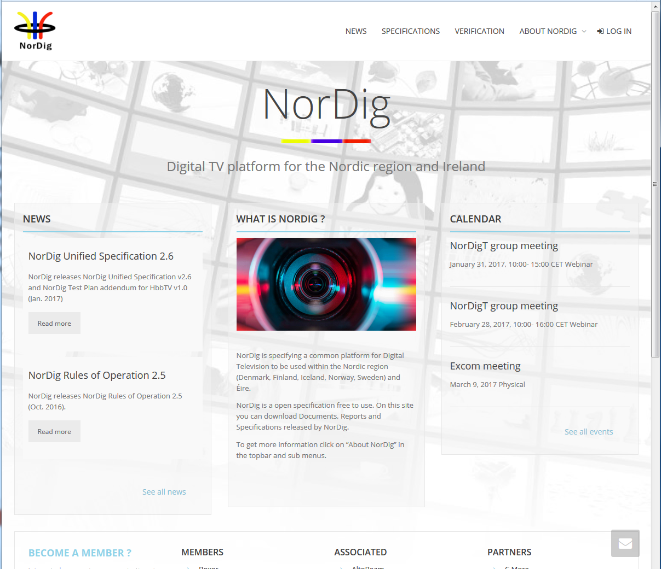
NorDig T report – website
NorDig Excom meeting 13th October 2016
Informative, status website:
Changes (last period):
minor (SSL security for Chrome Web browser + simple internal meeting calendar function)
Usage:
NorDig-T + subgroups: frequent user for sharing and storing documents (minutes, proposals etc)
NorDig Excom: no usage so far
New letters:
Around 20 companies has signed up for news letters
Very few NorDig members has signed up for news letters (for example to get automatic e-mail when new specification/document is published at NorDig website)
Recommend to sign up
Costs:
Hosting (WorldPress ~280+EUR/y),
Web expert (ST Design) for functional updates
Techn editor (Peter Mølsted) for content updates
Webmaster: Peter Mølsted (for text content, login etc)
Snapshot example public area

Slide 14
NorDig T report – NorDig and DTG harmonisation
NorDig Excom meeting 9th March 2017 Stockholm, Sweden
Harmonise NorDig Unified IRD, DTG D-book and IRD specs:
NorDig has used D-book as input for the update of the Remote Control (NorDig IRD v2.6 in 2016)
DTG used NorDig as input for update of DTT front-end (D-book v9) in 2016
NorDig has sent NorDig Commercial Requirement for HEVC IRDs to DTG in Nov/Dec 2016 (so far no comments).
(DTG HEVC, so far mainly discussion around using and testing of HEVC for OTT/broadband streaming)

Slide 15
NorDig T report – NorDig countries/networks
NorDig Excom meeting 9th March 2017 Stockholm, Sweden
List of Countries using NorDig specifications (outside NorDig members),
Nothing new to report, same as last meeting.
Several IRD manufactures and other mentions that several other territories and DVB networks refers or uses NorDig as basis for their IRD specs (especially “newer” networks). Among reasons seems open spec and content (T2, HbbTV, subtitling etc).
First list:
Country / Network | Status
Turkey DTT | Confirmed via Vestel
Several eastern Europe countries | Indications, not confirmed
Malaysia (blue copy) | Digita
Germany DTT (Media broadcast/TDF) | Based on/reference to NorDig IRD
Georgia DTT | Based on/reference to NorDig IRD (v2.2)

Slide 16
NorDig T report - Unified IRD spec
NorDig Excom meeting 9th March 2017 Stockholm, Sweden
NorDig Unified IRD spec
Release plan new NorDig Unified IRD spec – proposal:
  v3.0 mid/autumn 2017 incl of HEVC IRD profile - depending on DVB specs available
Proposed items to be included into new IRD spec in NorDig T review work:
v3.0 – HEVC IRD “profile” (video, audio, subt, I/O, SI etc) according w NorDig Commercial Requirements, see separate slides
non codec related items:
v3.0 – Bug list (smaller items and typo corrections), maintain and update current requirements & referenced standards (today ~7 items in “bugzilla” list), expect more to come when detail drafting work starts.
v3.0 – FE DVB-S/-S2 (IRD spec + Test plan) update NorDig requirements (IRD and test cases) to be inline with new RED directive (ETSI ) for satellite receivers (i.e. raise NorDig requirements e.g. for dynamic range and adjacent channel)
v3.0 – SSU (sw update), proposal from Industry to allow only using OverTheNetwork/Internet SSU as an alternative, today this is an optional/extra alt - depending Excom decision (separate presentation)
v3.0 – Update guidelines wordings in GUI and translations (mainly related Accessibility and Audio)
v3.0 – Document structure, review and simplify reading/understanding (maybe use table format or similar, try to split text so that only one IRD requirement per “subchapter” to simplify for e.g. Test Plan). (Observe IRD structure has impact upon Test Plan).
From previous IRD spec update, proposed earlier but not incl due to lack of input:
v3.0 – Mix of broadcast and OTT (common channel list of broadcast and broadband/OTT services)?
v3.0 – Review and improve IRD’s auto update for network changes
Proposed to be close, from earlier specification work v2.5/2.6 (no inputs):
IPTV – ComHem launching IPTV and has some interest to updated current IPTV IRD requirement - not started
IRD surveillance (like using TR069), some interest to investigate this more - not started
Excom view?

Slide 17
NorDig T report - HEVC
NorDig Excom meeting 9th March 2017 Stockholm, Sweden
NorDig Unified IRD spec v3.0, HEVC IRD “profile” – Status so far:
Will be based upon Excom approved NorDig HEVC Commercial Requirements v1.0 from 13th October 2016.
Expected lifetime of HEVC IRD “profile”: 10y or more
Time plan: original time ready by mid 2017
Info of parts that is planned to be updated:
Video
  First release v3.0 (2017): HEVC, 10bits, UHDTV, static HDR & WCG (PQ and HLG), SFR
  Coming (within 2y): inclusion of HFR but proposal in v3.0 mention HFR is planned to come. Proposal to incl dynamic HDR
Audio
  Excom to decide: old audio codecs or incl NGA, separate presentation
Subtitling
  Slow progress in DVB (especially for other new technologies like Timed Text)
HbbTV
  Excom to decide: mandate HbbTV for all HEVC IRDs or continue as an optional feature, separate slide
IRD I/O (HDMI etc):
  Investigating which HDMI level is enough for NorDig’s need (HDMI v2.0, v2.0a, v2.0b or v2.1)
SI
CA/CI and security
  Slow progress in DVB, main discussion is around securing premium UHD content out on HDMI, all DVB work is still on CI+ v1.4 (PCMCIA based) and very little/no progress on CI+ v2.0 (USB based)
Tuner & demod
  Some comments/remark for IRD manufactures for DVB-S2X, but Telenor/CanalDigital have confirm their interest
HDR High Dynamic Range, WCG Wider Colour Gammut, SFR Standard Frame Rate (up to 50fps), HFR High Frame Rate (up to 100fps), NGA Next Generation Audio

Slide 18
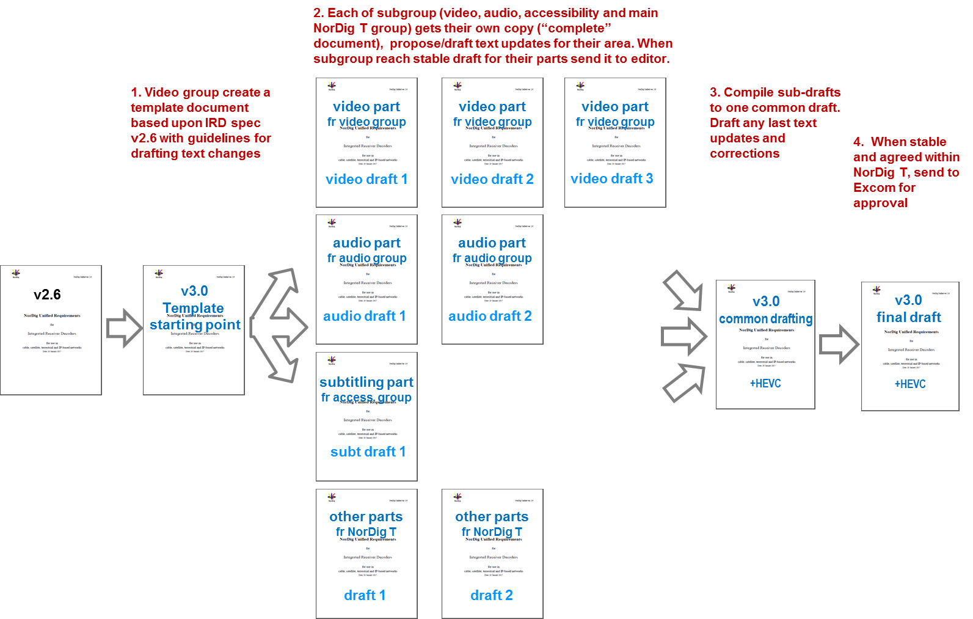
NorDig T report - HEVC
NorDig Excom meeting 9th March 2017 Stockholm, Sweden
Drafting/writing of NorDig IRD spec v3.0 (adding HEVC):
  Plan/proposal is to add HEVC into current common IRD document (instead of new doc or addendum)
  Drafting: work in parallel (video, audio, subt, API & others), at the end combine proposals
Status today

Slide 19
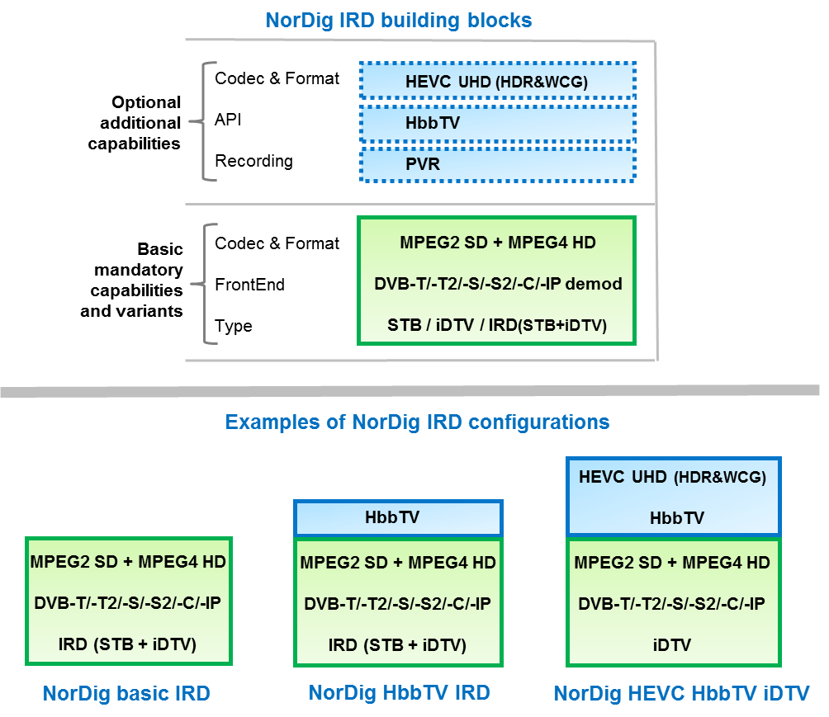
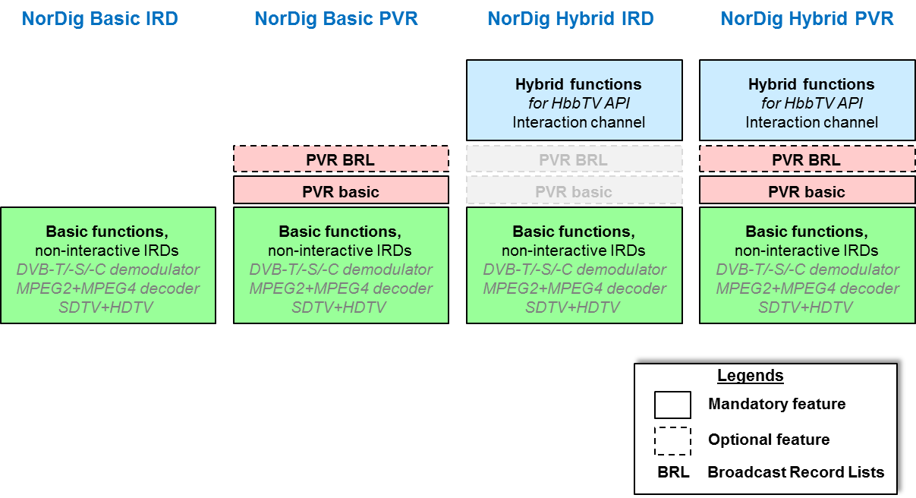
NorDig T report - HEVC
NorDig Excom meeting 9th March 2017 Stockholm, Sweden
Status drafting NorDig IRD spec v3.0 (HEVC) – general, wording/naming:
Past (intro of MPEG4) IRD spec v2.0 in 2007/2008 (profiles and levels a la DVB) :
  Profiles (API/MHP) and Level (M2/MPEG2 and M4/MPEG4), no PVR function
Current IRD spec v2.6 in 2016/2017 (profiles, levels and function):
  Profiles (API/HbbTV: Basic TV IRD or Hybrid IRD), no levels (all NorDig shall support MPEG2+MPEG4), PVR function (added 2009). Also has Internet connectable/non-connectable IRD type.
Proposal IRD spec v3.0 2017/2018 (Basic variants and additional capabilities) :
  So many variants (Type, FrontEnd, Codec/Format, PVR, API/HbbTV, Internet connectable…)
  Proposal is to simplify and change to use word capability (a la new DVB used for HEVC)
  Change Hybrid IRD → HbbTV IRD
  Then NorDig IRDs comes in variants (frontend+type) and with additional optional capabilities (PVR, HbbTV, HEVC, HFR-HEVC…)
Excom view/comment?
Proposal for NorDig Unified IRD spec v3.0
NorDig Unified IRD spec v2.6

Slide 20
NorDig T report - HEVC
NorDig Excom meeting 9th March 2017 Stockholm, Sweden
Report relevant referenced standards (DVB, HDMI, ITU…) related to NorDig HEVC IRD:
Video
  NorDig Liaison letter to DVB asking for dynamic HDR and blending/mixing of SDR subtitling/HbbTV/menu on top of HDR video, (no official reply letter yet).
    DVB will have no specification for dynamic HDR (PQ) during 2017.
    DVB Subtitling group might study this (slow progress)
    DVB refer to HbbTV org for blending/mixing HbbTV (SDR) on top of HDR video (strange since HbbTV asked NorDig to contact DVB for this).
Audio
  Info: DVB CM-AVC has sent (Feb 2017) to NorDig/T questionnaire checking interest that DVB works with audio prioritization (NGA and legacy codecs). NorDig/T and Audio subgroup has replied positive for this DVB activity both for NGA and legacy (March 2017). (NorDig has spent much much work in past on our quite detailed defined audio prioritization for legacy codecs and changed it several times).
Subtitling
  Warning: DVB Subtilting group lacks volunteer editor, slow progress, difficult to finalize HDR UHD DVB bitmap subt and new Timed Text subtitling format before mid2017.
HbbTV
  Possibility to mandate HbbTV (v2) for HEVC IRDs, study not yet completed. Big TV manufacture no big protests but says to prefer to have as optional.
  Testing: Industry really stress importance that Broadcasters’ HbbTV apps are well tested before launch and that the HbbTV apps are available for the manufacture in advance. TV manufactures reports that they would receive complains from viewers for misbehaviors and therefore hesitate to activate HbbTV for markets that do not handle testing and debugging of the apps well.

Slide 21
NorDig T report - HEVC
NorDig Excom meeting 9th March 2017 Stockholm, Sweden
Report relevant referenced standards (DVB, HDMI, ITU…) related to NorDig HEVC IRD:
CA&CI: DVB CI and security
  Warning: DVB focus is still right now upon CI v1.4 and to ensure UHD security. Complains in current CI v1.4 of HW routed support. Worries from Industry that Content Owners (like MovieLabs) do not allow UHD for current CI v1.4 products (iDTVs), but seems OK w CI v1.4 for FHD (1080p) content.
  Uncertain for CI v2 (USB) ready to mid 2017 (or even any CI for UHD content)
Others
  Signaling, in current NorDig MP2+MP4 IRD, NorDig proprietary signaling simulcast (MP2) SD and (MP4) HD. Update needed for simulcast (MP2/MP4) SD/HD and (HEVC) FullHD/UHD.
  Info: Emergency Warning System / Early Warning System (EWS), DVB just started up an activity for this. Many DTV platforms has there proprietary EWS (US “message from the president”, Russia, Pacific for Tsunami warning etc). DVB has since early some basic EWS (audio announcement service). This could later be adopted by NorDig, whenever DVB ready and if of value for NorDig.

Slide 22
NorDig T report - Audio
NorDig Excom meeting 9th March 2017 Stockholm, Sweden
Placeholder
Separate presentation Next Generation Audio (NGA) – Johan Lindroos
  Background/basics of NGA
  NorDig Questionnaire NGA / future need of audio for HEVC IRDs
  Information of audio formats over others non-NorDig HEVC platforms
  Recommendation from audio experts
  NorDig Excom discussion audio format for HEVC IRDs
    NGA (MPEG-H/AC4) codec or keep using legacy audio format (MP2, AC3/E-AC3, HE-AAC)

Slide 23
NorDig T report - EPG / Event metadata exchange format
NorDig Excom meeting 9th March 2017 Stockholm, Sweden
(1/9)
NorDig EPG / Event metadata subgroup has evaluated candidates for NorDig common exchange file format and have come to the conclusion of recommend:
- TV-Anytime file format for NorDig
Technical group support this recommendation, approved at NorDigT meeting 8th Dec 2016.
Mandate for the work in the group (2016):
Broadcaster and network operators handle todays many different data formats and delivery forms of metadata to meet the needs of EPG / Event information or different media platforms (broadcast TV, PC, mobile, Tablets ..) and various distribution networks (DTT, Sat, internet ..) which is an cost and source of error.
The group's task will be to examine and use the different file formats used today as input (for example ‘Public Schedule’ format) and to specify a NorDig Common EPG / Event interchange delivery file format, based on existing standards.
Excom view?

Slide 24
NorDig T report - EPG / Event metadata exchange format
NorDig Excom meeting 9th March 2017 Stockholm, Sweden
(2/9)
NorDigT EPG/Event metadata subgroup started up 26.11.2015
The 9 members of the subgroup represents the entire chain of stakeholders, broadcasters, distributors, data aggregator and experts in metadata standards, to ensure that we cover all interests.
Basic criteria for a common NorDig metadata exchange format:
It shall meet NorDig requirement of today and near future for EPG/Event metadata exchange for live and on demand services, both for broadcast and online distribution
It shall cover both “free to air” services and program rights management
To be either a standard format already used by the parties in the distribution chain / stakeholders or a format that is very simple to map up to
It should not require significant changes in internal systems for the companies
It should be an immediate benefit for all stakeholders to use

Slide 25
NorDig T report - EPG / Event metadata exchange format
NorDig Excom meeting 9th March 2017 Stockholm, Sweden
(3/9)
Work done, Comparison and Evaluation of the various solutions and candidates:
There have been studied the various exchange formats used today in the NorDig countries and Ireland and what potential could work as a future NorDig exchange metadata format
It has been studied what the status is on common EPG / Event metadata exchange formats in Europe, at DTG and EBU
Terms and requirement list with the different used terms descriptions and field names developed to be able to compare and evaluate the metadata formats.
(Broadcaster and distributors currently use different names for the same elements and features of their metadata formats)
Functional requirements list drafted describing basic requirements for a B2B Common EPG / Event interchange delivery file format
The candidates for a NorDig exchange format, TV-Anytime, PS4, XMLTV and EBUCore was compared and evaluated on 30 different items and functionalities
XML examples / schema´s made of each of the candidate formats to compare the standards and functionality in detail to see if the standards covers all requirements listed in the comparison and evaluation document (eg. series, program image, right)

Slide 26
NorDig T report - EPG / Event metadata exchange format
NorDig Excom meeting 9th March 2017 Stockholm, Sweden
(4/9)
Metadata exchange formats used today in the Nordic countries and Ireland:
TV-Anytime in different versions used to a large extent
Public Schedule is widely used in Sweden (almost de facto standard)
EBUCore are used for program exchange between Nordic public service broadcasters
XMLTV are used by EPG / TV guide providers
and there are used some own developed proprietary formats
Status for metadata exchange formats in Europe and activities at EBU:
DTG / UK due not have a common metadata exchange format
German public services broadcaster and others are using the BMF format developed by IRT
EBU refer to EBUCore / Nordif3 and TV-Anytime

Slide 27
NorDig T report - EPG / Event metadata exchange format
NorDig Excom meeting 9th March 2017 Stockholm, Sweden
(5/9)
Comparison and Evaluation of the various solutions / candidates for a NorDig exchange format
The candidates for a NorDig exchange format, which where compared and evaluated on 30 different items and functionalities :
  TV-Anytime,
  Public Schedule,
  XMLTV and
  EBUCore
EBUCore is taken out as it is primarily an archive and program exchange standard for use by broadcasters
  It is possible to meet the requirement using EBUCore but it will cost a lot of development
XMLTV is taken out as is too pure a format to meet the requirements
  Lacks structure for handling rights for lines and on demand and distribution to different devices
  No formal organization behind XMLTV that can ensure a stable standard
Pro / con, rating and evaluations of TV-Anytime and Public Schedule

Slide 28
NorDig T report - EPG / Event metadata exchange format
NorDig Excom meeting 9th March 2017 Stockholm, Sweden
(6/9)
TV-Anytime was agreed inside subgroup & techn.group as NorDig metadata exchange format, under the condition that TV-Anytime will be updated followering NorDig requirement including:
  rights management and
  distribution blocking
  (blocking: if no right for distribution on a platform eg. mobil)
Main arguments for choosing TV-Anytime and not Public Schedule:
  TV-Anytime is a ETSI standard well-established known and used internationally
  TV-Anytime CRID structure is a well-functioning system
  and TV-Anytime is complete documented
Next step and planned activities

Slide 29
NorDig T report - EPG / Event metadata exchange format
NorDig Excom meeting 9th March 2017 Stockholm, Sweden
(7/9)
Proposal for next step and planned activities:
TV-Anytime new version updated with the NorDig required changes three months after TV-Anytime is finally decided as NorDig common metadata exchange format
  The update, preparation and release of the new TV-Anytime version will follow the normal procedure with ETSI standards
  Jean-Pierre Evain, EBU responsible for TV-Anytime maintenance, will describe the required changes together with the NorDig EPG / Event metadata group, which will be sent for comment to the TV-Anytime Group (TVA reflector) after which it is sent for approval and release of ETSI
  (The process have already started up)
  (Red Bee and several other stakeholders are also interested in that TV-Anytime will be updated with rights management and distribution blocking)
Establish a NorDig specification of common EPG/Event exchange file format based on TV Anytime updated version
TV Anytime xml schema including all NorDig requirements to be completed
NorDig implementation guidelines / user guide to be completed

Slide 30
NorDig T report - EPG / Event metadata exchange format
NorDig Excom meeting 9th March 2017 Stockholm, Sweden
(8/9)
Proposal for next step and planned activities:
Guidelines for “last minutes” updates of program start and changes (“last minutes” refers to shortly before but also afterwards for “correcting” catch-up segmenting) to be made
Mapping document for handling data from Public Schedule to TV-Anytime, to be realised together with the updated TV-Anytime spec. xml schema and guidelines
Make a workshop inside NorDig around Rights management cross networks and platforms to help the stakeholder in the distribution chain
Promote use from NorDig members of NorDig metadata exchange format
Propose how to maintain EPG/Event exchange file format and secure TV Anytime update its specification
Contact the “Public Schedule” steering group to be asked to migrate Public Schedule exchange format to TV-Anytime
Excom view?

Slide 31
NorDig T report - EPG / Event metadata exchange format
NorDig Excom meeting 9th March 2017 Stockholm, Sweden
(9/9)
Extra slide
NorDig metadata exchange format - Comparison and evaluation list
No. Item
1 Open standard
2 Licence cost
3 Maintenance of standard
4 Organisation
5 Documentation
6 NorDig access
7 Implementation
8 Handling update events
9 Global identifier
10 NorDig EPG requirements
11 Broadcast services
12 Live tv, non broadcast
13 VOD / On demand
14 Download rights
15 Catch Up rights
No. Item
16 Device rights
17 Block Transmission
18 Next Episode
19 DVB genre
20 Series
21 Episode
22 Season
23 Link more information
24 Program image
25 Season image
26 Series image
27 Series synopsis
28 Season synopsis
29 Episode synopsis
30 Split programs

Slide 32
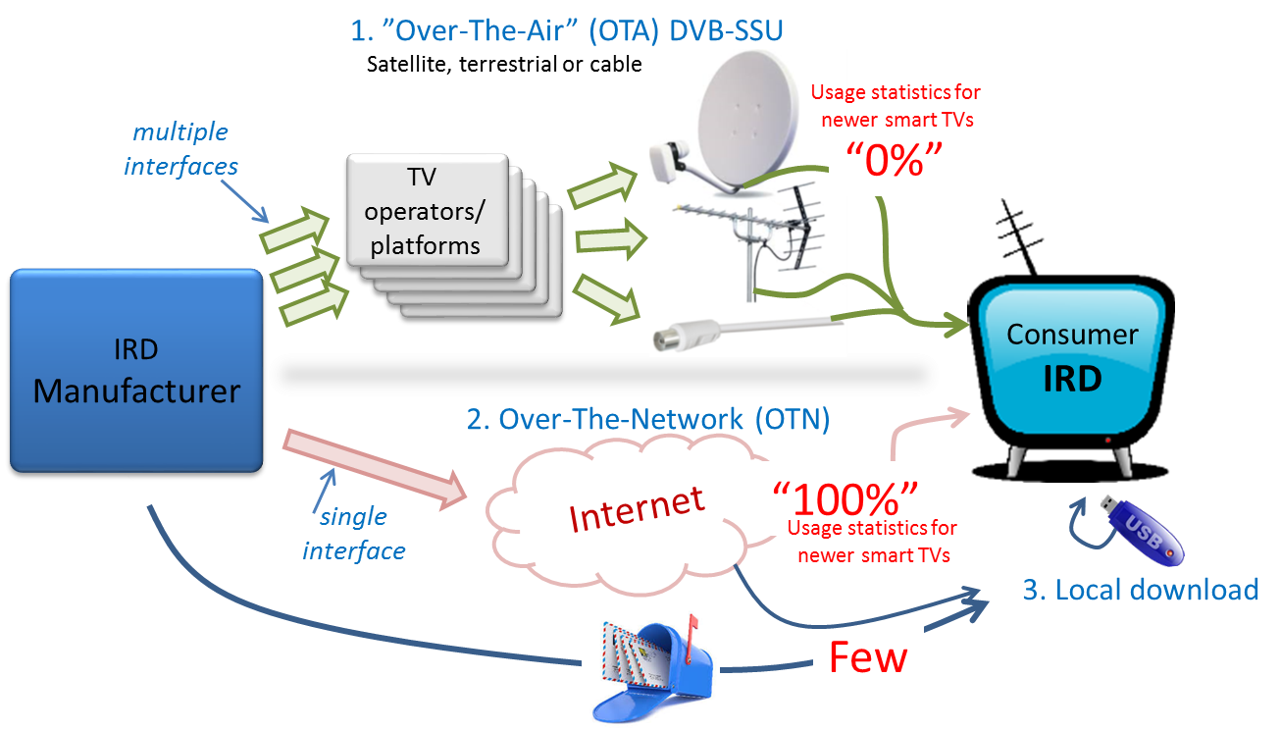
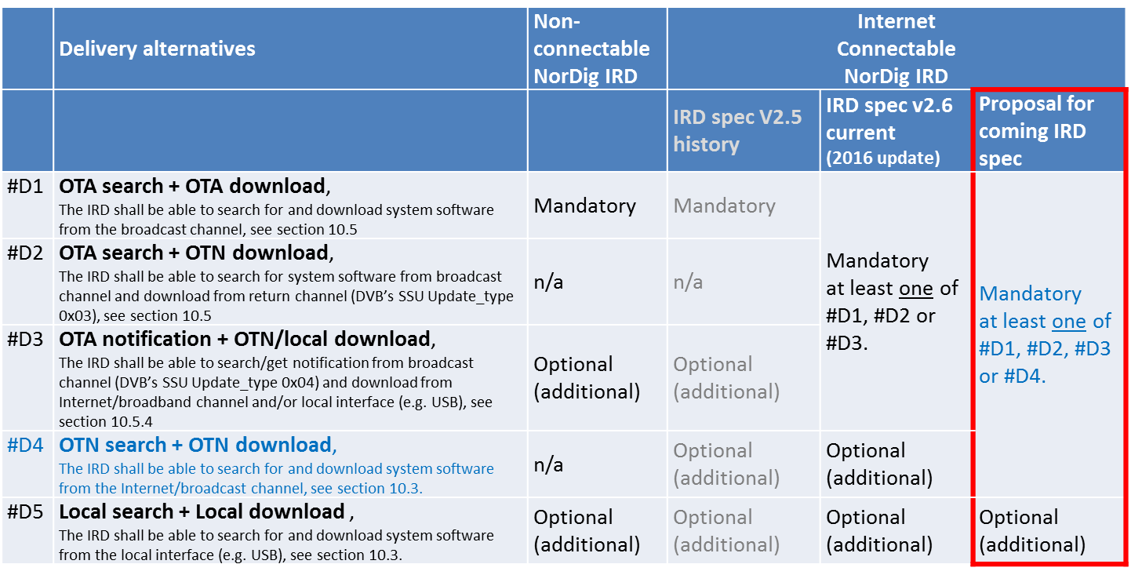
NorDig T report – SSU/sw update, proposal from Industry
NorDig Excom meeting 9th March 2017 Stockholm, Sweden
Introduction/placeholder (separate presentation):
Last NorDig Excom meeting (13 Oct 2016):
  Excom decided for allow Over-The-Air notification alternative (incl in new NorDig IRD spec v2.6 from Jan 2017) but
  was not convinced to allow IRDs only use over-the-Internet/network for SSU.
This NorDig Excom meeting (9 Mar 2017):
  Excom opened up for the Industry to come back to Excom with more information and arguments why NorDig should consider over-the-Internet/network for SSU.
See separate presentation from Industry
  NorDig T waiting Excom decision, small task to update IRD spec

Slide 33
NorDig T report –
NorDig Excom meeting 9th March 2017 Stockholm, Sweden
END presentation
NorDig-T report
After here some detailed informative slides
ANNEX
NorDig T mandates 2015-2016 (Jan 2015)

Slide 34
NorDig T report –
NorDig Excom meeting 9th March 2017 Stockholm, Sweden
ANNEX
NorDig T OLD mandates 2015-2016
If anyone wish to compare
with the new proposed ones

Slide 35
NorDig T report – OLD mandates and activities (1/4)
NorDig Excom meeting 9th March 2017 Stockholm, Sweden
NorDig T – OLD mandates & activities for period 2015-2016 to compare with:
RoO
  Continue major update of RoO spec and exchange experience (focus area within NorDig T)
    Plan in basic have same structure to be same as IRD spec
    Guidelines and recommend broadcast settings and levels (to reduce differences between NorDig networks)
    examples
    Include specific info related to different NorDig members networks/platforms
  (after major update above) Maintain and update NorDig RoO.
Test and Test plan
  Test plan v2.5
    Match IRD spec v2.5.1 (incl PVR crids, HbbTV and other today missing test cases)
    Review and where possible combine similar test cases to make it easier and faster to test
    “minimize” all redundant redundant test cases/combine test cases to speed up testing (without affecting test quality)
    Missing audio/video test cases (e.g. metadata, video crop etc.)
  Update and improve test cases
  HbbTV test and test cases:
    finalise development of already defined NorDig specific HbbTV test cases and maintain them (minimise NorDig unique specific test cases, based on open test cases). Propose new test cases to be developed if needed (keep to minimum).
    add HbbTV test requirements into NorDig Test Plan (based on ref as much as possible to HbbTV test suit, clarify if HbbTV optional test is mandatory for NorDig Hybrids)
    contribute to HbbTV org the NorDig developed HbbTV test cases for inclusion in HbbTV standard Test suits (include as much as possible in HbbTV standard test suits).
    Propose budget for NorDig’s HbbTV activities (costs , descriptions, alternatives)
    Supervise and manage any NorDig HbbTV consultancy work (currently Sofia Digital)

Slide 36
NorDig T report – OLD mandates and activities (2/4)
NorDig Excom meeting 9th March 2017 Stockholm, Sweden
continue - NorDig T OLD mandate and activities for coming period 2015-2016:
HbbTV IRD requirements
  Monitor and report HbbTV spec development and usage, (HbbTV now close to release v2.0 spec w HTML5 etc).
  Investigate additional HbbTV feature and requirements that are of interest for NorDig members (to be confirmed by –T and Excom before detailed proposal and any incl into IRD spec) like:
    HbbTV 2.0 (functionalities, IRD manufactures implementation, when and how this could be incl into IRD spec, potential possibilities with v2.0 like HTML5, HEVC. Members interest for new feature/functionality with v2.0)
    Portable devices, Second screen, synchronisation etc (part of HbbTV 2.0)
HbbTV implementation:
  Monitor and report HbbTV implementation in NorDig networks and other networks,
  Monitor and report implementation status on IRD side
  Monitor and discuss experience and issues/problems with launching HbbTV services
  Write Guidelines on Operators and broadcasters use of HbbTV, possible cooperation
HbbTV DRM
  Monitor HbbTV DRM implementation, interest for common DRM requirements
  Monitor technologies and functionality (common encryption, CAM/CI+ etc)
  Review security requirements espec for 4k premium OTT content that has higher security requirements from content owners (interest from Telenor/CanalDigital and TV2 NO)

Slide 37
NorDig T report – OLD mandates and activities (3/4)
NorDig Excom meeting 9th March 2017 Stockholm, Sweden
continue - NorDig T OLD mandate and activities for coming period 2015-2016:
Video, audio, subtitling
  Surround sound, is it possible to reduce the problems with down-mixing, especially investigate broadcast side.
  Dolby AC4, monitor and get more info about its efficiency and functionality (not yet proposed to specify).
  Monitor and report NorDig members interest for new audio and video codecs (HEVC, 3D Audio etc) and formats. Investigate how new codec can be introduced in NorDig specs. Check with industry support for new codecs (New codec like HEVC would probably also need review of HDMI, SI and maybe audio requirements etc).
  Propose “commercial requirements” for HEVC and description of impact on IRDs other parts due to this
Accessibility
  Work with harmonization of broadcast and better describe current broadcast for IRD manufactures
  Advanced Clean Audio / Dialogue Enhancement - investigate members interest for this and if they are able to broadcast this
  Spoken subtitling, investigate how NorDig broadcasters today broadcast this and how much difference there is around this in NorDig broadcast.
  HbbTV for Accessibility services – investigate how HbbTV can be used for Accessibility and if needed propose changes to IRD and RoO requirements
  Investing new technology and equipment for accessibility services.
  (SVT) Investigate more in to adjusting volume for receiver mixing (if needed)
CA and CI
  monitor and report CIplus LLP (CI+ v1.4 and v2.0) and DVB work (CI+ v2.0 etc) within these topics to NorDig Excom and Technical group.
  Review security requirements espec for 4k premium OTT content that has higher security requirements from content owners (interest from Telenor/CanalDigital and TV2 NO)

Slide 38
NorDig T report – OLD mandates and activities (4/4)
NorDig Excom meeting 9th March 2017 Stockholm, Sweden
continue - NorDig T OLD mandate and activities for coming period 2015-2016:
NorDig Unified IRD spec
  No major updates or new requirement foreseen for 2015
  Maintain and update current requirements for NorDig IRDs (minor, all sections, references to other spec are up to date, requirements are up to date, clarification is added for FAQ etc, e.g. HbbTV errata).
  Update guidelines wordings in GUI and translations (mainly related Accessibility and Audio)
  Review and improve IRD’s auto update for network changes
  FE (DVB-T/-T2) review if 800MHz scanning can be removed (NRK) and add optional requirements for 700MHz LTE immunity (hopefully via reference to ITU/ETSI )
  IPTV – ComHem launching IPTV and has some interest to updated current IPTV IRD requirement.
  IRD surveillance (like using TR069), some interest to investigate this more.
  SSU, add alternative for broadcasting SSU notification in accordance with new DVB SSU spec 2015 for IRDs with very large file size
  Recommendation Remote Control related to accessibility settings, check if possible to get a RC key for changing Accessibility setting or modify current requirements and recommendations. (Ensure RC can be via Smartphones etc)
  HbbTV – investigate and prepare update IRD spec for latest HbbTV v1.5 (i.e. latest errata)
  (TV recorder – closed. No need to define TV Recorder (PVR lite) unless someone volunteer to come with a more concrete text proposal)
  Mix of broadcast and OTT (ideal/intension one common channel list of broadcast and broadband/OTT services for hybrid receivers, viewers should ideal not notice zapping diff between zapping among broadcast or OTT services)
Others
  Common Event Info file format (Broadcast + OTT), interchange Content Providers to Distributers (e.g. based on “Public schedule”). Shall support event info and metadata for both broadcast (linear TV) and OTT (linear and on-demand/catch-up)

