Slide 1


NorDig T report to Excom
NorDig Excom meeting 5th October 2017 Stockholm, Sweden
Early/preliminary report back from NorDig Excom
Marked as “Excom” in blue text is outcome from this Excom meeting (decision, comments, tasks, feedback etc)
NorDig T (Per Tullstedt) extra report back from NorDig Excom meeting, mainly NorDig T related issues, not the official NorDig Excom report (which will come from our Excom secretary)
NorDig Excom Agenda 5th October 2017:
Place: Blu Radisson Hotel, Arlanda in Stockholm, Time: 10:00 to approx. 16:00
1. Agenda and report from previous meeting
2. Organizational matters
  2.1. Membership situation
  2.2. Finance matters, preliminary budget 2018
  2.3. Organizational matters
  2.4. NorDig 20 years
3. Report from NorDig/T
  3.1. Mandates for coming period
  3.2. Status and report from NorDig/T general
  3.3. Presentation of new NorDig IRD specification 3.0 (inclusion of HEVC)
  3.4. Next generation Audio, Per Tullstedt & Johan Lindroos
  3.5. (Preliminary) Presentation New Test Plan, “v 2.6”
4. LUNCH
5. Report from Industry
  5.1. Report from Nordic Product Manager meeting
  5.2. Report from industry members
6. Reports from members, DVB and other organizations
7. Any other business
8. Date and place for the meetings in 2018: Thursday March 8th and October 4th
20
NorDig
years

Slide 2
NorDig T report - mandates for 2017-2018
NorDig Excom meeting 5th October 2017 Stockholm, Sweden
NorDig T mandates and work items - Informative
Guidelines what Excom wants the Technical group to work with and prepare.
Mandates used inside Technical group and subgroups for planning and what to prepare.
In addition to mandates: Commercial Requirements for HEVC IRD “profile”
Current Mandates are for 2017-2018
    Excom approved March 2017,
    see annex A for current full mandates
Short summary:
RoO - Maintain and update NorDig RoO.
Test and Test plan - Maintain and update NorDig Test plan to match IRD spec
Unified IRD spec
  Maintain and update NorDig IRD specification
  After NorDig IRD spec v3.0 – prepare and investigate NorDig HighFrameRate HEVC IRD “profile”
HbbTV – test cases, IRD requirement, report members usage, monitor DRM
Video, audio, subtitling, CA & CI
Accessibility
EPG - Establish a NorDig specification of common EPG/Event exchange file format
Excom 5th Oct 2017: OK

Slide 3
NorDig T report - Overview specification work
NorDig Excom meeting 5th October 2017 Stockholm, Sweden
Overview NorDig T specification work - informative:
Rules of Operation
  Latest published: RoO v2.5 (published October 2016)
  Should RoO be upgraded to v3.0? Audio+video+accessibility has identified a number of new requirements that would be great to add to RoO. Check w Des
Unified IRD specification
  Latest published: IRD spec v2.6 (published 23rd Jan 2017)
  IRD spec v3.0 (add HEVC IRD “profile”) – proposal to be presented today 5th October,
    95% ready, based upon NorDig HEVC Commercial Requirements
Test Plan
  Latest: Test Plan v2.5.0 (published Jan 2016) + Test Plan addendum for HbbTV v1.0 (published 23rd Jan 2017)
  Drafting Test Plan v2.6, plan final draft for approval within 3-4w
HbbTV
  Maintenance of NorDig’s HbbTV test cases
EPG/EIT exchange file format
  Common NorDig file format, TV Anytime based
Website and admin

Slide 4
NorDig T report - Work and subgroups
NorDig Excom meeting 5th October 2017 Stockholm, Sweden
Overview - informative
NorDig T – active
NorDig T subgroups – status
Video – active (video related for IRD, Test Plan and RoO)
Audio – active (audio related for IRD, Test Plan. Working together w Accessiblity group)
Test – active (Test Plan)
RoO – active (RoO spec)
Accessibility – active (accessibility related for IRD, Test Plan and RoO)
API/PVR – active (HbbTV testing, API+PVR related for IRD, Test Plan and RoO)
EPG/Event exchange metadata – active (common NorDig format for exchange EPG metadata for broadcast and OTT)
SSU – dormant after IRD spec v3.0
CA/CI+/Sec – dormant (CI+ v1.4/v2.x…)

Slide 5
NorDig T report - Work and subgroups
NorDig Excom meeting 5th October 2017 Stockholm, Sweden
Organisation and status
NorDig T – Per Tullstedt, Teracom
NorDig T subgroups – status
Video – Per Tullstedt, Teracom
Audio – Johan Lindroos, SVT,
Test – Pasi Toiva, Labwise,
RoO – Des Mac Giolla an Chloig, RTÉNL,
Accessibility – Kjell Norberg, NRK,
API/PVR – Erik Vold, NRK,
EPG/Event metadata – Peter Mølsted (consultant NorDig tech secretary),
SSU – dormant (Per Tullstedt, Teracom)
CA/CI+/Sec – dormant (CI+ v1.3, CI+ v1.4) – Interest among Excom to wake up subgroup to study UHD content security requirement, for coming/future IRD spec releases.

Slide 6

NorDig T report - Meeting calendar 2017
NorDig Excom meeting 5th October 2017 Stockholm, Sweden
NorDig T (main group) meeting calendar 2017:
31th January 2017, webinar, 10:00-15:00 CET
28th February 2017, webinar, 10:00-16:00 CET
Informative: NorDig Excom 9th March 2017
4th April 2017, webinar, 10:00-15:00 CET
16th May 2017, webinar, 10:00-15:00 CET
20th June 2017, webinar, placeholder, 10:00-12:00 CET
29th August 2017, webinar, 10:00-14:00 CET
20th Sep 2017, at Teracom Stockholm Sweden, 10:00-15:00 CET
Extra 28th Sep 2017, webinar, 14:00-16:00 (focus IRD spec v3.0 drafting)
Extra 2nd Oct 2017, webinar, 10:00-12:00 (focus IRD spec v3.0 drafting)
Informative: NorDig Excom 5th October 2017
Extra DD Oct 2017, webinar, clean-up IRD spec v3.0 after Excom decision
14th November 2017, physical TBD, 10:00-16:00 CET
14th December 2017, webinar, placeholder, 10:00-12:00 CET
Meeting calendar 2018 – TBD (target is to set in December the calendar for coming year)

Slide 7
NorDig T report - consultancy & costs 2018
NorDig Excom meeting 5th October 2017 Stockholm, Sweden
NorDig T, consultancy and costs 2018:
Excom decided for 2017:
  continue with consultancy support & raised budget fr 350kSEK to 400kSEK (to ensure NorDig HEVC IRD etc).
Proposal planning of consultancy 2018:
  Technical secretary – Peter Mølsted, part of techn.budget 400kSEK/~42kEUR
    Updated workplan 2018 with following mission:
    (a) Webmaster NorDig.org
    (b) Editor for the NorDig Specifications incl maintaining and release management of the specifications
    (c) Chair work with NorDig common EPG/EIT exchange file format
    (d) Support NorDig/T and Test group for development of new Unified IRD specifications and Test Plans (2017-2018)
    (d) Support and compile result from NorDig/T investigations and questionnaires among NorDig members and others.
    (e) Participation to the NorDig/T and relevant sub-group meetings
  Test Plan – Labwise (Pasi Toiva), shared w Peter M 400kSEK/~42kEUR
    Test group, test plan, editor etc
  HbbTV test cases, maintenance – SofiaDigital, 50kSEK/~5kEUR
    Maintenance (update & correction) of our NorDig created HbbTV test cases
  Website
    Hosting (WorldPress) – 285EUR/year (300USD/year)
    Technical support & update functions (ST Design) – case-by-case (part of main techn.budget 400kSEK/42kEUR)
    Webmaster (Peter Mølsted) – part of his consultancy (part of techn.budget 400kSEK/42kEUR)
Excom 5th Oct 2017: OK

Slide 8
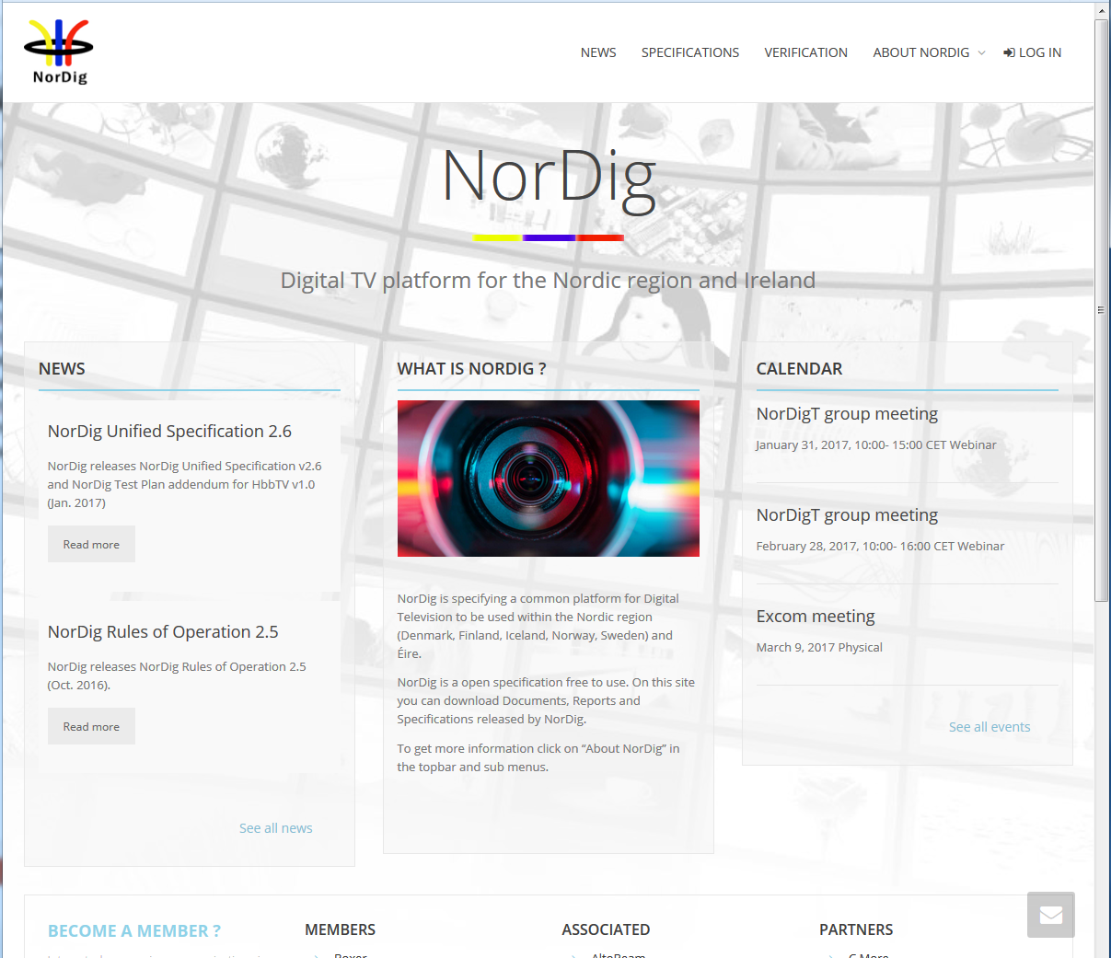
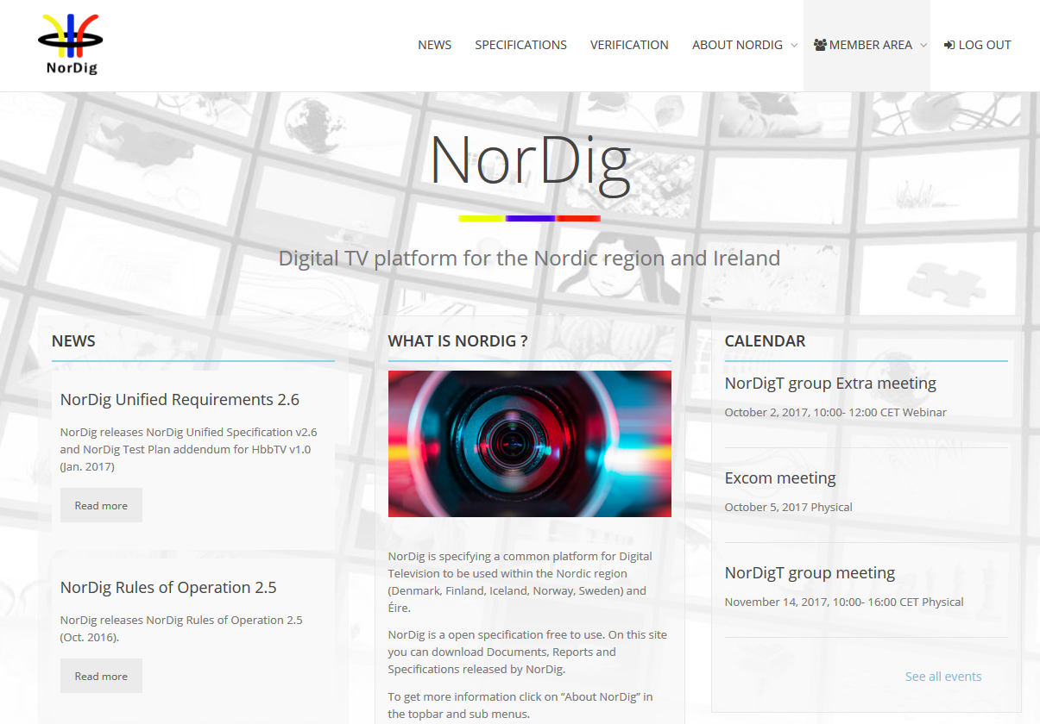
NorDig T report – website
NorDig Excom meeting 5th October 2017 Stockholm, Sweden
Informative, status website:
Changes (last period):
-
Proposal:
News NorDig 20 Years – Excom view?
Usage:
NorDig-T + subgroups: frequent user for sharing and storing documents (minutes, proposals etc)
New letters:
Around 20 companies has signed up for news letters
Recommend to sign up
Costs:
Hosting (WorldPress ~300EUR/y),
Web expert (ST Design) for functional updates
Techn editor (Peter Mølsted) for content updates
Webmaster: Peter Mølsted (for text content, login etc)
Excom 5th Oct 2017: OK
Snapshot example public area

Slide 9
NorDig T report – NorDig and DTG harmonisation
NorDig Excom meeting 5th October 2017 Stockholm, Sweden
Harmonise NorDig Unified IRD, DTG D-book and IRD specs:
NorDig has used D-book as input for the update of the Remote Control (NorDig IRD v2.6 in 2016)
DTG used NorDig as input for update of DTT front-end (D-book v9) in 2016
NorDig has sent NorDig Commercial Requirement for HEVC IRDs to DTG in Nov/Dec 2016.
DTG has not specified detailed HEVC IRD requirements nor test cased for broadcast usage (some for OTT/broadband/iPlayer)

Slide 10
NorDig T report – NorDig countries/networks
NorDig Excom meeting 5th October 2017 Stockholm, Sweden
List of Countries using NorDig specifications (outside NorDig members),
Nothing new to report, same as last meeting (same as previous report).
Several IRD manufactures and other mentions that several other territories and DVB networks refers or uses NorDig as basis for their IRD specs (especially “newer” networks). Among reasons seems open spec and content (T2, HbbTV, subtitling etc).
List so far:
Country / Network | Status
Turkey DTT | Confirmed via Vestel
Several eastern Europe countries | Indications, not confirmed
Malaysia (blue copy) | Digita
Germany DTT (Media broadcast/TDF) | Based on/reference to NorDig IRD
Georgia DTT | Based on/reference to NorDig IRD (v2.2)
Vietnam
Excom 5th Oct 2017: Can we get any info back from these user? Maybe it could be things that are of value for the members and into future revisions. AP NorDig T

Slide 11
NorDig T report - Test Plan
NorDig Excom meeting 5th October 2017 Stockholm, Sweden
Test Plan
Test Plan v2.6 drafting:
  v2.6 is now 90% ready
    Inputs from Labwise, Teracom and Sony
  No open questions for Excom
  Plan is to integrate HbbTV Test Plan addendum into main document
  ~3w to reach final draft
  Proposal is to send to Excom and approve via e-mail silent approval 2w
  Excom view?
Test Plan v3.0 (HEVC, S2X…)
  2018
Excom 5th Oct 2017: OK, proceed accord to proposal (approval via e-mail and silent approval in Excom group)

Slide 12
NorDig T report - EPG / Event metadata exchange format
NorDig Excom meeting 5th October 2017 Stockholm, Sweden
(1/2)
Specification of common NorDig EPG/Event metadata exchange format
NorDig EPG / Event metadata subgroup – Status and Planned activities:
TV-Anytime new version updated with the NorDig requirements including program rights
  ETSI had 21th. September approved (with no comments) the TV-Anytime update, and it is now published on ETSI and EBU website. http://www.etsi.org/deliver/etsi_ts/102800_102899/1028220301/01.10.01_60/ts_1028220301v011001p.pdf
  https://tech.ebu.ch/tvanytime
Preparation of NorDig specification of common EPG/Event exchange file format based on TV Anytime updated version
  Independent recommendation document, not included in the IRD specification – because not all stakeholders have interest and know how in the IRD spec.
  The NorDig EPG/Event metadata Group shall maintain the NorDig EPG/Event exchange file format specification in the future, and will help interested parties with expert knowledge in relation to TV-Anytime implementation.
  Final draft expected in December 2017.
Excom 5th Oct 2017: OK, Excom will wait with approval for NorDig EPG/event metadata specification document until next Excom meeting, March 2018 (ie no “e-mail-silent-approval”)

Slide 13
NorDig T report - EPG / Event metadata exchange format
NorDig Excom meeting 5th October 2017 Stockholm, Sweden
(2/2)
NorDig EPG / Event metadata subgroup – Status and Planned activities:
The NorDig common EPG/Event exchange file format specification includes
  Detailed references to the TV-Anytime specification
  NorDig Implementation guidelines – to help broadcasters and distributors for easy implementation
  Termslist with NorDig requirements - including references to Public Schedule to support change of format to TV-Anytime
  XML Examples files - for simple basic and advanced implementation, including rights handling and On demand
  Guidelines for “last minutes” updates of program start and changes (“last minutes” refers to shortly before but also afterwards for “correcting” catch-up segmenting)
  Automatic mapping script / function for handling data from Public Schedule to TV-Anytime and visa a versa
The documentation (guidelines, examplefiles and termslist) will be tuned for all users in the whole EPG value chain.
Workshop / NorDig common EPG/Event exchange file format and Rights management cross networks and platforms to help the stakeholder in the distribution chain - to be arranged.
The workshop will be open for all interested - not only NorDig members - in order to promote the use and understanding of TVAnytime as common exchange format.
  Excom 5th Oct 2017: OK

Slide 14
NorDig T report - Unified IRD spec
NorDig Excom meeting 5th October 2017 Stockholm, Sweden
NorDig Unified IRD spec v3.0 draft presentation
  major update
  Main change: inclusion of HEVC IRD profile
    - HEVC video, NGA audio, TTML Subtitling, HbbTV, SI…
  draft008 – “95-98%” ready

Slide 15
NorDig T report - Unified IRD spec
NorDig Excom meeting 5th October 2017 Stockholm, Sweden
NorDig Unified IRD spec v3.0 - major update, inclusion of HEVC IRD profile:
Draft proposal - Overview
Draft today 95% ready
Remaining (draft008 dated 3rd October):
  Excom decision in a number of items (e.g. DVB-S2X, NGA and HbbTV for HEVC IRDs, layout, grace period)
  Links/cross-references to be updated, illustration/figures to be modernized, wordings (uniform spelling)
  Minor text updates Audio related (User preferences etc)
Based upon Excom approved Commercial Requirements NorDig HEVC IRD (13 Oct 2016) – see Annex B
HEVC IRD “profile” (video, audio, subtitling, I/O, SI, HbbTV etc)
Video HEVC, up to UHD with HDR & WCG up to 50fps (SFR)
Audio NGA, proposal includes two new (NGA) audio codecs, for Excom to decide (one of them, no one, both, which to be mandatory etc), separate slides
HbbTV, proposal includes mandate HbbTV for all HEVC IRDs (Telenor/CanalDigital objection), Excom to decide, separate slide
FrontEnd, Proposal includes adding DVB-S2X for sat HEVC IRDs as optional, for Excom to decide, separate slide
Other relevant items/changes that are also included in draft IRD v3.0 (according with Excom decision Oct 2016 and March 2017 meetings):
Bug list (smaller items and typo corrections), maintain and update current requirements & referenced standards.
FE DVB-S/-S2 (IRD spec + Test plan) update NorDig requirements (IRD and test cases) to be inline with new RED directive (ETSI ) for satellite receivers (i.e. raise NorDig requirements e.g. for dynamic range and adjacent channel)
FE DVB-T2, mandate DVB-T2 for all terrestrial IRDs
SSU (sw update), allow only using OverTheNetwork/Internet SSU as an alternative,)
Definitions, new definitions for NroDig IRD, basic IRD, HEVC IRD, STB and iDTV etc
Document structure/layout, review and simplify reading/understanding (maybe use table format or similar, try to split text so that only one IRD requirement per “subchapter” to simplify for e.g. Test Plan). (Observe IRD structure has impact upon Test Plan).

Slide 16
NorDig T report - Unified IRD spec
NorDig Excom meeting 5th October 2017 Stockholm, Sweden
NorDig Unified IRD spec v3.0 - major update, inclusion of HEVC IRD profile:
Items not included in this Draft proposal (from earlier indicated items for v3.0):
From previous IRD spec update, proposed earlier but not incl due to lack of input:
Mix of broadcast and OTT (common channel list of broadcast and broadband/OTT services) – no inputs, postponed
Review and improve IRD’s auto update for network changes – no inputs, postponed
SSU over-the-air handling of other country code, need of clarification for cable and sat- Question fr Test group, no inputs, postponed
User setting country setting states “pre-select” language – Question fr Test group, no inputs, postponed
Target region descriptor – no inputs, postponed
Items in NorDig HEVC commercial requirements not included:
SI-3 service and component prio. Component prio missed in draft008 for video (for multiple video streams within same service), specified for MPEG2 and MPEG4/AVC but not real use case, easy to add.
CA/CI-1, CIv2 (USB based) not included, waiting for DVB
Comments to NorDig HEVC commercial requirements
Subt-5 Removal of EBU Teletext support for HEVC based service. Not specific excluded. Industry asking for simulcasting TTML subt with legacy subtitling formats EBU or DVB (Industry prefer DVB Subt, Operators prefer often EBU). No text of making any subtitling limited for any service type.
Excom view? How to proceed with IRD spec v3.0 approval?
Excom decision made at this meeting, NorDig T to update draft (2-3w), finalize last update points (cross-references, illustrations, wordings…), removal/update of audio according to Excom, send final draft to Excom for final approval
Excom meeting (e.g. webex?) for approval or via silent approval?
Excom 5th Oct 2017:
  SI-3 service comp prio (item missed), NorDig T AP to draft this into IRD spec v3.0
  IRD spec v3.0 approval process: NorDig T update draft for Excom decisions and send to Excom members via e-mail, approval via 2-3w silent approval

Slide 17
NorDig T report - Unified IRD spec overview
NorDig Excom meeting 5th October 2017 Stockholm, Sweden
NorDig IRD Overview | “Classical” IRD | HEVC IRD
Video decoding/processing
MPEG-2/H.262 SDTV video | M | M
MPEG-4 AVC/H.264 HDTV video | M | M
MPEG-H HEVC/H.265 HDR SFR UHDTV video | - | M
Audio decoding/processing
MPEG-1 Layer II audio | M | M
HE-AAC Level 4 audio | Alt A | Alt A
E-AC-3 (incl AC-3) audio | Alt B | Alt B
NGA – MPEG-H audio | - | TBD Excom
NGA – AC4 audio | - | TBD Excom
Subtitling
DVB (SDTV) subtitling | M | M
DVB SD&HD Subtitling | M | M
EBU Teletext subtitling (subtitling pages) | M | M
(DVB) TTML Subtitling | - | M
Teletext and API
EBU Teletext (normal pages) | M | M
HbbTV | O (6) | M? M: iDTV O: STB
Interfaces
one FE (DVB-C, -T/T2, -S/S2 or IP) | M | M
DVB-S2X | - | O? Excom
HDMI with HDCP | M 1.4 | M 2.0b
Digital Audio Output (e.g. SPDIF) | O | O
Common Interface Plus for CA | M iDTV | M iDTV
Smartcard Interface for embedded CA | operator | operator
new
new
new
new
new

Slide 18
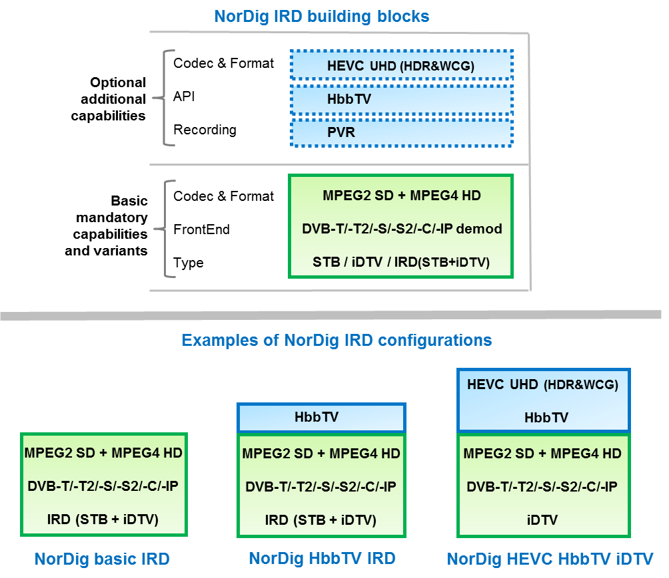
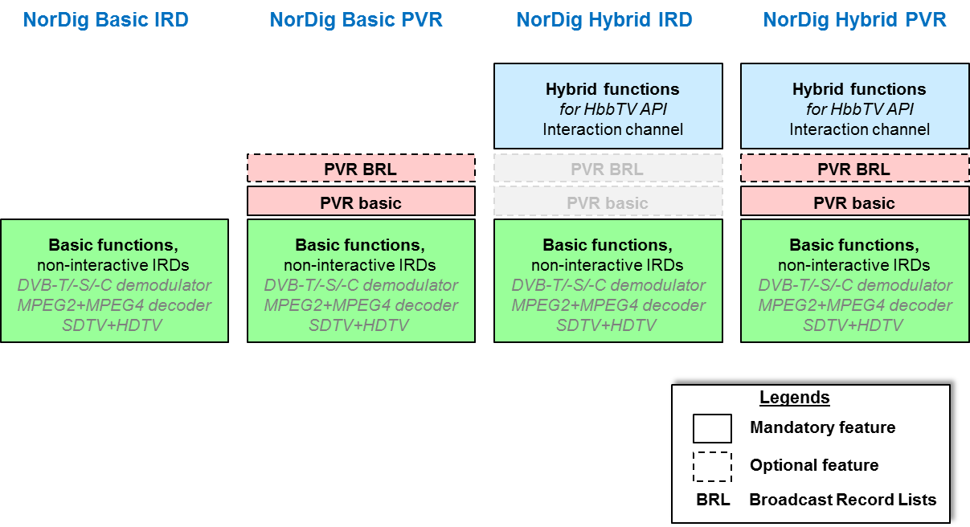
NorDig T report - Unified IRD spec v3.0 draft
NorDig Excom meeting 5th October 2017 Stockholm, Sweden
NorDig Unified IRD - Introduction and General:
Wordings + Definitions
Past IRD spec v2.0 in 2007/2008: profiles and levels a la DVB (Profiles = API, Level= codec, no PVR function)
Current IRD spec v2.6: profiles, levels and function (Profiles = API, Level= one level, PVR function)
IRD spec v3.0: variants (FE, STB/iDTV) and capabilities (HEVC, PVR, HbbTV),
Wording: Hybrid → HbbTV
New - Definitions: basic IRD, HEVC IRD, HbbTV IRD, iDTV, STB etc (missing earlier)
NorDig Unified IRD spec:
Introduction
General features
FrontEnd (-S, -C, -T, -IP)
Demultiplexer
Video
Audio
Subtitling
Interfaces
Interfaces CA/CI
System SW Update
Performance
Signaling PSI/SI
Navigator (“Menus”)
PVR/Recording
API/HbbTV
User Preferences
Annexes A-to-J
Proposal for NorDig Unified IRD spec v3.0
NorDig Unified IRD spec v2.6
Excom 5th Oct 2017: OK

Slide 19
NorDig T report - Unified IRD spec v3.0 draft
NorDig Excom meeting 5th October 2017 Stockholm, Sweden
NorDig Unified IRD - Intro, General and layout:
Layout
  Task from Excom to review/simplify layout and clarify mandatory requirements, check if table structure could be used
  Alternatives reviewed:
    Design alt1: “shall” is in red, “should” optional in blue, comments in green text
    Design alt2: “should” in italic, comments description is in normal text and in a frame
    Design alt3: Table structure, all text in a table, where “shall” and “should” descriptions is in separate rows. columns for STB, IDTV etc where “shall” is marked with M (for mandatory) and “should” is marked with O (for optional).
    Design alt4: “shall” is in red bold text, “should” / optional description is in regular black text, informative text and comments description is in italic, note + normative comments description is in normal text and in a frame, informative note/comments description is in italic text and in a frame.
    NorDig T propose to use alt4
Excom view?
Excom 5th Oct 2017: OK, continue work in coming version, sections and requirements should in future where possible be divided so each paragraph/subsection only include “one” requirement (mandatory or optional). “One paragraph/sub-section per test case”.
NorDig Unified IRD spec:
Introduction
General features
FrontEnd (-S, -C, -T, -IP)
Demultiplexer
Video
Audio
Subtitling
Interfaces
Interfaces CA/CI
System SW Update
Performance
Signaling PSI/SI
Navigator (“Menus”)
PVR/Recording
API/HbbTV
User Preferences
Annexes A-to-J
Alt1: too much colour
Alt2: just slightly improved compared to today (more in line with other international specs)
Requirement
STB
iDTV
HEVC
HbbTV
PVR
For services with multiple audio streams (PIDs), the NorDig IRD blah blah….
M
M
M
M
M
O
O
M
-
-
NorDig HEVC IRDs shall also support TTML subtitling…
Alt3: major work, difficult to handle tables, difficult to handle all variants and capabilities of NorDig IRDs, already a similar table in last Annex and Overview table.
Alt4: fairly easy to impl, improves reading compared to today (still in line with other specs)

Slide 20
NorDig T report - Unified IRD spec v3.0 draft
NorDig Excom meeting 5th October 2017 Stockholm, Sweden
NorDig Unified IRD - FrontEnd:
Satellite
  DVB-S2X for satellite HEVC IRD, a bit basic text proposal
  CanalDigital/Telenor plans to use S2X for HEVC services (long term could be used for other codecs). No major extra cost for sat IRDs. Gain approx 15%. Planned for CD coming STBs.
  CanalDigital/Telenor accepts to have it as optional for all satellite HEVC IRDs
  TV Industry OK with S2X as optional (other markets seems to use S2X only for contribution, only be used for NorDic, asks for optional for iDTVs).
  Proposal today: optional for sat HEVC IRDs.
  Excom view?
  Excom 5th Oct 2017: incl S2X requirements and as optional
Terrestrial
  NorDig IRD spec v2.6: DVB-T2 was optional for NorDig terrestrial IRDs, however already mandatory SWE, DNK (payTV), FIN, IRL.
  Proposal: mandate DVB-T2 for all terrestrial IRDs (no remarks inside NorDig T (operators/broadcasters nor industry)
  Proposal: remove search in 800MHz band
  Excom 5th Oct 2017: OK
NorDig Unified IRD spec:
Introduction
General features
FrontEnd (-S, -C, -T, -IP)
Demultiplexer
Video
Audio
Subtitling
Interfaces
Interfaces CA/CI
System SW Update
Performance
Signaling PSI/SI
Navigator (“Menus”)
PVR/Recording
API/HbbTV
User Preferences
Annexes A-to-J

Slide 21
NorDig T report - Unified IRD spec v3.0 draft
NorDig Excom meeting 5th October 2017 Stockholm, Sweden
NorDig Unified IRD - Video:
Changing wording to use DVB and MPEG wording as much as possible
  MPEG2/H.262, AVC/H.264 and HEVC/H.265
Adding NorDig HEVC IRD ”profile”:
  Based upon DVB’s HEVC HDR SFR UHDTV 10-bit bitstream profile
  HDR alt: none, HLG10 and PQ10
  No interlaces, only square pixels,
  NorDig HEVC IRD shall support decode one PID (SFR) out of a future dual PID HFR bitstream.
More reference to DVB spec text than having text in NorDig spec
MPEG still pictures proposed to be removed, no usage reported, no expert believe will be used for HEVC.
4:3 Monitor proposed to be removed (”no” new TV sets in 4:3AR)
Included hints/guidelines of handling SDR graphics (HbbTV, subt, menus) on top of HDR video (DVB have not agreed upon finding a common (minimum) solution/behaviour for this).
Proposal: no remarks within NorDig T
Excom 5th Oct 2017: OK, (Sony comment that SFR decoding of a dual PID HFR, this needs test case and test streams to secure fulfilment)
NorDig Unified IRD spec:
Introduction
General features
FrontEnd (-S, -C, -T, -IP)
Demultiplexer
Video
Audio
Subtitling
Interfaces
Interfaces CA/CI
System SW Update
Performance
Signaling PSI/SI
Navigator (“Menus”)
PVR/Recording
API/HbbTV
User Preferences
Annexes A-to-J

Slide 22
NorDig T report - Unified IRD spec v3.0 draft
NorDig Excom meeting 5th October 2017 Stockholm, Sweden
NorDig Unified IRD - Audio:
From Excom March 2017: interest to include NGA, but may not delay IRDv3.0 publication. No decision of NGA flavor/codec (MPEG-H Audio or Dolby AC-4), Tech group to prepare and recommend/pros&cons
NorDig HEVC Commercial Requirements – General 4: Duplication of tools or codecs fulfilling the same commercial requirement shall be avoided, i.e. no toolbox if possible.
IRD v3.0 spec draft008 includes technical requirements for NGA,
  both MPEG-H audio and Dolby AC-4 audio are drafted (to not delay IRD v3.0 process)
  Same basic functions for both NGA codecs
  Excom to decide for NGA and unnecessary requirements will be removed.
Technical details NGA:
  NGA decoding profile: according with DVB’s (up to “15” channels/objects, receiver mixing etc)
  NGA Dialogue Enhancement (plus AD and Spoken Subtitling)
  Audio prio (if multiple audio PIDs) for HEVC IRDs:
    NGA
    legacy audio prio: 2.1 type (normal/AD), 2.2 language, 2.3 format (stereo/multi), 2.4 legacy codec
  NGA preselection
  NGA requirements written mainly in separate sections.
  - Excom 5th Oct 2017: noted (separate discussion of weather to incl NGA or not and which codec)
NorDig Unified IRD spec:
Introduction
General features
FrontEnd (-S, -C, -T, -IP)
Demultiplexer
Video
Audio
Subtitling
Interfaces
Interfaces CA/CI
System SW Update
Performance
Signaling PSI/SI
Navigator (“Menus”)
PVR/Recording
API/HbbTV
User Preferences
Annexes A-to-J

Slide 23
NorDig T report - Unified IRD spec v3.0 draft
NorDig Excom meeting 5th October 2017 Stockholm, Sweden
NorDig Unified IRD - Subtitling:
Adding for HEVC IRDs to support new DVB TTML subtitling spec (still DVB blue book), character based transmission, extension of EBU TimedText
Intension is TTML is primary intended to be used for HEVC services
Full TTML spec, except:
  AD is optional (intended for text-to-speech, IRD generated spoken subtitling)
  content-related-commentary is optional
  Font download is optional
Add clarification of NorDig IRD decoding one subtitle-stream at a time
New wordings (to be in line with new TTML spec).
New TTML may separate non-translation dialogue and hard-of-hearing or keep them in same subtitle stream.
HEVC IRDs minimum two subtitle modes (“normal” or “hard-of-hearing”)
Excom 5th Oct 2017: OK, clear interest among Excom to use TTML, should be used also in MP2 and MP4/AVC service, in order among things to make it easier for catch-up OTT services
NorDig Unified IRD spec:
Introduction
General features
FrontEnd (-S, -C, -T, -IP)
Demultiplexer
Video
Audio
Subtitling
Interfaces
Interfaces CA/CI
System SW Update
Performance
Signaling PSI/SI
Navigator (“Menus”)
PVR/Recording
API/HbbTV
User Preferences
Annexes A-to-J
NorDig | EBU Teletext | DVB Subtitling | TTML | Interpretation
Translation dialogue subtitles (or Normal subtitles) | Subtitling | Normal subtitles | Translation dialogue subtitles | Subtitles that includes a translation of foreign language dialogue
Non-translation dialogue subtitles | - | - | Non-translation dialogue subtitles | Subtitles that includes a transcription of same language dialogue
Hard-of-hearing subtitles | Subtitle for hearing impaired | Hard of hearing subtitles | Hard-of-hearing subtitles | Subtitles that includes descriptions of non-dialogue sounds. (e.g. gun fire, explosion, lions roar).
Audio Description subtitles | - | - | Audio Description subtitles | Subtitles that includes description of the visual scene. (e.g. “a lion lies in the sun.”). Intended for text-to-speech.
Content-related commentary subtitles | - | - | Content-related commentary subtitles | Subtitles that includes commentary related information. (e.g. director’s commentary).

Slide 24
NorDig T report - Unified IRD spec v3.0 draft
NorDig Excom meeting 5th October 2017 Stockholm, Sweden
NorDig Unified IRD - Interfaces and CA/CI interfaces:
HDMI
  Classical IRD HDMI v1.4 (HDCP v1.4), HEVC IRD HDMI v2.0b (HDCP v2.0)
iDTV HDMI input
  Removal of exception for smaller TV set, instead case-by-case by the operators
STB HDMI output
  Shall support interface new TV display (HDMI v2.0b) with HDR and legacy TV display (HDMI v1.x incl convertion HDR-to-SDR and resolution scaling)
Signal Protection
  NorDig proprietary (PMT) signaling still included in proposal that was intended (2008) for broadcasters to be able to disable HDCP if viewers had issues.
  However several/most modern IRDs has HDCP always on.
  Question if any really use this? Could this be removed? (This or next release)
  Excom view?
For EuroDocis,
  in NorDig IRD spec still just v2.0
Common Interface
  No proposed change,
  DVB Common Interface v2 (USB based), still not published/stable, postponed
  (Informative: NorDig Commercial Requirement stated inclusion of CI v2)
Excom 5th Oct 2017:
  NorDig prop descriptor for HDCP, preliminary OK to remove, NRK to check and confirm if OK
  Docis, keep as is today, for next coming release review (an alternative could be to remove Docis from NorDig since most often impl as separate modem).
  CA/CI, keep as is today for IRD v3.0, for future work CanalDigital + Stofa are interested to go through Content Owners requirements (e.g. for UHD) and see if and what could potentially be added in IRD spec in order to handle UHD services. -> Re-start NorDig CA/Security group, CD + Stofa investigate if they could chair this NorDig T subgroup.
NorDig Unified IRD spec:
Introduction
General features
FrontEnd (-S, -C, -T, -IP)
Demultiplexer
Video
Audio
Subtitling
Interfaces
Interfaces CA/CI
System SW Update
Performance
Signaling PSI/SI
Navigator (“Menus”)
PVR/Recording
API/HbbTV
User Preferences
Annexes A-to-J

Slide 25
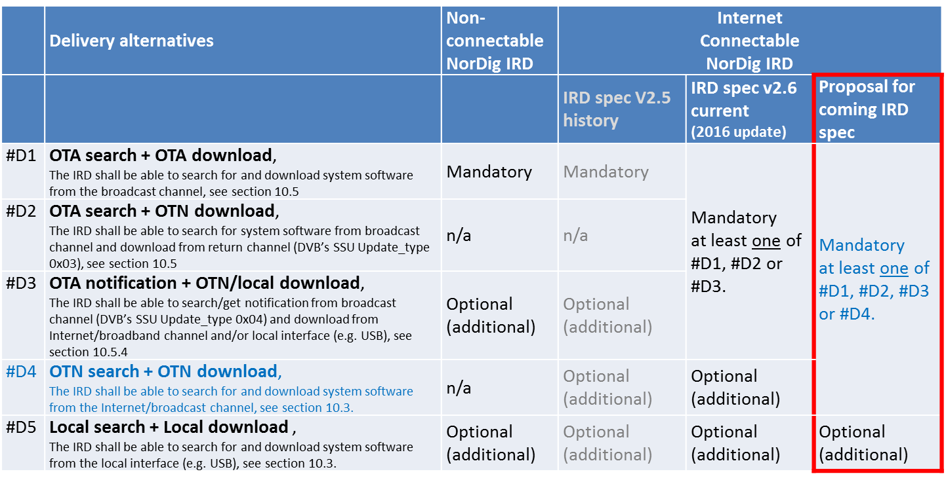
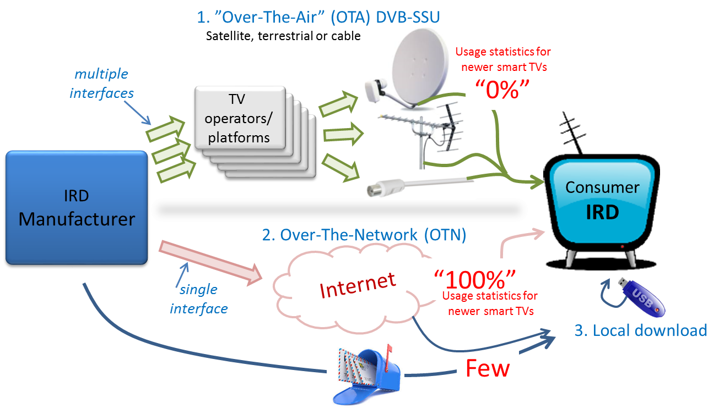
NorDig T report - Unified IRD spec v3.0 draft
NorDig Excom meeting 5th October 2017 Stockholm, Sweden
NorDig Unified IRD - System SW update & Performance:
System SW update, open up for Internet SSU, according w Excom meeting March 2017
NorDig Unified IRD spec:
Introduction
General features
FrontEnd (-S, -C, -T, -IP)
Demultiplexer
Video
Audio
Subtitling
Interfaces
Interfaces CA/CI
System SW Update
Performance
Signaling PSI/SI
Navigator (“Menus”)
PVR/Recording
API/HbbTV
User Preferences
Annexes A-to-J
Excom 5th Oct 2017: OK

Slide 26
NorDig T report - Unified IRD spec v3.0 draft
NorDig Excom meeting 5th October 2017 Stockholm, Sweden
NorDig Unified IRD - Signaling PSI/SI:
New service types for HEVC based services added (according w DVB)
New descriptors for HEVC, NGA (AC4/MPEG-H audio), TTML & S2X added
Simulcast signaling extended
  From MP2 SD to MP4 AVC HD to more generic (e.g. MP2-to-MP4, MP4-to-HEVC…)
  Proposal late, little time for comments inside NorDig T
New sub-service types for HEVC based service added (according to DVB)
  Only reflecting video for service
  Proposal/discussion in group about adding signaling for early legacy HEVC IRDs (not supporting NGA or TTML) so they can hide HEVC service only including NGA or TTML. Potential viewer complains of legacy HEVC IRD display TV service even though they do not support audio or subtitling format. However difficult to find solution that is compatible with legacy HEVC IRDs, would require SW update. Solution would maybe only work for soon-to-come legacy HEVC IRDs that do not support NGA opr TTML. Proposal was removed.
  Industry asking for simulcasting with old audio and subtitling format in HEVC services in order to coop with these early legacy HEVC IRDs. Note included in IRD text (proposed to be incl in future RoO also):
    ”12.3.6 Note 1: At the time of writing (October 2017) there is already a significant and increasing legacy of IRDs which can fully support HEVC video but may not fully support either NGA and /or TTML subtitles…it is strongly recommended that when delivering HEVC services NorDig broadcasters simulcast/carry the legacy audio and subtitle services matching those delivered on NorDig HD services (i.e.MPEG-4 HE-AAC and DVB Subtitles respectively) to ensure maximum uptake of any new HEVC services”
Excom 5th Oct 2017: OK
NorDig Unified IRD spec:
Introduction
General features
FrontEnd (-S, -C, -T, -IP)
Demultiplexer
Video
Audio
Subtitling
Interfaces
Interfaces CA/CI
System SW Update
Performance
Signaling PSI/SI
Navigator (“Menus”)
PVR/Recording
API/HbbTV
User Preferences
Annexes A-to-J

Slide 27
NorDig T report - Unified IRD spec v3.0 draft
NorDig Excom meeting 5th October 2017 Stockholm, Sweden
NorDig Unified IRD - PVR and HbbTV:
PVR – text updated to handle rec + playback of HEVC services (mainly bitrates)
HbbTV for HEVC IRDs
  Proposal: All NorDig HEVC IRDs shall support HbbTV
  Support: (so far) support from active TV industry and members in NorDig T
  Remarks: from CanalDigital/Telenor, asking for having HbbTV as optional also for HEVC IRDs
  Uncertain: RiksTV view?
  Excom view? Mandate HbbTV for HEVC IRDs or not?
  Excom 5th Oct 2017: HbbTV mandatory for HEVC iDTVs and optional for HEVC STBs. (Main part of STB for cable and sat.op are vertical STB/operator specific STB)
HbbTV errata – industry asking for grace period for late text update:
  V2.6 spec: “…support all mandatory features and requirements of HbbTV 1.5 including updates by published errata from the HbbTV Association. At the time of writing (January 2017), the most recent published errata to HbbTV 1.5 is errata #3…”
  V3.0 spec: “…support all mandatory features and requirements of HbbTV 1.5 including updates by published errata from the HbbTV Association. At the time of writing (January 2017), the most recent published errata to HbbTV 1.5 is errata #4…”
  TV industry asking (2nd Oct) for grace period in order to have time to impl changes
  Per T therefore drafted a very late proposal (3rd Oct), not yet discussed in NorDig T
    ”Updates and corrections in errata shall be implemented within six month for new IRDs after HbbTV organisation published the Errata and updated the HbbTV Test suits accordingly, in order to give IRD manufacture a reasonable time for implementation.”
  Excom view? Too late change? Not needed? OK? Jon Peising has comment to writing
  Excom 5th Oct 2017: OK (ok to change to as preferred by Jon Peising)
NorDig Unified IRD spec:
Introduction
General features
FrontEnd (-S, -C, -T, -IP)
Demultiplexer
Video
Audio
Subtitling
Interfaces
Interfaces CA/CI
System SW Update
Performance
Signaling PSI/SI
Navigator (“Menus”)
PVR/Recording
API/HbbTV
User Preferences
Annexes A-to-J

Slide 28
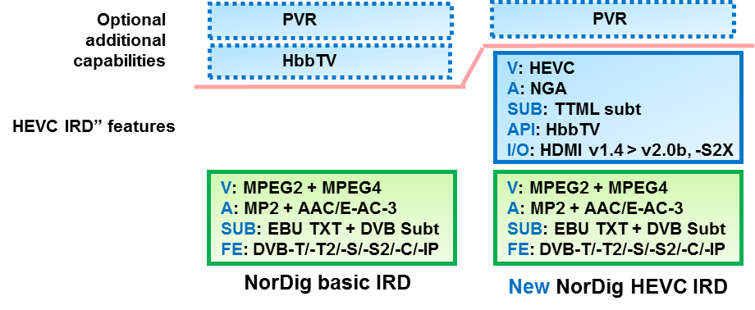
NorDig T report - Unified IRD spec v3.0 draft
NorDig Excom meeting 5th October 2017 Stockholm, Sweden
NorDig Unified IRD - Grace period/sunrise f HEVC IRD functions and/or other new items:
IRD manufactures has asked for grace period for some of the new functions for the new NorDig HEVC IRD
  NGA audio
  TTML subtitling
However NorDig HEVC IRD ”profile” is completly new, no legacy today, so why a grace period(s)?
TV manufactures has early legacy HEVC IRDs, fulfill only partly NorDig HEVC IRD requirements (ie the HEVC video, but not audio nor subt)
Excom view?
Excom 5th Oct 2017: 2 years of grace period for TTML and NGA (if NGA is incl as mandatory)
NorDig Unified IRD spec:
Introduction
General features
FrontEnd (-S, -C, -T, -IP)
Demultiplexer
Video
Audio
Subtitling
Interfaces
Interfaces CA/CI
System SW Update
Performance
Signaling PSI/SI
Navigator (“Menus”)
PVR/Recording
API/HbbTV
User Preferences
Annexes A-to-J

Slide 29



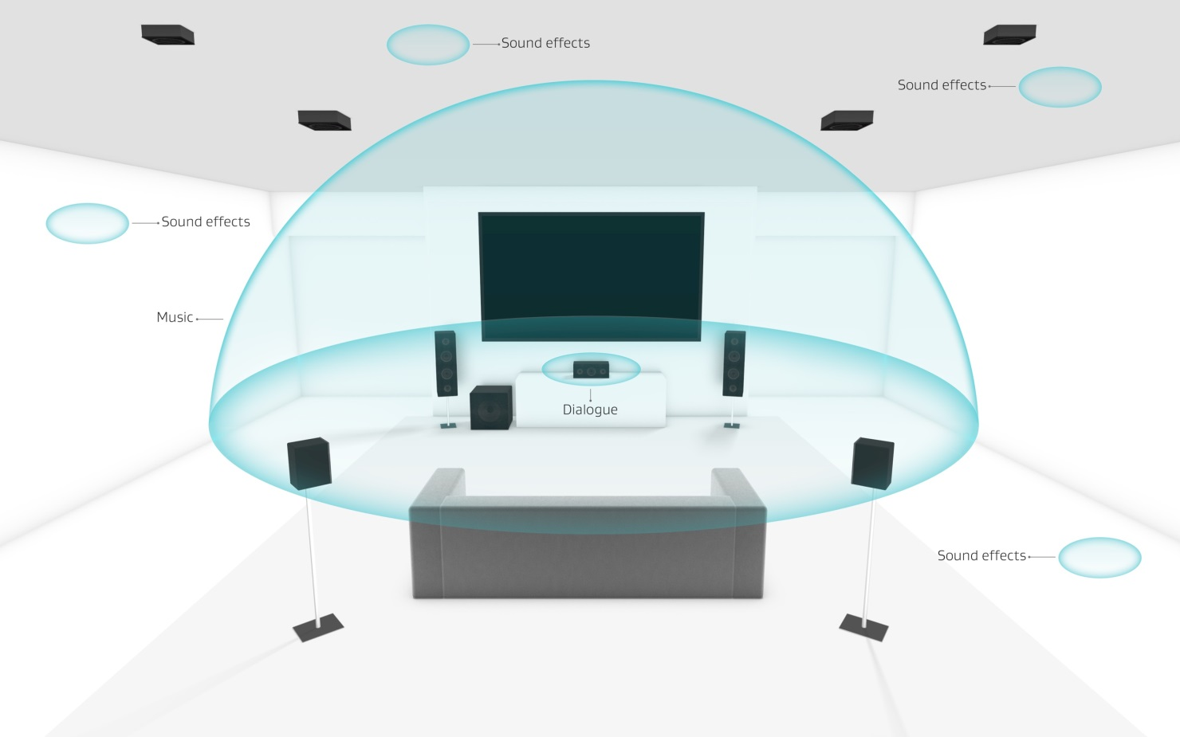

NorDig Audio Sub Group – NGA presentation for NorDig Excom
NorDig Excom meeting 5th October 2017 Stockholm, Sweden
Next Generation Audio – NGA
    Facts for selection of NGA codec
    Discussion and selection NGA
Accessibility & Reach
Personalized
Immersive
Universal delivery
Johan Lindroos, SVT, chair NorDig Audio subgroup

Slide 30
NorDig Audio Sub Group – NGA presentation for NorDig Excom
NorDig Excom meeting 5th October 2017 Stockholm, Sweden
Background information NGA:
Mixed results from questionnaire (winter 2017). Dialogue Enhancement and Accessibility features the broadcasters. Little or no interest in immersive sound with more than 5.1 channels.
NGA can be used in channel based audio, does not need to be object based audio in the beginning. “Soft start” is possible.
Remember that with HEVC, a new Audio codec will prolong for the next 10 – 15 years or even more. A wise decision that consider the future would be great.
Manufacturers need to have truly representative reference test streams and test specifications to be able to validate potential services,
Manufactures wants to have early commitment from broadcasters
NorDig is the leading specification of the world for IRD´s!

Slide 31
NorDig Audio Sub Group – NGA presentation for NorDig Excom
NorDig Excom meeting 5th October 2017 Stockholm, Sweden
Selection alternatives
NorDig ExCom has the intention to select either MPEG-H or AC-4
NorDig ExCom has these choices:
  Select AC-4
  Select MPEG-H
  Select one of the two codecs, but have them both in the IRD spec.; one mandatory and the other optional
  Select AC-4 and MPEG-H and leave selection up to broadcaster/country (as today´s legacy codecs, not intended)
  Wait with decision (NorDig HEVC IRD´s will appear on the market with no NGA and therefore broadcasters will need to use legacy audio codecs as well)
  Select no NGA and stick to legacy audio codecs (no evolution in audio)

Slide 32
NorDig Audio Sub Group – NGA presentation for NorDig Excom
NorDig Excom meeting 5th October 2017 Stockholm, Sweden
Selection alternatives
1 x Mandatory (removal of other)
NGA included as Mandatory
1 x Mandatory + 1 x Optional
Yes
Both included (Operator decides ”á la HE-AAC vs. E-AC-3”)
1 x Mandatory + 1 x Mandatory
NGA
Both Optional (operator may decide)
NGA included as Optional
No
1 x Optional
No NGA text included in IRD spec v3.0

Slide 33
NorDig Audio Sub Group – NGA presentation for NorDig Excom
NorDig Excom meeting 5th October 2017 Stockholm, Sweden
Conclusions from NorDig Audio Sub Group
Select one NGA alternative: Fulfills NorDig Commercial Requirements. New Audio and video TTML. No need for simulcast of legacy audio*. Non-HEVC IRD´s can still be on the market
Wait (NGA maybe later): If NGA is selected later, legacy audio codec still needs to be simulcasted
Both NGA alternatives still in IRD spec, but only optional: Risk of no NGA at all within 5 to 10 years.
No NGA at all, Only legacy codecs: The future for audio will be delayed. NGA may never happen för HEVC IRD´s
Select one NGA codec and have the other NGA codec as optional: More testing might be needed for the manufacturers
TV industry asking for commitment to really use NGA if NGA is mandated for NorDig HEVC IRDs
*) Already existing legacy ”HEVC” IRD´s on the market that does not have NGA, may need simulcast of legacy audio

Slide 34
NorDig Audio Sub Group – NGA presentation for NorDig Excom
NorDig Excom meeting 5th October 2017 Stockholm, Sweden
Key criteria for codec evaluation and discussion
Licensing fee for operators / receiver manufacturers
Status in DVB, specification
Country adoption
Status in other regions (US, Asia, Europe, etc.)
Service situation including trials
Features (special features, etc.)
Eco system
  Production environment support
  Continuity chain support (metadata handling, manufacturers, etc.)
  Headend system support (encoder)
  TV/STB support (product examples if possible or coming products year 2017(?), 2018, 2019, etc. (if possible))
  TV/STB SOC support
  AV Receiver and Soundbar support (product examples if possible or coming products year 2017(?), 2018, 2019, etc. (if possible))
Codec efficiency

Slide 35
NorDig Audio Sub Group – NGA presentation for NorDig Excom
NorDig Excom meeting 5th October 2017 Stockholm, Sweden
Facts and compare: MPEG-H Audio vs Dolby AC-4 – discussion point:
Topic | MPEG-H | AC-4
Cost | A bit unclear, all patent holders not included. Indicative prices: http://www.mpeghaa.com/licensing.html | For IRD´s that already use DD/DD+ Dolby software; no extra cost for AC-4. Non mobile devices: Low vol. $1.20, Typ. vol. $0.85, High vol. $0.50
Codec efficiency | Difficult to compare since listening tests are separately made
Standardisation | ISO/IEC 23008-3 | ETSI TS 103 190-2
Production/Continuity chain/Headend support | Jünger, Linear Acoustics. DS Broadcast, KaiMedia, PixTree. | More products. Ericsson, Harmonic, Elemental, Cisco, Axon, Linear Acoustics, Grass Valley, Arris, Jünger, Tektronix, Imagine, Interra Syst., DekTec, AdTec, TSL.
IRD manufacturer´s support | In Korea: LG and Samsung Chipset: Mstar, Realtek, Analog Devices Manufacturers indicate issues with ”transcoding” | Stronger support from manufacturers. LG, Samsung, Sony, Sagemcom, TP Vision, Vizio. Chipset: Broadcom, HiSilicon, Mstar Semicond., Sigma Design, Novatek, Mediatek, Cadence
AV Receiver/Soundbar Support | Works with most kinds of equipment that has AC-3/E-AC-3/ DTS decoders. Future products with built-in MPEG-H decoders. | Works with most kinds of equipment that has AC-3/E-AC-3 decoders
Country adoption / Service situation | UHD ATSC 3.0 regular DTT service in South Korea | ATSC 3.0 in USA, Mexico, Canada. Trials on air in DTT in France, Spain, Poland, european FTA satellite

Slide 36
NorDig Audio Sub Group – NGA presentation for NorDig Excom
NorDig Excom meeting 5th October 2017 Stockholm, Sweden
Excom 5th Oct 2017 – discussion/view/decision around NGA:
(long looooong discussion, had to stop due to end of meeting)
Conclusion: Excom interest to incl NGA, for mandating (one) NGA,
Not all can not commit today to a specific NGA codec, members will investigate internally
(not all members participated at this Excom meeting)
-> NorDig T: IRD spec v3.0 on hold for this, prepare all other items that been decided by Excom. Excom to come back with info to NorDig T.

