Slide 1


NorDig T report to Excom
NorDig Excom meeting 8th March 2018 Stockholm, Sweden
NorDig Excom Agenda 8th March 2018:
Place: Blu Radisson Hotel, Arlanda in Stockholm, Time: 10:00 to approx. 16:00
1. Agenda and report from previous meeting
2. Organizational matters
2.1. Chairman for NorDig Excom
2.2. Membership situation
2.3. Finance matters, budget for 2018
2.4. Organizational matters
3. Report from NorDig/T
3.1. Next generation Audio for HEVC IRDs
NorDig-T & Audio to present background info,
NorDig Excom to decide for NGA
LUNCH
Continue NGA discussion if need
3.2. Status and report from NorDig/T general
NorDig EPG/EIT exchange file format – ready for Excom to approve
4. Report from Industry
5. Reports from members, DVB and other organizations
6. Any other business
7. Date and place for the meetings in 2018 and 2019
Green Text: text highlighted for Excom (waiting Excom decision/approval)

Slide 2
NorDig T report - Overview specification work
NorDig Excom meeting 8th March 2018 Stockholm, Sweden
Overview NorDig T specification work :
Rules of Operation
  Latest published: RoO v2.5 (published October 2016)
Unified IRD specification
  Latest published: IRD spec v3.0 (published November 2017)
  Audio NGA or not - Excom to decide (separate presentation)
  Video HFR – future (2019) work
Test Plan
  Latest: Test Plan v2.6 (published Dec 2017, now incl Test for HbbTV)
HbbTV
  Maintenance of NorDig’s HbbTV and its test cases
EPG/EIT exchange file format
  Common NorDig file format, TV Anytime based
  Final draft NorDig EPG/EIT B2B exchange file format ready for Excom to approve at this meeting
Website and admin

Slide 3
NorDig T report - Work and subgroups
NorDig Excom meeting 8th March 2018 Stockholm, Sweden
Overview - informative
NorDig T – active
NorDig T subgroups – status
Audio – active (audio related for IRD, Test Plan. Working together w Accessiblity group)
Test – active (Test Plan)
RoO – active (RoO spec)
Accessibility – active (accessibility related for IRD, Test Plan and RoO)
API/PVR – active (HbbTV testing, API+PVR related for IRD, Test Plan and RoO)
EPG/Event exchange metadata – active (common NorDig format for exchange EPG metadata for broadcast and OTT)
SSU – active (SSU Test cases)
CA/CI+/Sec – dormant (CI+ v1.4/v2.x…)
Video – dormat (video related for IRD, Test Plan and RoO)

Slide 4
NorDig T report - Work and subgroups
NorDig Excom meeting 8th March 2018 Stockholm, Sweden
Organisation and status
NorDig T – Per Tullstedt, Teracom
NorDig T subgroups – status
Audio – Johan Lindroos, SVT,
Test – Pasi Toiva, Labwise,
RoO – Des Mac Giolla an Chloig, RTÉNL,
Accessibility – Kjell Norberg, NRK,
API/PVR – Erik Vold, NRK,
EPG/Event metadata – Peter Mølsted, consultant (NorDig tech secretary),
SSU – Per Tullstedt, Teracom
CA/CI+/Sec – dormant (CI+ v1.3, CI+ v1.4)
Video – dormant (Per Tullstedt, Teracom)

Slide 5

NorDig T report - Meeting calendar 2017
NorDig Excom meeting 8th March 2018 Stockholm, Sweden
NorDig T (main group) meeting calendar 2018:
NorDig T, Mon 29th January 2018, webinar, 10:00-15:00 CET
NorDig T, Thu 22th February 2018, webinar, 10:00-16:00 CET
Informative: Excom 8th March 2018 (NGA, EPG/EIT file format)
NorDig T, Thu 5th April 2018, webinar, 10:00-15:00 CET
NorDig T, Tue 15th May 2017, Physical TBD, 10:00-14:00 CET
NorDig T, Tue 19th June 2018, webinar, placeholder, 10:00-12:00 CET
NorDig T, Thu 29th August 2018, webinar, 10:00-14:00 CET
NorDig T, Thu 20th Sep 2018, webinar, 10:00-16:00 CET.
Informative: Excom 4th October 2018
NorDig T, Thu 8th November 2018, webinar, 10:00-14:00 CET
NorDig T, Tue 11th December 2018, webinar, placeholder, 10:00-12:00 CET

Slide 6
NorDig T report – NorDig countries/networks
NorDig Excom meeting 8th March 2018 Stockholm, Sweden
List of Countries using NorDig specifications (outside NorDig members),
Nothing new to report, same as last meeting (same as previous report).
Several IRD manufactures and other mentions that several other territories and DVB networks refers or uses NorDig as basis for their IRD specs (especially “newer” networks). Among reasons seems open spec and content (T2, HbbTV, subtitling etc).
First list:
Country / Network | Status
Turkey DTT | Confirmed via Vestel
Several eastern Europe countries | Indications, not confirmed
Malaysia (blue copy) | Digita
Germany DTT (Media broadcast/TDF) | Based on/reference to NorDig IRD
Georgia DTT | Based on/reference to NorDig IRD (v2.2)

Slide 7
NorDig T report - EPG / Event metadata exchange format
NorDig Excom meeting 8th March 2018 Stockholm, Sweden
(1/2)
Specification of common NorDig EPG/Event metadata exchange format (B2B)
Work done by NorDigT EPG / Event metadata subgroup.
22th January 2018 NorDig T approved the specification technical level,
Final draft now ready and recommend it to Excom for approval and release
The NorDig common EPG/Event metadata exchange format is meant for professional B2B use for all stakeholders in the distribution chain. The specification refers to the NorDig Unified IRD specification and NorDig Roll of Operation
The specification covers EPG / Event program information both for live and On demand content, on all media platforms (broadcast TV, PC, mobile, Tablets, etc.) and various distribution networks (DTT, Sat, internet, etc.) and include rights managements
The NorDig EPG/Event metadata exchange format is based on the TV-Anytime specification (hereafter TVA), latest version, which supports NorDig requirement including rights management and cross platform distribution for both Live TV and On demand
TV-Anytime new version was updated with the NorDig requirements including program rights, ETSI had 21th. September approved the TV-Anytime update, and it is published on ETSI website. http://www.etsi.org/deliver/etsi_ts/102800_102899/1028220301/01.10.01_60/ts_1028220301v011001p.pdf
  Excom view?

Slide 8
NorDig T report - EPG / Event metadata exchange format
NorDig Excom meeting 8th March 2018 Stockholm, Sweden
(2/2)
With the specification is released a implementation package, “Guidelines for implementation” including accompanying information and documents, available for download at www.nordig.org
Guidelines for implementation of NorDig TVA metadata exchange format, is a document meant for broadcasters, other content providers and distributors to facilitate planning and implementation of NorDig common EPG/Event metadata exchange format based on the TV-Anytime standard in their production chain, metadata delivering systems and distribution networks
The package contains technical guidelines for implementation of NorDig TVA EPG metadata XML files, including NorDig Termslist, NorDig deviseType, DeviceOS and RightsType lists, NorDig TVA example scenarios and NorDig TVA metadata XML example files.
And “Guidelines for Last minutes update” - document meant for help to broadcasters and other content providers to facilitate planning and implementation of “last minutes update” in their production chain and metadata delivering systems for live and “correcting” catch-up segmenting
For distribution of EPG/Event metadata is recommend to use the pull technique.
The publisher of EPG metadata should provide a public area where the latest and most updated information is available
NorDig EPG/Event metadata Group maintain the specification and will ensure future updates of the TVA specification to supports future requirements and needs in new TVA releases, and will be able to help and support with expertise and know-how to content providers and distributor

Slide 9
NorDig T report - Test Plan
NorDig Excom meeting 8th March 2018 Stockholm, Sweden
Test Plan
Test Plan v3.0 drafting (among things incl test cases f HEVC IRDs, S2X etc):
  Prel time plan: mid 2018
  Work started, analysing ongoing what test cases needs to be updated
  SSU/SW updating
    Test cases development started for SSU Over-the-Network/Internet (new alt for NorDig IRD spec v3.0), proposal to make test cases possible as classical testing (e.g. via testlab, espec relevant for STB/vertical) but also as manufacture “self declaration” (performed by manufacture and sending test report + result to Operators, typically target iDTV/horizontal) - Excom view?
Test Plan v3.1 – future
  (In case Excom decide for NGA for NorDig Unified IRD spec v3.1, then need for NGA test cases but also industry/manufactures asks for representative test streams)

Slide 10
NorDig T report - Unified IRD spec
NorDig Excom meeting 8th March 2018 Stockholm, Sweden
NorDig Unified IRD spec v3.x.x – potential future version(s):
(no drafting started)
Bug list
  a few number of listed typos, bug list maintained (no one pushing for new IRD release)
Audio: NGA
  if Excom decide for this, separate discussion on this meeting,
  earlier IRD drafting for NGA exist since our v3.0 work that could shorten time for NorDig NGA drafting
CA/CP/Security update for UHD content
  some high level input proposal from Canal Digital, at present time no detail requirement text ready
  CommonInterface v2 (USB), still monitoring status
Video: HFR
  Excom earlier decided for incl of a HFR HEVC IRD profile within 2 years after our first HEVC IRD profile Dec 2017, NorDig T has not started this work, still waiting DVB to finalise its work, earlier planned for 2019.
HbbTV v2.0.2
  HbbTV v2.0.2 for HEVC IRDs (not yet studied)
Excom view?

Slide 11
NorDig T report - HbbTV
NorDig Excom meeting 8th March 2018 Stockholm, Sweden
HbbTV status:
HbbTV organization has created test cases for DRM – Dec 2017
  asked NorDig and others for comments
UK DTT launched HbbTV (v2.0.1/v1.4.1) - Jan 2018
HbbTV v2.0.1 (ETSI v1.4.1) – Feb 2018
  Released a new version that includes Errata #3,
  NorDig (API group) will now study and come with recommendation for next IRD spec
HbbTV organization just released HbbTV v2.0.2 (ETSI v1.5.1) - Feb 2018
  Adds HDR, HFR and NGA support that can be used for HbbTV apps/broadband for IRD supporting HDR, HFR and NGA for broadcast.
  NorDig (API group) will now study and come with recommendation for next IRD spec, could for example be that NorDig MPEG4 IRDs HbbTV v2.0.1 functions while NorDig HEVC IRDs to support v2.0.2.

Slide 12


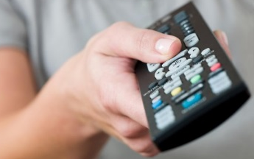
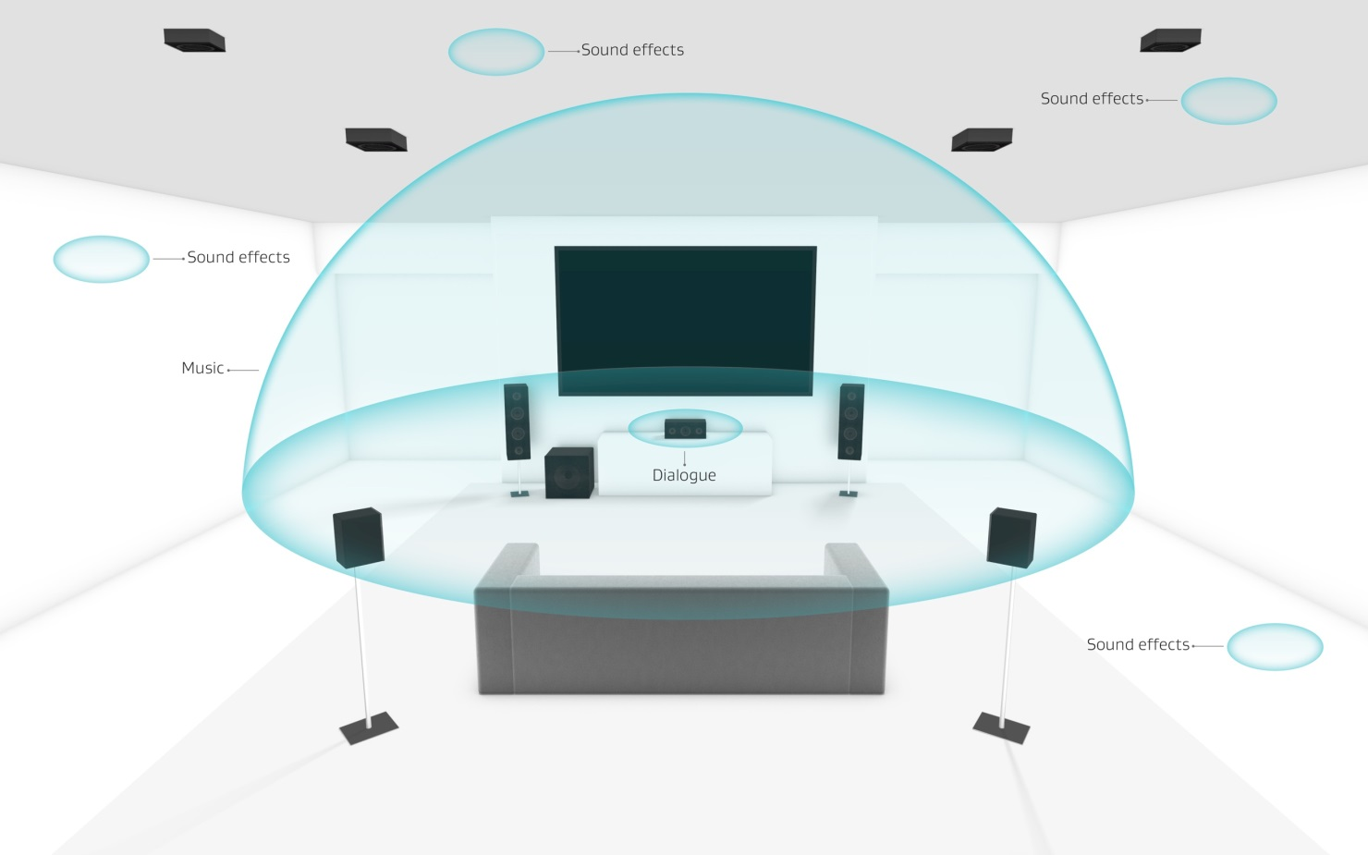

NorDig Audio Sub Group – NGA presentation for NorDig Excom
NorDig Excom meeting 8th March 2018 Stockholm, Sweden
Next Generation Audio – NGA
Separate presentation (see separate powerpoint document)
Presentation includes background info/input from NorDig T/Audio group to help NorDig Excom decision around NGA (no/yes to NGA and which codec).
Presentation is an updated NGA presentation from Excom meeting October 2017
  Facts, compare AC4 vs MPEG-H, some Excom NGA decision alternatives, timeline
NorDig Technical group still propose inclusion of NGA into NorDig IRD spec (for HEVC IRDs) but has still no preferred NGA codec of the two candidates (Dolby AC4 or MPEG-H audio)
Johan Lindroos, SVT, chair NorDig Audio subgroup
Accessibility & Reach
Personalized
Immersive
Universal delivery

Slide 13
NorDig T report –
NorDig Excom meeting 8th March 2018 Stockholm, Sweden
END presentation
NorDig-T report
After here some detailed informative slides
ANNEX
  Annex A: NorDig T mandates 2017-2018 (March 2017)
  Annex B: old slides B2B EPG/EIT exchange file format

Slide 14
NorDig T report –
NorDig Excom meeting 8th March 2018 Stockholm, Sweden
ANNEX A
NorDig T mandates 2017-2018

Slide 15
NorDig T report - mandates and activities (1/4)
NorDig Excom meeting 8th March 2018 Stockholm, Sweden
NorDig T - mandates & items for period 2017-2018 – (approved by Excom March 2017)
RoO
  Maintain and update NorDig RoO.
Test and Test plan
  Maintain and update NorDig Test plan to match IRD spec
    Review and where possible combine similar test cases to make it easier and faster to test
    “minimize” redundant test cases if possible without compromising with test quality, to speed up time for verification testing.
    Update and improve test cases
NorDig Unified IRD spec
  General: Maintain and update NorDig IRD specification (debugging, references to international standards and specifications are up to date)
  Update NorDig IRD spec v3.0 – inclusion of (SFR) HEVC IRD profile during 2017:
    Inclusion of HEVC IRD requirements according with Excom decision and approved HEVC commercial requirements.
    Update guidelines wordings in GUI and translations (mainly related Accessibility and Audio)
    Review and improve IRD’s auto update for network changes
    (depending on Excom decision) SSU update for new possible alternatives
    Handle mix of broadcast and OTT in same channel list
  After NorDig IRD spec v3.0 – prepare and investigate possibility for NorDig HFR HEVC IRD “profile”

Slide 16
NorDig T report - mandates and activities (2/4)
NorDig Excom meeting 8th March 2018 Stockholm, Sweden
continue NorDig mandates & items for period 2017-2018 – (approved by Excom March 2017)
HbbTV
  NorDig HbbTV test and test cases:
    Maintain NorDig developed test cases. Propose new test cases to be developed if needed.
    Update NorDig Test Plan with new/updated HbbTV test requirements (based on ref as much as possible to HbbTV test suit, clarify if HbbTV optional test is mandatory for NorDig Hybrids)
    Contribute to HbbTV org the NorDig developed HbbTV test cases for inclusion in HbbTV standard Test suits (include as much as possible in HbbTV standard test suits).
    Propose budget for NorDig’s HbbTV activities (costs , descriptions, alternatives)
    Supervise and manage any NorDig HbbTV consultancy work (currently Sofia Digital)
  NorDig HbbTV IRD requirements:
    Maintain and update HbbTV requirements (spring 2017 NorDig require HbbTV v2.0.1).
    Investigate possibilities to mandate HbbTV capability for HEVC IRDs, could HbbTV be a similar basic functions as Teletext? HbbTV is the standardized way to deliver UHD content via OTT/broadband.
    Monitor and report HbbTV spec development and usage.
  Investigate additional HbbTV feature and requirements that are of interest for NorDig members (to be confirmed by –T and Excom before detailed proposal and any incl into IRD spec).
  HbbTV implementation:
    Monitor and report HbbTV implementation in NorDig networks and other networks,
    Monitor and report implementation status on IRD side
    Monitor and discuss experience and issues/problems with launching HbbTV services
  HbbTV DRM
    Monitor HbbTV DRM implementation, interest for common DRM requirements
    Monitor technologies and functionality (common encryption, CAM/CI+ etc)
    Review security requirements if needed to ensure handling UHDTV (“4k”) premium OTT content.

Slide 17
NorDig T report - mandates and activities (3/4)
NorDig Excom meeting 8th March 2018 Stockholm, Sweden
continue NorDig mandates & items for period 2017-2018 – (approved by Excom March 2017)
Video, audio, subtitling
  Video codec: NorDig’s first subset of HEVC (DVB’s UHD, HDR&WCG, SFR), incl video processing and I/O (HDMI).
  Video codec: investigate possibility and issues with later adding HEVC HFR support.
  Video: Secure good IRD implementation for mixing/blending of SDR content (HbbTV, menus, subtitling) on top of HDR video.
  Audio NGA (MPEG-H and Dolby AC-4), monitor and get more info about its efficiency and functionality (not yet proposed to specify).
  Audio Monitor and report NorDig members interest for next generation audio (MPEG-H and Dolby AC-4) and formats. Check with industry support for new audio codecs.
  Audio Surround sound, is it possible to reduce the problems with down-mixing, especially investigate broadcast side.
  Subtitling: update requirements for subtitling to handle HEVC services, ensure subtitling support for HDR and/or UHD video for HEVC IRDs.
  Subtitling: investigate new subtitling formats for HEVC IRDs, like EBU TT-D (as stated in HEVC commercial requirements).
  HbbTV: Investigate use and mandate of new codes (HEVC and NGA) for (HEVC) HbbTV/Hybrid IRDs.

Slide 18
NorDig T report - mandates and activities (4/4)
NorDig Excom meeting 8th March 2018 Stockholm, Sweden
continue NorDig mandates & items for period 2017-2018 – – (approved by Excom March 2017)
Accessibility
  Work with harmonization of broadcast and better describe current broadcast for IRD manufactures
  Subtitling, propose updates and new IRD requirements both for normal and hard-of-hearing subtitling, especially for HEVC IRDs.
  Dialogue Enhancement - investigate members interest for this and if they are able to broadcast this
  Audio, propose requirements related to supplementary audio for HEVC IRDs (audio + accessibility group)
  Supplementary Audio (Audio description, Spoken subtitling), investigate how NorDig broadcasters status today broadcast this and how much difference there is around this in NorDig broadcast.
  HbbTV for Accessibility services – investigate how HbbTV can be used for Accessibility and if needed propose changes to IRD and RoO requirements
  Investing new technology and equipment for accessibility services.
CA and CI
  monitor and report CIplus LLP (CI+ v1.4 and v2.0) and DVB work (CI+ v2.0 etc) within these topics to NorDig Excom and Technical group.
  Review security requirements if needed to ensure handling UHDTV (“4k”) premium OTT content (see also HbbTV)
Others
  EPG/Event exchange file format:
    Investigate and decide common (“NorDig standard”) Event Info file format (Broadcast + OTT), interchange between Content Providers to Distributers. Shall support event info and metadata for both broadcast (linear TV) and OTT (linear and on-demand/catch-up).
    Promote use from NorDig members.
    Establish a NorDig specification of common EPG/Event exchange file format based upon proposed TV Anytime.
    Propose how to maintain EPG/Event exchange file format
    Secure TV Anytime update its specification for Right Management and workshop inside NorDig around Right Management
    Guidelines for “last minutes” updates of program start and changes (“last minutes” refers to shortly before but also afterwards for “correcting” catch-up segmenting).

Slide 19
NorDig T report –
NorDig Excom meeting 8th March 2018 Stockholm, Sweden
ANNEX B
NorDig EPG/EIT exchange file format old slides from Excom meeting Oct 2017

Slide 20

NorDig EPG / Event metadata exchange format
Specification of common NorDig EPG/Event metadata exchange format
NorDig EPG / Event metadata subgroup – Status and Planned activities:
TV-Anytime new version updated with the NorDig requirements including program rights
  ETSI had 21th. September approved (with no comments) the TV-Anytime update, and it is now published on ETSI and EBU website. http://www.etsi.org/deliver/etsi_ts/102800_102899/1028220301/01.10.01_60/ts_1028220301v011001p.pdf
  https://tech.ebu.ch/tvanytime
Preparation of NorDig specification of common EPG/Event exchange file format based on TV Anytime updated version
  Independent recommendation document, not included in the IRD specification – because not all stakeholders have interest and know how in the IRD spec.
  The NorDig EPG/Event metadata Group shall maintain the NorDig EPG/Event exchange file format specification in the future, and will help interested parties with expert knowledge in relation to TV-Anytime implementation.
  Final draft expected in December -17.
Peter Mølsted 05.10.2017

Slide 21
NorDig EPG / Event metadata exchange format
NorDig EPG / Event metadata subgroup – Status and Planned activities:
The NorDig common EPG/Event exchange file format specification includes
  Detailed references to the TV-Anytime specification
  NorDig Implementation guidelines – to help broadcasters and distributors for easy implementation
  Termslist with NorDig requirements - including references to Public Schedule to support change of format to TV-Anytime
  XML Examples files - for simple basic and advanced implementation, including rights handling and On demand
  Guidelines for “last minutes” updates of program start and changes (“last minutes” refers to shortly before but also afterwards for “correcting” catch-up segmenting)
  Automatic mapping script / function for handling data from Public Schedule to TV-Anytime and visa a versa
The documentation (guidelines, examplefiles and termslist) will be tuned for all users in the whole EPG value chain.
Workshop / NorDig common EPG/Event exchange file format and Rights management cross networks and platforms to help the stakeholder in the distribution chain - to be arranged.
The workshop will be open for all interested - not only NorDig members - in order to promote the use and understanding of TVAnytime as common exchange format.
Peter Mølsted 05.10.2017

