Slide 1


NorDig T report to Excom
NorDig Excom meeting 7th March 2019 Stockholm, Sweden
Early/preliminary report back from NorDig Excom
Marked as “Excom” in blue text is outcome from this Excom meeting (decision, comments, tasks, feedback etc)
NorDig T (Per Tullstedt) extra report back from NorDig Excom meeting, mainly NorDig T related issues, not the official NorDig Excom report (which will come from our Excom secretary)
NorDig ExCom agenda 7th March 2019:
Place: Clarion hotel, Arlanda in Stockholm
1. Agenda and report from previous meeting
2. Organizational matters
2.1. Membership situation
2.2. Finance matters
2.3. Organizational matters
2.4. NorDig basic rules of communication final version for approval
3. Report from NorDig/T
3.1. NorDig/T status & planning
3.2 NorDig/T mandate y2019-2020
3.3 Specifications:
3.3.1 NorDig Test Plan v3.1 draft010 95% ready – basic presentation
3.3.2 NorDig Test stream (AC4)
3.4 HEVC update (for future NorDig IRD spec v3.2), report back and proposal
3.5 NorDig article in DVB Scene Magazine
4. Report from Industry
5. Reports from members, DVB and other
6. Any other business
7. Date and place for the meetings in 2019, next 7th Oct 2019 10th Oct 2019, 5th March 2020

Slide 2
NorDig T report - Overview specification work
NorDig Excom meeting 4th October 2018 Stockholm, Sweden
Overview NorDig T specification work :
Rules of Operation
  Latest published: RoO v2.5 (published October 2016)
  Update of RoO to v3.1, focus for 2019 but first TestPlan v3.1. Excom (Oct 2018) asked for changing layout to same as IRD spec, most important content for RoO shall be items necessary to avoid misbehavior in IRDs.
Unified IRD specification
  Latest published: IRD spec v3.1 (published October 2018)
  New IRD spec v3.1.1 to be published Q2.2019 (at the same time as new TestPlan v3.1.1) silent approval process incl:
    SI APD change from optional mandatory
    Buglist and clean-up (removal) HFR text
Test Plan
  Latest: Test Plan v2.6 (published Dec 2017, now incl Test for HbbTV)
  Test Plan v3.1 to be published Q2.2019 (at the same time as new IRD spec v3.1.1), silent approval process
    Version to be changed fr v3.1 to v3.1.1
    Test Plan v3.1 incl new updated tests for SSU and therefore proposal withdraw Test Plan v2.6 SSU addendum
  NorDig Test stream, 8 streams for testing NGA/AC-4, to be used together with new Test Plan v3.1.
Video – potential HEVC extension: dynamic HDR and HFR (see also separate slides)
  dHDR Excom will investigate interest and service plan (NorDig T study and wait inputs f Excom)
  HFR postponed
Accessibility
  Status usage of Accessibility services among NorDig members/broadcasters - see separate slides
EPG/EIT exchange file format
  Workshop Nov 2018 and new May 2019.
  Inputs to TV Anytime organisation to update TV Anytime/ETSI specifications
Website and admin

Slide 3
NorDig T report - Work and subgroups
NorDig Excom meeting 7th March 2019 Stockholm, Sweden
Overview - informative
NorDig T – active – Per Tullstedt, Teracom
group – status - chairman
NorDig T subgroups – status
Audio – active – Johan Lindroos, SVT
Test – active – (Pasi Toiva, Labwise) Per T and Peter M has co-chaired in absence of Pasi during autumn 2018/early 2019
RoO – no meeting last period - Des Mac Giolla an Chloig, RTÉNL
Accessibility – active – Kjell Norberg, NRK
API/PVR – active – Erik Vold, NRK
EPG/Event exchange metadata – active - Peter Mølsted, consultant (NorDig tech secretary)
SSU – active – Per Tullstedt, Teracom
CA/CI+/Sec – within NorDig T
Video – active - (Per Tullstedt, Teracom)

Slide 4

NorDig T report - Meeting calendar 2017
NorDig Excom meeting 7th March 2019 Stockholm, Sweden
NorDig T (main group) meeting calendar 2019:
meetings 2019 are booked as shorter (typically 2-3h/meeting) compared to 2018 (5-6h/meeting)
NorDig T, #1, Thu 31st January 2019, webinar, 10:00-12:30 CET
NorDig T, #2, Tue 26th February 2019, webinar, 10:00-14:00 CET
Informative: Excom 7th March
NorDig T, #3, Tue 2nd April 2019, webinar, 10:00-12:30 CET
NorDig T, #4, Tue 14th May 2019, TBD physical/webinar, 10:00-15:00 CET,
NorDig T, #5, Tue 18th June 2019, webinar, placeholder, 10:00-12:30 CET
NorDig T, #6, Tue 27th August 2019, webinar, 10:00-14:00 CET
NorDig T, #7, Tue 24th Sep 2019, webinar, 10:00-16:00 CET.
Informative: Excom 10th October (target RoO v3.2/3.1, IRD spec v3.2, Test Plan 3.2)
NorDig T, #8, Thu 17th October 2019, webinar, 10:00-14:00 CET
NorDig T, #9, Tue 3rd December 2019, webinar, placeholder, 10:00-12:00 CET.

Slide 5
NorDig T report – NorDig countries/networks
NorDig Excom meeting 7th March 2019 Stockholm, Sweden
draft
List of Countries using NorDig specifications (outside NorDig members),
Nothing new to report, same as last meeting (same as previous report).
Several IRD manufactures and other mentions that several other territories and DVB networks refers or uses NorDig as basis for their IRD specs (especially “newer” networks). Among reasons seems open spec and content (T2, HbbTV, subtitling etc).
Country / Network | Status
Turkey DTT | Confirmed via Vestel
Several eastern Europe countries | Indications, not confirmed
Malaysia (blue copy) | Digita
German DTT (Media broadcast/TDF) | Based on/reference to NorDig IRD
Georgia DTT | Based on/reference to NorDig IRD (v2.2)
French DTT/FAVN ?? | Based on/reference to NorDig IRD v??
Italien DTT + Satellite | Partly based on/reference to NorDig IRD (v2.5, RF), partly own requirements (e.g. SI)

Slide 6
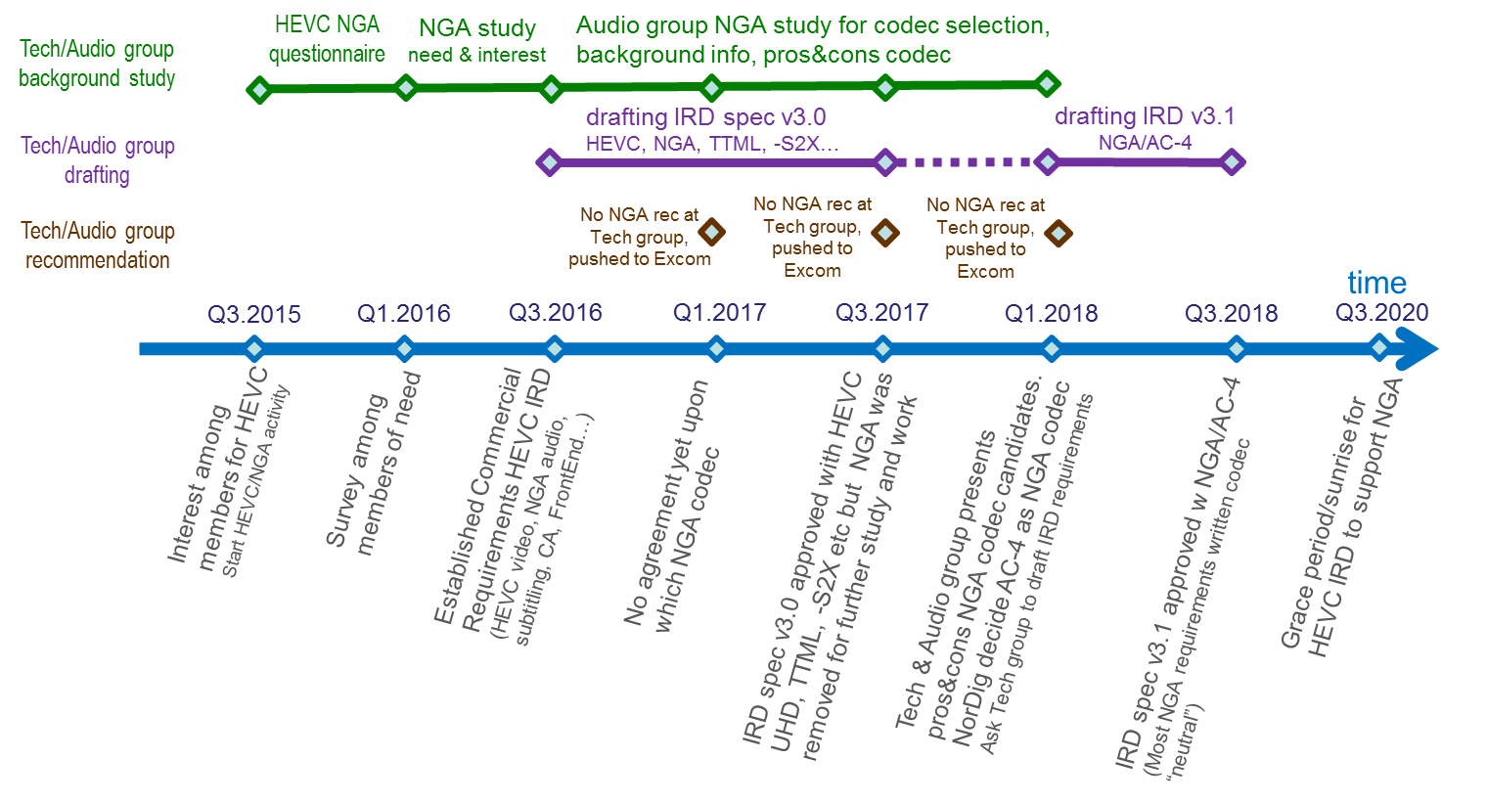
NorDig T report – meeting w FAVN (French HD forum) Nov 2018
NorDig Excom meeting 7th March 2019 Stockholm, Sweden
NorDig T was invited to one French DTT forum (FAVN) meeting Nov 2018. Asked to present info of NorDig process around establishing HEVC IRD, especially about NGA. Johan Lindroos and Per Tullstedt participated and presented short about our NorDig work, however excluded sensitive part from our work.
NorDig - info about the HEVC and NGA process
from NorDig Technical group and Audio subgroup
meeting with FAVN 2018.11.15
NorDig timeline for HEVC and NGA work (here especially NGA part)
NorDig Excom gives mandates to NorDig Tech group and approves proposal from tech group
NorDig Technical group normally prepare drafts and comes w recommendation for selections to Excom who approve/decide
Sometimes Technical group can not agree and pushes decision up to NorDig Excom to decide, this was the case for NGA

Slide 7
NorDig T report - Accessibility report status (1/4)
NorDig Excom meeting 4th October 2018 Stockholm, Sweden
Investigate members usage of accessibility features and how it is signalized within the NorDig area (audio- and subtitle- languages, dubbing, spoken subtitles, sign languages and more). Make an overview.
(Full report in Annex B of this presentation).
Mission
To understand the current state of accessibility services across the NorDig region
To survey the members and gather feedback
To find the pain points in workflows
To find possible pain points in the customer experience
To learn if the technologies specified in the NorDig specification are being used
To find our why certain technologies are used or not used
Questionnaire Jan 2019
Questions asked to what extent the following accessibility / disability services types are used today:
Audio Description (AD)
Spoken subtitles (audio captioning)
Same-language Subtitles (captioning) / Hard-of-Hearing Subtitles (HoH or HHS)
Sign Language Description (video)
Common questions
(Prime time in this questionnaire was defined from 19:00 to 23:00 every day, may differ in countries)

Slide 8
NorDig T report - Accessibility report status (2/4)
NorDig Excom meeting 4th October 2018 Stockholm, Sweden
Conclusions 1
The use of accessibility in broadcast services
More requirements and guidelines for accessibility are expected to be drafted as a result of the EAA and AVMS Directives (EAA = European Accessibility Act and AVMSD = Audio visual media services directive)
It was identified that in many cases, except “Same Language Subtitles”, the provision of Accessibility services was lower than ideal, although always meeting minimum regulations, this may be because of several reasons:
  Broadcasters want everyone to be able to receive their services, so transmission is done the simplest way which may not always be the most spectrally efficient or the best use of available technology.
  There is a perception that legacy receivers may cause problems are preventing broadcasters from launching new services or using new features.

Slide 9
NorDig T report - Accessibility report status (3/4)
NorDig Excom meeting 4th October 2018 Stockholm, Sweden
Conclusions 2
The use of accessibility in broadcast services
Pre-testing of Accessibility features on receivers (typically based upon Nordig testplan) may not always catch all problems and broadcaster use-case. (Some functionality like receiver mix is used outside Nordig area)
Re-testing of new Accessibility features on legacy receivers is likely to be expensive and broadcasters need to have a simple launch program.
Broadcasters tends to use other types of broadcast technology than those recommended in Nordig/DVB, like setting up separate services for new accessibility features.
Broadcasters do not prioritize informing consumers about their accessibility services and how to find them on different IRDs.
Conclusion: We have a common spec, but all broadcasters are doing things their own way.

Slide 10
NorDig T report - Accessibility report status (4/4)
NorDig Excom meeting 4th October 2018 Stockholm, Sweden
Next Steps
The Nordig Accessibility group should prepare a short document explaining the work of the group and ask ExCom members to pass this to their internal accessibility teams.
  Invite them to contribute and ask questions.
  We propose a to set up a best practice workshop with broadcasters, manufacturers and distributors
  Broadcasters who are considering to launch a new or modify an existing accessibility service should contact Nordig Accessibility group.
We should gather information from accessibility groups and broadcasters to understand what their pain points are.
Collaborate with these accessibility groups so they can inform their members how to find/use the existing services.
  We propose a question to external accessibility groups: Should Nordig Broadcasters deliver additional accessibility services even if not all IRDs can receive them initially?
Investigate the implications for streaming services on accessibility
Excom: OK as proposed, but first check/study more members pain points

Slide 11
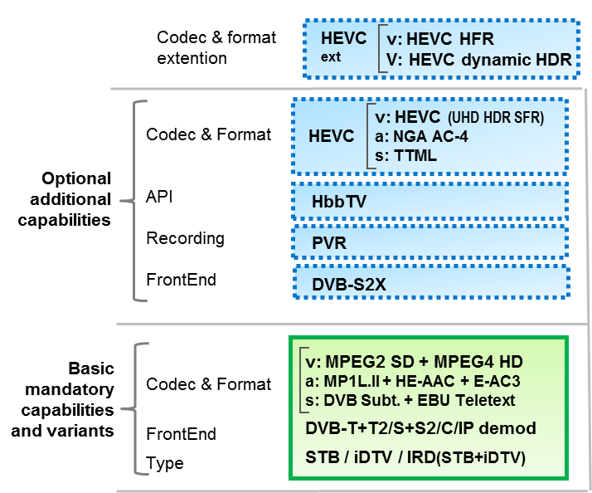

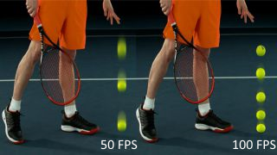

NorDig T report - Video dynamic HDR and HFR
NorDig Excom meeting 4th October 2018 Stockholm, Sweden
Background: Dynamic metadata HighDynamicRange (dHDR) and HighFrameRate (HFR):
  Investigating as Excom asked Oct2018:
    Members interest now 2019 for HFR and/or dynamic HDR (should NorDig add both or one of them?).
    If HFR and/or dynamic HDR is recommended, then should it be included as a new IRD “profile” (two NorDig HEVC “profiles” (basic HEVC and HFR/dHDR HEVC IRD) or extent the existing HEVC IRD “profile” (with a certain grace period)?
    If HFR, should HFR HEVC IRD support both dual PID (backward compatible) and single PID or only single HFR PID?
    If dynamic HDR, how many of DVB three alt to be included? Which one if not all?
  As earlier NorDig based upon DVB spec, only variants inside coming DVB specs is relevant here.
  Earlier proposal to start NorDig work in parallel Spring 2019 drafting HFR + dynamic HDR with goal to a final draft to autumn 2019.
Under discussion today
static HDR (shall support both HLG10 and PQ10)
SFR up to 50 fps e.g. 1080p50fps
dHDR
HFR

Slide 12
NorDig T report - Video dynamic HDR and HFR
NorDig Excom meeting 4th October 2018 Stockholm, Sweden
Dynamic metadata HDR (dHDR)
  DVB status: still under progress, prel plan finalise drafting to summer 2019
  DVB is preparing 3 dHDR technologies/formats and the plan is to incl all of them:
    Technicolor/Philips SL-HDR2 (ETSI TS 103 433-2, SMPTE ST 2094-20 Philips & 2094-30 Technicolor formats)
    Samsung HDR10+ (SMPTE ST 2094-40)
    Dolby Vision (ETSI TS 103 572, SMPTE ST 2094-10)
  (Note: all three dHDR candidates been present in NorDig-T/video subgroup meetings)
  All 3 dHDR formats are backward compatible for static HDR/PQ10 IRDs to receive and display (up to broadcaster/colourist to ensure performance for static HDR HEVC IRDs).
  NorDig-T/video has not (yet) compared the 3 formats (pros&cons, relative efficiency, IPR costs…).
  dHDR already used in some OTT/Online streaming services (e.g. Netflix, Amazon, Apple, multiple formats used) and available in some TV sets (even if it might not yet impl as coming DVB signalling for dHDRs). (Note, we can not expect that current dHDR impl on TV sets will work for broadcast usage or DVB DASH streaming).
  Conversion from one dHDR format to another, could harm “artistic intension” from colourist, content owner/broadcasters may not allow this, no “approved” method today.
  The dHDR metadata is reasonable low extra capacity and supports of “simulcast” several dHDR metadata formats for one and the same video stream, (similar as simulcrypt) (not yet tested)
HighFrameRate (HFR) 100fps
  DVB status: has already published HFR in latest DVB/ETSI specs
  DVB has specified requirement text for HFR,
    both dual PID and single PID solution.
    Dual PID HFR is (intended to be) backward compatible for HEVC SFR IRDs while single PID HFR non-backward compatible for SFR IRDs. (Single PID solution could be more bandwidth efficient and the more likely the alternative for OTT/Online streaming).
  “No” information available (yet) for NorDig of how bandwidth efficient relative each other the dual and single PID alt are.
  Does not (yet) come for “free” in TV sets due to inclusion for other non-broadcast purposes (streaming services or packet media/bluray). Would require higher video processing and higher bandwidth HDMI

Slide 13
NorDig T report - Video dynamic HDR and HFR
NorDig Excom meeting 4th October 2018 Stockholm, Sweden
Members view (broadcasters and operators)
  SVT, DR & NRK:
    dHDR, right now more interest than HFR and UHD,
    dHDR could make big difference espec for drama production,
    dHDR roll-out could for example be first via OTT streaming and later within broadcast,
    dHDR too early today to select one of the formats,
    dHDR could accept that this would be optional tool for IRD (initially), (but big interest among broadcasters for dHDR than NorDig should mandate dHDR w grace period)
    HFR_{100fps} could accept wait and revisit topic later, a bit challenging to produce right now
    backward compatibility is of interest.
    interesting TV format: 1080p50fps dHDR
    SVT/Lars typical future production could be: drama 2160p25fps dHDR and sports/general 1080p100fps SDR/HDR.
  TDC: follow broadcasters, CD: some interest depends upon broadcasters
  Preferebly if Nordic & Irish broadcasters could agree upon a common dHDR format (for production). Propose to make a study around dHDR to find a common dHDR among broadcasters.
  If dHDR format, then the decision of which dHDR format should be done productions side and not on the IRD side
new tools w HEVC: NorDig broadcasters interest (2017 NorDig work)
Figure: data from NorDig T/video HEVC study 2017 and questionnaire.
Note about FullHD, refers to as sub-resolution UHD BT2100
?
10bits
HDR
WCG
dHDR
HFR
FullHD
1080p
UHD
2160p

Slide 14
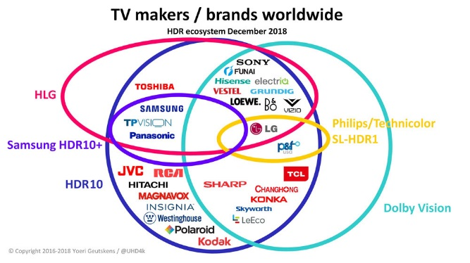
NorDig T report - Video dynamic HDR and HFR
NorDig Excom meeting 4th October 2018 Stockholm, Sweden
Industry view
  dHDR, some TV manufacture prefer dHDR is optional feature in NorDig.
  dHDR, if NorDig would add dHDR (as mandatory), than most manufactures request only one dHDR format and not require all 3 formats, similar NGA
    Samsung, TP Vision prefer markets decide themselves
  dHDR already in some TV sets, already used for some services, smaller step than HFR
  HFR is today too early and not mature enough
  HFR, single or dual PID important question for IRD manufacturers.
  HFR, manufacturers could be ready HFR (within a reasonable time frame 1.5-2y), then typically (initially) in HighEnd models, but needs real/committed service plans from broadcasters.
    HFR should then be either an optional feature for current HEVC IRD “profile” (i.e. extra capability) or a separate NorDig HFR HEVC IRD “profile”.
  dHDR &/or HFR, manufactures asks for service plans/roll-out plans from broadcaster to consider this.
  NorDig should collect from members/broadcasters and regular present/provide service plans and intensions to the Industry.
Source: https://www.flatpanelshd.com/focus.php?subaction=showfull&id=1543913516

Slide 15
NorDig T report - Video dynamic HDR and HFR
NorDig Excom meeting 4th October 2018 Stockholm, Sweden
Summary mini-study and proposal NorDig HEVC extensions HFR + dynamic HDR:
dHDR
  DVB still working, three formats,
  no result f comparing, coming/already in several TV sets to some degree (not as DVB specified),
  Service plans in Europe: broadcast: no info, several considering, live broadcast trials been made in France and Spain. (OTT already on-air)
  NorDig Broadcasters: high interest from broadcasters (for usage in some program events, like drama productions)
  Proposal (from NorDig video, not one common view inside video group):
    NorDig should collect from members/broadcasters service plans and intensions and (regularly) present it the Industry - AP Olli/Excom to investigate w members interest and service plans
    IRD spec/TestPlan/RoO spec: either (Excom to choose one of below or something else)
      wait (do nothing now) or
      NorDig T/video group study more, report back in Oct 2019 or
      to Oct 2019 prepare proposal for IRD spec update and then that only edit a minimum of text referring to DVB specifications dHDR (not select one of DVB’s dHDR format), as an optional capability to existing HEVC IRD “profile” (not as new NorDig dHDR IRD “profile”), update other relevant IRD parts to handle dHDR (like HDMI EDID handshaking and mapping, SI etc), clean up IRD spec <this would partly conflict with NorDig commercial requirement of avoiding toolbox>
  Excom: if possible study more (not highest prio before Olli/Excom report back members plans/interest, too early to start drafting)
  Excom: Commercial requirement should be updated (old commercial requirements used during HEVC & NGA process 2017-2018)
HFR
  DVB finalized specs, two alts (single and dual PIDs),
  no result yet comparing efficiency, as now big/costly item for IRDs,
  Service plans in Europe: not aware of
  NorDig Broadcasters: low interest right now
  Proposal (from NorDig video): postpone 2y then revisit (clean up IRD spec)
  Excom: OK as proposed, postpone 2y then revisit (clean up IRD spec)

Slide 16
NorDig T report - HbbTV and NorDig EPG/Event info
NorDig Excom meeting 7th March 2019 Stockholm, Sweden
HbbTV status:
NorDig IRD spec v3.1: HbbTV v2.0.2 (latest available)
NorDig Test Plan: test tasks now updated in Test Plan v3.1 proposal
NorDig HbbTV meeting at Digita’s HbbTV plugfest March 2019
NorDig EPG group and Event exchange file format:
Keep TV Anytime spec up to date - developed six NorDig proposals for updated of TVAnytime spec. final reviewed at ETSI, expected release end March 2019.
Updated of guidelines
Work to promote / help impl and use of NorDig EPG/event file format
Open workshop Nov 2018 at TV2DK in Copenhagen, successful
Next open workshop 16. May 2019 at TV2 Norway in Bergen
Status of implementation and use of NorDig common EPG/Event metadata exchange format, done or in process: NRK, TV2DK, TV2NO, DR, TDC, Red Be Media.
Excom: OK, noted

Slide 17
NorDig T report - Test Plan (1/2)
NorDig Excom meeting 7th March 2019 Stockholm, Sweden
Test Plan v3.1 final draft proposal:
  Now draft010 is 95% ready (presented at Excom meeting)
  (Test group chair Pasi Toiva been too buzy, not yet “approved” this candidate)
  MAJOR update of most parts, from TestPlan v2.6 to this v3.1, (text update, ref, new requirements etc)
    Intro, layout etc: fully updated, new wordings from IRD spec used (variants and extra capabilities)
    FrontEnd – fully updated (incl optional parts like -S2X)
    Video/HEVC – fully updated
      One test task, 6:4 Colorimetry, that in v2.6 been “ToBeDefined” still in v3.1 “ToBeDefined” due to complexity and time to draft, no concreate proposal presented, proposal to wait with this.
    Audio/NGA – new NGA updated
      Legacy audio test tasks not fully updated regarding ref and other minor changes
    Subtitling/TTML – fully updated
    SSU/SW updating – fully updated
    Interfaces – fully updated
    PVR – partly updated
      Updated tests’ requirements for v3.1, but not yet incl HEVC elements into test procedures, could be action for next update.
    HbbTV – fully updated
    SI, menus, user pref. settings
      Still under development, basic proposal today
    Annex A: NorDig Network Custodians list – proposed to be separate document (easier to update)
  Remaining (typos, x.references, SI)
    Typos, cross.ref. check, SI and list of testlabs/test custodians.
    Approx 3-4w more to finalise last parts
  Proposal: finalise draft (3-4w), e-mail distribute to Excom for silent approval process (2w to comment, if no comments (excl typos) than approved).
  Excom: OK as proposed, but take more time if needed. Change version to v3.1.1 (since fast update of IRD spec to v3.1.1). Combine (silent approval + publication) TestPlan v3.1.1 and IRD spec v3.1.1 and new Test stream. Annex A can be separate document or info within webpage.

Slide 18
NorDig T report - Test Plan (2/2)
NorDig Excom meeting 7th March 2019 Stockholm, Sweden
NorDig Test streams
  NorDig has “no” test stream since past (except LTE reference signal for testing interference)
  New NorDig Test stream for NGA/AC-4 created (Dolby)
    Plan to be published at NorDig website, ~370MB, approx. 8 MPEG2 TS streams with V/A plus all SI, basic parts for testing NGA/AC-4, created by Dolby, license: Creative CommonsAttribution-NonCommercial-NoDerivatives
  Proposal is that Test stream package is published at same time as new Test Plan v3.1.
  Our new NorDig test stream could need some updates/corrections when more feedback.
  Asking Excom for a simple process to updated test stream for “smaller” corrections & updates or should approval process be via Excom approval (meeting or e-mail silent approval)
  Excom: OK, if possible remove Dolby logo. Future minor update/corrections can handle inside NorDig T group.
Self-certification SSU Testing – OTN and USB SSU Approved by Excom Oct 2018 – no change
  Group finds this document up to date

Slide 19
NorDig T report - Unified IRD spec v3.1.1 (1/2)
NorDig Excom meeting 7th March 2019 Stockholm, Sweden
NorDig Unified IRD spec v3.1 Oct 2018 (NGA/AC4, HbbTV v2.0.2, HEVC Sec):
Two items (ECP and APD) needed more time to sort out, pushed Excom March 2019 meeting
  AP for NorDig-T/Audio to investigate further why not mandate APD and recommend for ECP.
  Excom to decide if or not change these two from optional to mandatory and then if release a smaller update v3.1.1
CA/Security – CI+ Enhanced Content Protection (ECP):
  Background:
    Requirement text included for CI+ ECP requirements, but as optional
    part Industry against mandating (Samsung, Vestel), part/most Industry can accept mandating,
      Samsung view is that ECP is a platform specific issue (similar as CAS & DRM)
    Italy UHD DTT spec mandates CI+ ECP
    Technical group have highlighted that this could potentially be required from Content Owners (eg MovieLabs) for more or less all payTV HEVC services (not just UHD), since HEVC comes with new TV format
  Excom Oct 2018 – keep ECP as optional for v3.1, Excom will ask members (espec operators) view of mandating this and if needed for members Excom release (March 2019) an update of IRD spec v3.1.1
  NorDig T and Secretary:
    Secretary (Kari E.) has checked with all NorDig operators for their view (should NorDig change to mandate or keep as optional), no report back from Operator asking NorDig to change from today’s optional.
    NorDig T recommend to keep as optional/Excom to decide.
  Excom: OK as proposed (keep as optional)

Slide 20
NorDig T report - Unified IRD spec v3.1.1 (2/2)
NorDig Excom meeting 7th March 2019 Stockholm, Sweden
NorDig Unified IRD spec v3.1 Oct 2018 (NGA/AC4, HbbTV v2.0.2, HEVC Sec):
Two items (ECP and APD) needed more time to sort out, pushed Excom March 2019 meeting
Audio – NGA/AC-4 Audio Preselection descriptor (APD)
  Background:
    NGA/AC-4 included as mandatory for NorDig HEVC IRDs (grace period until July 2020)
    NorDig NGA/HEVC IRDs shall be able to separate & have separate settings for AD and spoken subtitling
    all necessary NGA/AC-4 signalling included, BUT the APD is included as optional for HEVC IRDs,
    APD improves e.g. selections among Accessibility audio. APD is the DVB standardised way to differentiate AD and Spoken Subt and to incl text labels.
    Dolby: APD is recommended by Dolby, as Dolby can see it most IRDs likely to support APD by mid 2020.
    members wants to mandate, some TV manufactures asks for optional
      reports indicates that HighEnd HEVC TV sets seems to support APD, while LowEnd/entry level HEVC TV sets seems not yet support this.
  Excom Oct 2018 – decided to keep APD optional for v3.1, BUT with clear intention to mandate APD (with grace period until 1 July 2020) at Excom meeting March 2019 into update IRD spec v3.1.1.
  NorDig T
    Most (broadcaster and operator) members for mandating APD and most IRD manufactures can accept mandating APD (from 1 July 2020)
      One IRD manufacture (Samsung) is investigating internally
    Recommend that it is OK to mandate APD and grace period (until July 2020) is necessary.
    The prepared new NorDig AC-4 test stream includes APD (if Excom approves it today)
  Excom: OK as proposed, mandate APD (w grace period same as AC4), prepare a release of ipdate of IRD spec “asap” v3.1.1 (APD + buglist and a joint package w TestPlanv3.1.1)

Slide 21
NorDig T report - Unified IRD spec, after v3.1
NorDig Excom meeting 7th March 2019 Stockholm, Sweden
NorDig Unified IRD spec future – “v3.2” proposals:
v3.1.1 “asap” together w new TestPlan v3.1.1.
  APD change from optional to mandatory (w grace period)
  Bug list items (incl HDCP)
  Clean up HFR from spec (v3.1 indicates that HFR will be coming)
“v3.2” future proposals – wait for Excom decision
  General (debugging/typos etc)
  Video: dynamic HDR and/or HFR (dHDR wait for Excom decision, HFR postponed)
  CA/CP/Security (potentially CI v2)
  Audio – none
  Subtitling – none
  HbbTV - none
  FrontEnd – none
  SSU - none
  PSI/SI, menus etc…
  Others?

Slide 22
NorDig T report - mandates and activities (1/4)
NorDig Excom meeting 7th March 2019 Stockholm, Sweden
NorDig T – PROPOSAL mandates & items for period 2019-2020
New Excom approved mandates:
General: Keep IRD, RoO and Test Plan in line with each other
RoO
  Maintain and update NorDig RoO - focus for 2019 RoO v3.1
  change layout to same as IRD spec, focus for RoO on items necessary to avoid misbehavior in IRDs.
Test and Test plan
  Maintain and update NorDig Test plan to match IRD spec
    Review and where possible combine similar test cases to make it easier and faster to test
    “minimize” redundant test cases if possible without compromising with test quality, to speed up time for verification testing.
    Update and improve test cases
NorDig Unified IRD spec
  Maintain and update NorDig IRD specification
    debugging, references to international standards and specifications are up to date)
  Other items that could be studied:
    Review and improve IRD’s auto update for network changes?
    Handle mix of broadcast and OTT in same channel list? (similar to or based upon DVB-I)
    Dynamic metadata HDR HEVC video – study mode (wait drafting to Excom decision)
Excom: OK with updates above.

Slide 23
NorDig T report - mandates and activities (2/4)
NorDig Excom meeting 7th March 2019 Stockholm, Sweden
continue NorDig mandates & items for period 2019-2020
Video, audio, subtitling
  Video codec: NorDig’s first subset of HEVC (DVB’s UHD, HDR&WCG, SFR), incl video processing and I/O (HDMI).
  Video codec: investigate issues with adding HEVC HFR support, check with Industry, make proposal
    Questions that needs to be prepared by NorDig:
      two NorDig HEVC “profiles” (SFR HEVC + HFR HEVC) or one (HEVC that supports HFR),
      HFR both dual PID (backward compatible) and single PID or only single HFR PID,
      dynamic HDR how many of DVB three alt to be included?
      Dynamic metadata HDR – study mode (or wait), wait Excom decision before drafting IRD spec update
      (HFR postponed 2y (2021), then check interest)
  New Video codec: If Excom decide, propose tech requirements for HEVC HFR which incl also dynamic HDR, target ready to Oct 2019
  Video: Secure good IRD implementation for mixing/blending of SDR content (HbbTV, menus, subtitling) on top of HDR video.
  Audio NGA (Dolby AC-4), monitor DVB and Dolby specifications and recommendations
  Audio: monitor evolution immersive audio and object based audio.
  Audio: if it is possible supports with tests and trials of NGA audio (both basic NGA and more advanced NGA).
  Subtitling: monitor DVB specifications (TXT subt, DVB Subt, TTML)
  HbbTV: Investigate use and mandate of new codes (HEVC and NGA) for (HEVC) HbbTV/Hybrid IRDs.
Excom: OK with updates above.

Slide 24
NorDig T report - mandates and activities (3/4)
NorDig Excom meeting 7th March 2019 Stockholm, Sweden
continue NorDig mandates & items for period 2019-2020
HbbTV
  NorDig HbbTV test and test cases:
    Maintain NorDig developed test cases. Propose new test cases to be developed if needed.
  NorDig HbbTV IRD requirements:
    Maintain and update HbbTV requirements
    Monitor and report HbbTV spec development and usage.
  Investigate additional HbbTV feature and requirements that are of interest for NorDig members (to be confirmed by –T and Excom before detailed proposal and any incl into IRD spec).
    Investigate DVB-TA watermarking, impact V/A and possibility to use for STB solutions where STB do not support HbbTV (STB bypass)
  HbbTV implementation:
    Monitor and report HbbTV implementation in NorDig networks and other networks,
    Monitor and report implementation status on IRD side
    Monitor and discuss experience and issues/problems with launching HbbTV services
  HbbTV DRM
    Monitor HbbTV DRM
    Review security requirements
Excom: OK

Slide 25
NorDig T report - mandates and activities (4/4)
NorDig Excom meeting 7th March 2019 Stockholm, Sweden
continue NorDig mandates & items for period 2019-2020
Accessibility
  Work with harmonization of broadcast and better describe current broadcast for IRD manufactures
  Subtitling, propose updates and new IRD requirements both for normal and hard-of-hearing subtitling.
  Create document explaining the work of the group, (which ExCom members to pass this to their internal accessibility teams). Gather information from accessibility groups and broadcasters to understand what their pain points are.
  Set up a best practice workshop with broadcasters, manufacturers and distributors
  Investigate the implications for streaming services on accessibility
  HbbTV for Accessibility services – investigate how HbbTV can be used for Accessibility and if needed propose changes to IRD and RoO requirements
  Investigate benefits with NGA for accessibility.
CA and CI
  monitor and report CIplus LLP (CI+ v1.4 and v2.0) and DVB work (CI+ v2.0 etc) within these topics to NorDig Excom and Technical group.
  Review security requirements
EPG/Event exchange file format:
  Promote use for NorDig members for example via open workshops to support promoting and implementation of NorDig TVA format.
  Maintain NorDig specification of common EPG/Event exchange file format and Guidelines, to be inline with TA Anytime specs
  Common solution and recommendations about unique program ID’s.
  Translation of genres between Nordic and Irich language and English.
  Transform NorDig TVA XML schemas to JSON and developing guidelines for using TVA with JSON (on request from developers)
Excom: OK

Slide 26
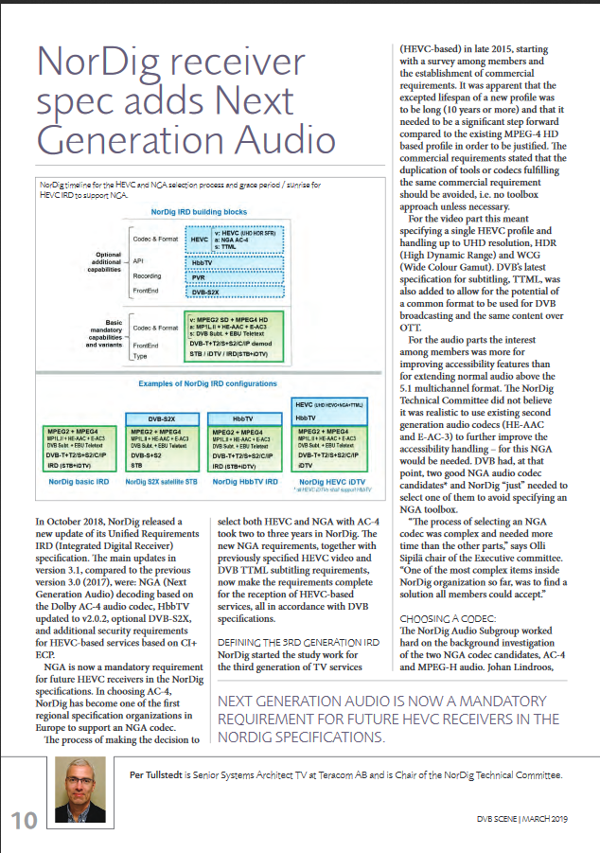
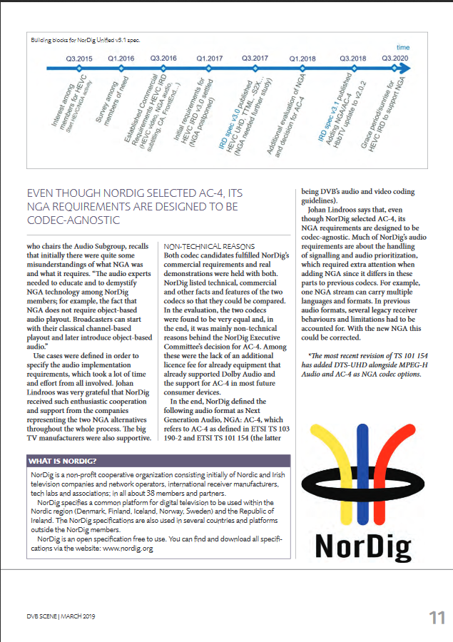

NorDig T report – DVB Scene Magasine
NorDig Excom meeting 7th March 2019 Stockholm, Sweden
NorDig was invited in Nov2018 by DVB Scene Magazine to contribute with an article around our NorDig work with NGA and 3rd generation IRDs (HEVC, NGA, TTML, S2X…) to coming paper in March 2019 to DVB World Conference.
Many thanks to Peter Molsted, Johan Lindroos, Kari Eriksson, Ingve Bjerknes, Olli Sipilä and Per Tullstedt for the help contributing (with support from Industry Elfed, Richard and David)!!

Slide 27
NorDig T report –
NorDig Excom meeting 7th March 2019 Stockholm, Sweden
END presentation
NorDig-T report

