Slide 1

Application Discovery over Broadband (ADB)
Phase 2
HbbTV Webinar Series
October 21, 2020
Notes:
Klaus is given moderator function to share screen / control slides

Slide 2
Introduction and Motivation for ADB2
Klaus Merkel, Senior Engineer,
Institut für Rundfunktechnik (IRT) merkel@irt.de

Slide 3


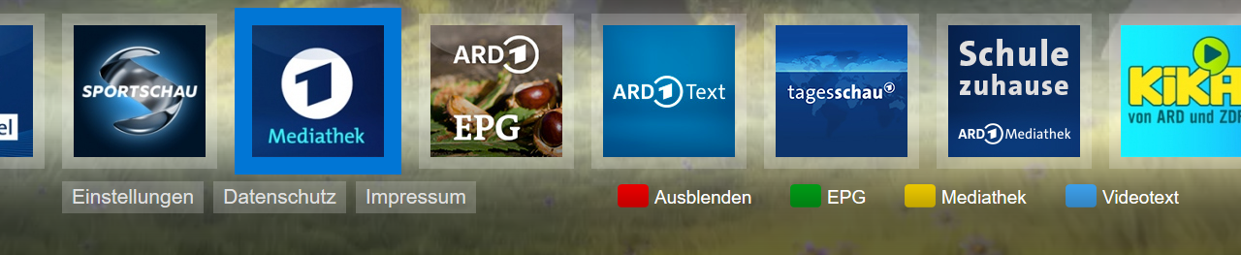
Regular usage of HbbTV
The AIT contained in the DVB multiplex carries the signalling info for HbbTV.
Each channel has ist own AIT to signal its individual HbbTV application
AIT contained
in broadcast
regular HbbTV usage

Slide 4

Usage scenarios for ADB
AIT suppressed in
cable headend
AIT contained
in broadcast
case for ADB 1
TV does channel selection
(„knows current channel“) but AIT missing
regular HbbTV usage

Slide 5

Usage scenarios for ADB
AIT suppressed in
cable headend
AIT contained
in broadcast
HDMI connection
case for ADB 1
TV does channel selection
(„knows current channel“) but AIT missing
regular HbbTV usage
case for ADB 2
TV does no channel selection
(„does not know current channel“) and AIT missing

Slide 6
The Role of broadcast components in HbbTV
Besides application discovery (AIT), HbbTV makes also use of broadcast components like stream events and timelines
Signaling Information | Purpose | Use Cases
Application Discovery (AIT) | Used by the terminal to find and launch the application | Required for any use of HbbTV
Stream Events (HbbTV1/2) | Deliver messages from the broadcaster to the application via the broadcast path | Push notifications to applications
Timeline (HbbTV2) | Used by the application to synchronize application content broadcast content | Applications with content-related overlays, supplemental audio or video

Slide 7
Deficits when broadcast components are lost
Loss of broadcast components leads to loss of HbbTV functionality that relies on it
These problems motivated the creation of HbbTV Application Discovery over Broadband
Signaling Information | Implications of Loss | Workaround
Application Discovery (AIT) | Television will not launch a broadcaster application | Application Discovery over Broadband, Phase 1 or 2
Stream Events | Stream event data must be delivered via broadband, imposing additional latency and infrastructure cost | Application Discovery over Broadband, Phase 2
Timelines | Application content cannot be synchronized to broadcast content (only some use cases require this) | Application Discovery over Broadband, Phase 2

Slide 8

ETSI specs resulting of HbbTV work on ADB
TS 103464 v1.1.1 (Sept. 2016)
ADB Phase 1
[now obsolete]
TS 103464 v1.2.1 (May 2020)
ADB Phase 1 (including updates)
ADB Phase 2

Slide 9
Application Discovery Over Broadband Solution / Technical
Joe Winograd, CTO
Verance jwinograd@verance.com
Notes:
Klaus gives Joe control

Slide 10
Application Discovery over Broadband (ADB)
Phase 1: DVB Triplet
ADB Phase 1 solution is applicable to live viewing from a DVB transmission
It uses the centralized DNS service hbbtvdns.org to convert the DVB triplet into the hostname of a Broadband AIT Server
The terminal retrieves an AIT from the Broadband AIT Server, which enables application retrieval from an Application Server (steps 1-4 below)
Originating Broadcaster
VIDEO
Local Broadcaster
VIDEO
AUDIO
AUDIO
TIMECODE
TIMECODE
HDMI
EVENTS
EVENTS
TERMINAL
VIDEO
AIT
DISTRIBUTION
AIT
VIDEO
AUDIO
MUX
AUDIO
APP
TIMECODE
DVB TS
IPTV
TIMECODE
EVENTS
DVB TS
EVENTS
AIT
DVB
AIT
TRIPLET
1
AIT URL
BROADBAND AIT SERVER
2
AIT
3
APPLICATION URL
BROADBAND APP SERVER
4
APPLICATION

Slide 11
Application Discovery over Broadband (ADB)
Phase 2: Watermarking
Watermarking extends use cases for Application Discovery over Broadband to include:
  Application discovery via HDMI and other non-DVB interfaces
  Support for live, time-shifted, and on-demand viewing
  Timecode
  Stream Events
For ADB Phase 2, use of audio watermarking is required and video watermarking is optional
VIDEO+WM
Originating Broadcaster
Local Broadcaster
AUDIO+WM
VIDEO+WM
TIMECODE
EVENTS
AUDIO+WM
AIT
TIMECODE
TERMINAL
EVENTS
HDMI
VIDEO+WM
VIDEO
WATERMARK EMBEDDER
VIDEO+WM
MUX
AIT
DISTRIBUTION
HDMI
AUDIO+WM
AUDIO
AUDIO+WM
IPTV
TIMECODE
APP
TIMECODE
DVB TS
DVB TS
EVENTS
EVENTS
DVB
WM DATA
AIT
AIT
1
AIT URL
BROADBAND AIT SERVER
2
AIT+DVB-SI
3
APPLICATION URL
BROADBAND APP SERVER
4
APPLICATION

Slide 12
ADB Capabilities Summary
 | TV Interface Support |  | Discovery over Broadband
 | DVB w/ missing DVB-SI | HDMI or other non-DVB | Application | Timeline | Stream Events
Phase 1 | ü |  | ü
Phase 2, audio watermark only | ü | ü | ü | ü- | ü-
Phase 2, audio and video watermarks | ü | ü | ü | ü | ü
ü : Supported
ü- : Supported with reduced functionality

Slide 13
Questions?
Notes:
Joe/Klaus can answer a few questions that have been submitted. Please stop around 6:27am/15:27 CET and move to next section.
(AT THIS TIME KLAUS TAKES BACK CONTROL OVER SLIDES)

Slide 14
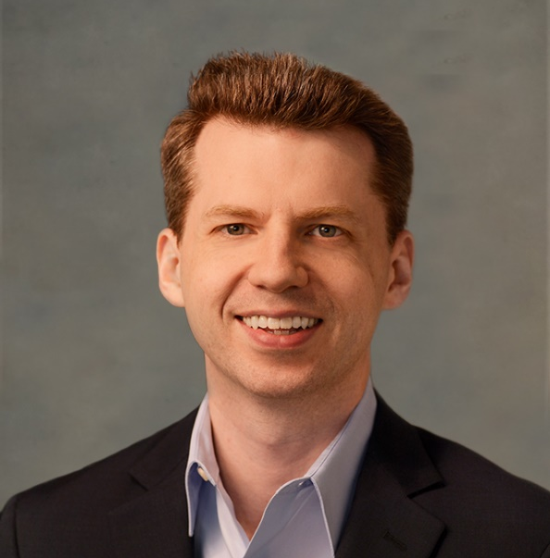
Industry Perspectives on ADB2
U.S.
Jason Patton
Verance
jpatton@verance.com
Notes:
Joe or Klaus controls slide for Jason

Slide 15


Watermark Embedding & Detection
U.S. Broadcasters
Embedding the Watermark
Television Manufacturers
Detecting the Watermark
ABC/Disney
Capitol
CBS
Cox
FOX
Graham
Gray
Hearst
Meredith
NBC
News-Press & Gazette
PBS
Pearl
Scripps
Sinclair
Tegna
Telemundo
Univision
5 successful lab integrations across different TV manufacturers and chip makers
3 successful field integrations in different U.S. cities across different TV manufacturers
Recognized by standards organizations in the U.S. as an essential feature

Slide 16
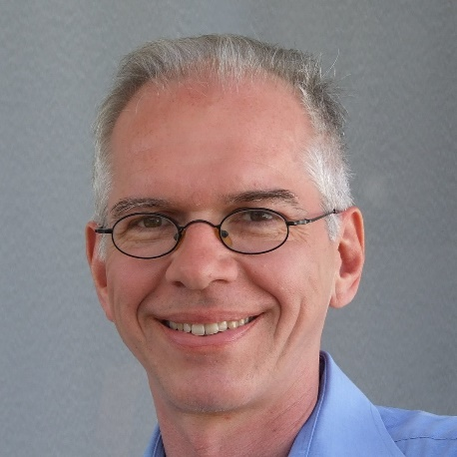
Industry Perspectives on ADB2
Germany
Klaus Merkel
IRT
merkel@irt.de
Notes:
Klaus has control of slides by now

Slide 17
ADB1 perspective in Germany
Cable operators refusing to retransmit AITs for ARD/ZDF channels had been one of the triggers to start ADB1 work
meanwhile AIT retransmission happens due to new contracts with cable operators – so ADB1 is obsolete in this market segment
BUT
ADB1 has become of interest in the context of OTT platforms
proof of concept has been implemented in cooperation TARA Systems/ IRT/ Zattoo
activities are ongoing …

Slide 18
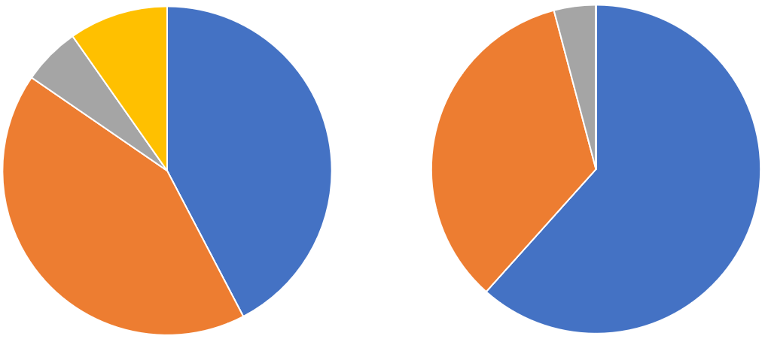
ADB2 perspective in Germany
Relative market share of distribution paths for Linear TV in general … and reception of HbbTV services

Slide 19
ADB2 perspective in Germany
Cable is significantly underrepresented in HbbTV reach – IPTV missing at all
Reason: Set-Top-Boxes by operators which do not support HbbTV – and operators do not really plan to change this
currently we have a technical reach of roughly 15 Mio connected HbbTV sets
potential for ADB2: roughly some 5 Mio more HbbTV devices
→ ADB2 perspective very simple: increasing reach
→ major broadcasters in Germany are planning ADB2 showcase / proof of concept
→ cooperation with manufacturers highly welcome for this showcase!
→ communication with broadcasters in other countries welcome to alingn ADB use

Slide 20

Industry Perspectives on ADB2
Norway
Erik Vold
NRK
Notes:
Erik brief intro and Klaus gives Erik control

Slide 21







Nordic Region
5.6M HH
4.5M HH
NorDig Unified IRD spec:
  HbbTV 2.0.2 > 1.7.20
  Nordic region & Ireland
2.2M HH
2.4M HH
1.7M HH

Slide 22
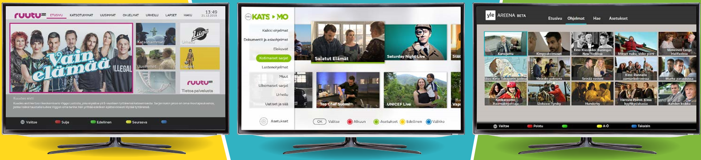
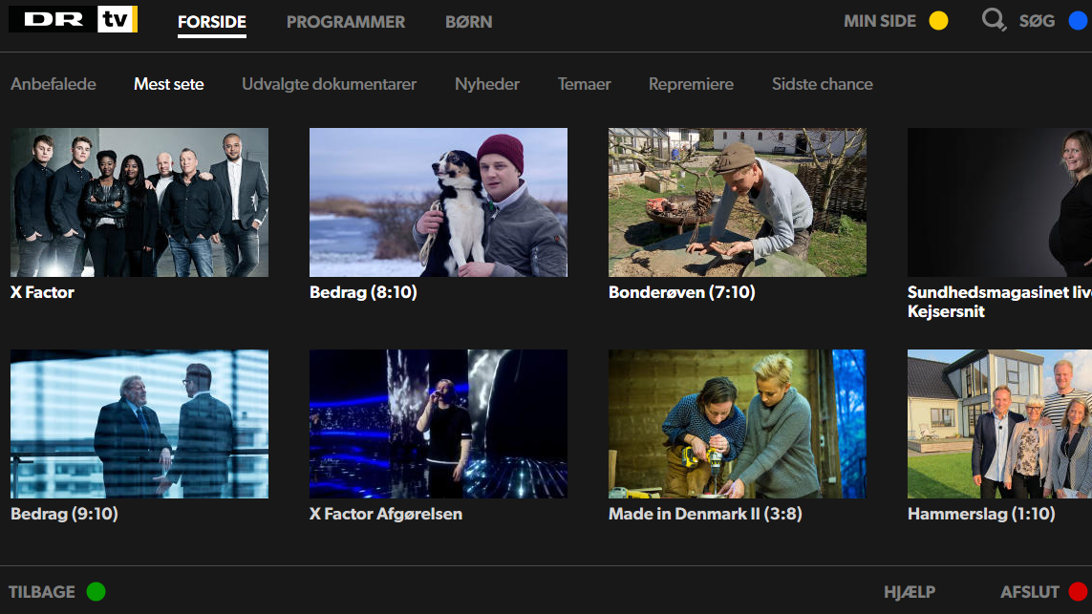
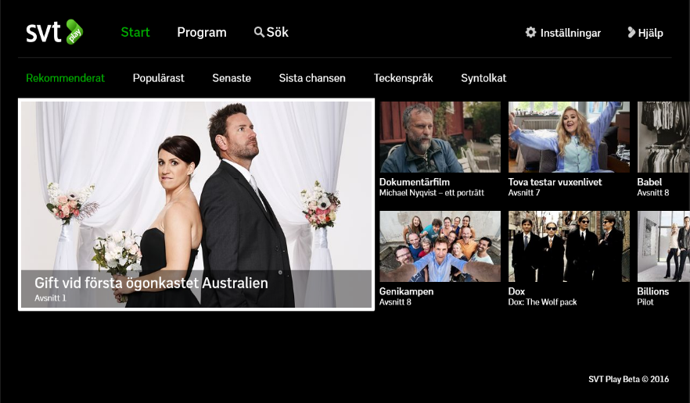
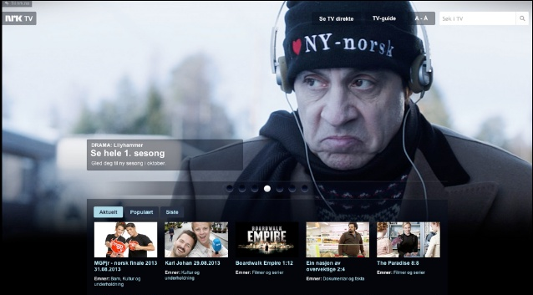
Popular catch-up services in Nordic region

Slide 23
HbbTV – Promoting itself with «red button»

Slide 24
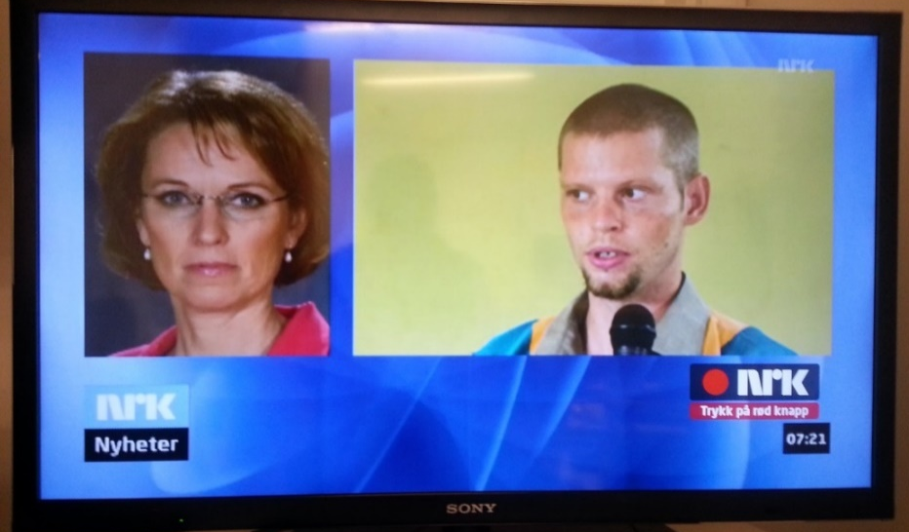
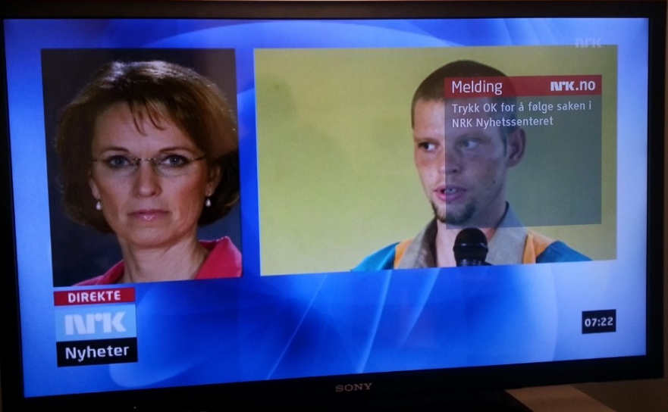
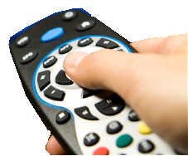
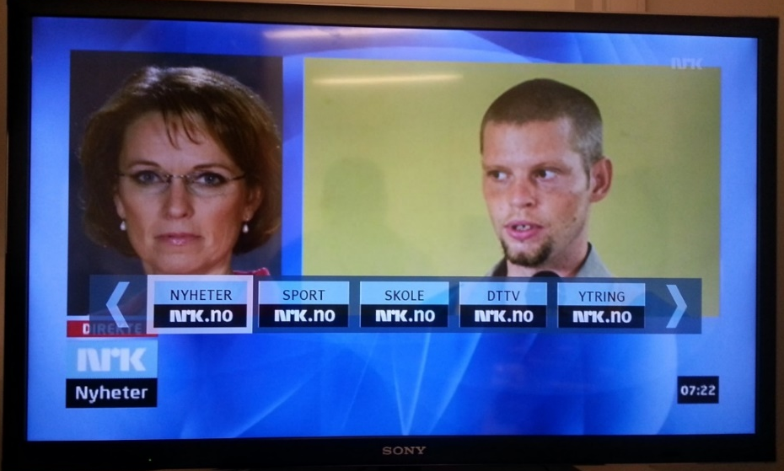
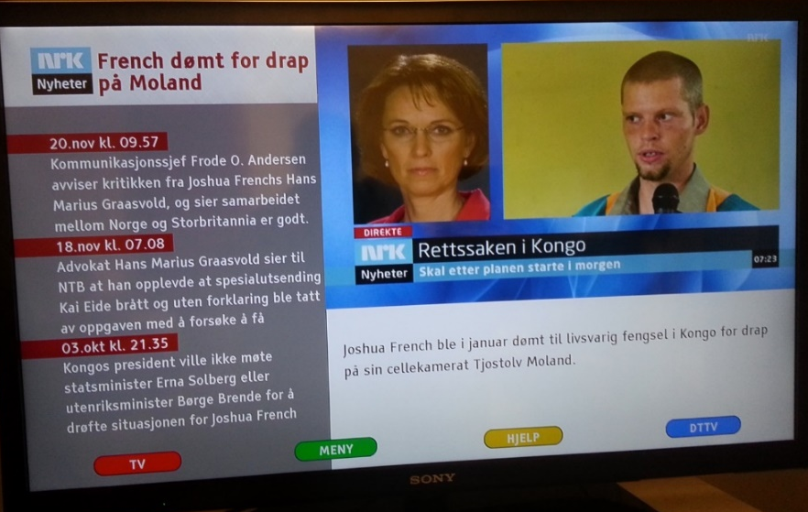
«Red button» / Contextual link

Slide 25




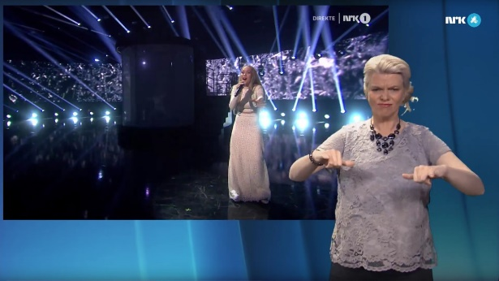

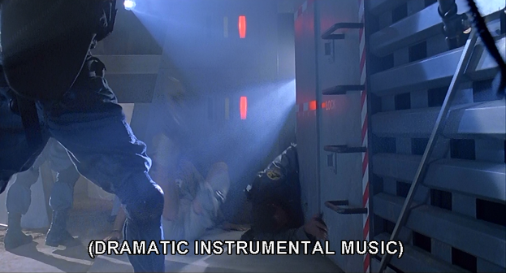
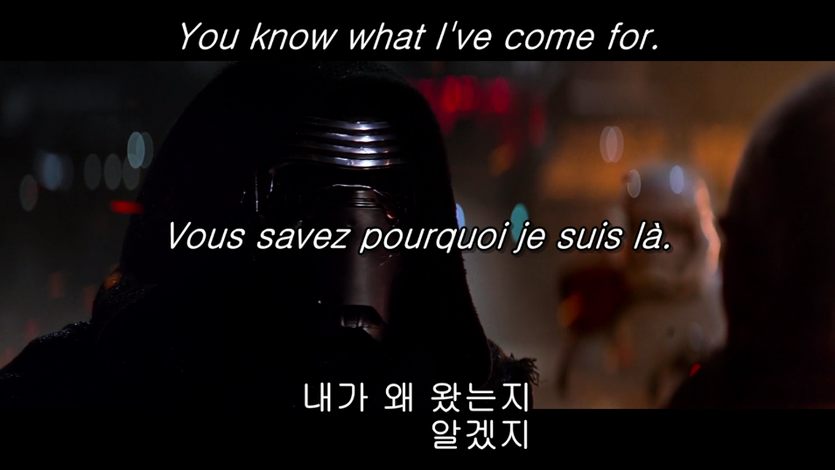
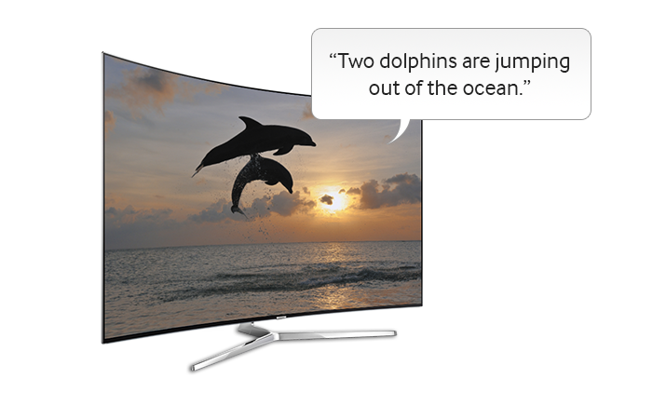
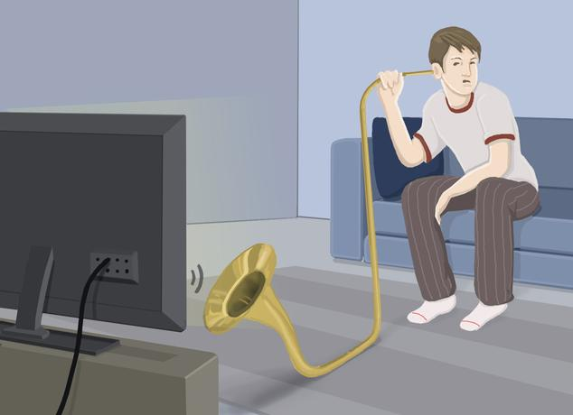


Accessibility Services
Enhanced dialogue

Slide 26
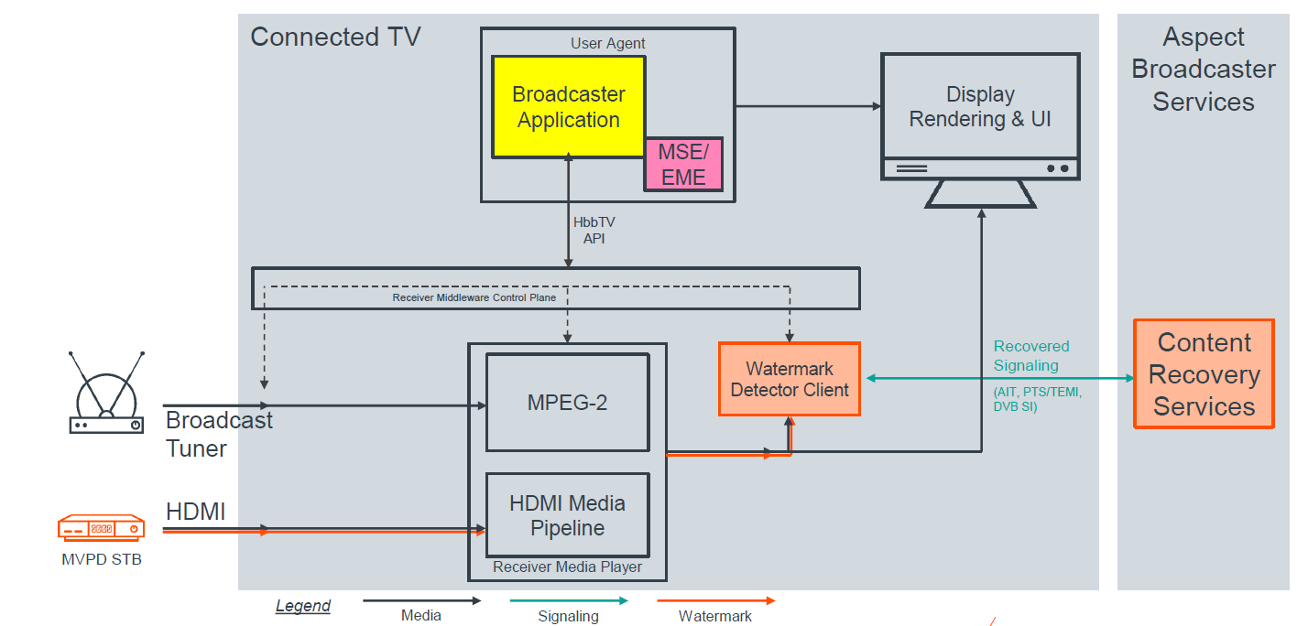
HbbTV/DVB Receiver Reference Architecture
Including HDMI Access to Rich Services

Slide 27
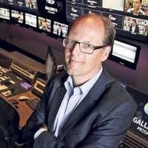
Industry Perspectives on ADB2
Netherlands
Frank Visser
Media Perspectives
Notes:
Frank brief intro and Klaus gives Frank control

Slide 28

TV market in the Netherlands
disclaimer: all data are best estimates
± 8.000.000 households (2020)
almost all TV’s are connected through a set-top-box / hdmi
± 300.000 HbbTV polling TV’s (~2017 stats)
a very small number connected directly to DVB-T

Slide 29
Chances for the Dutch market
Despite working group efforts, HbbTV has not taken off due to lack of TV’s reached
NPO and Talpa had a limited offering, RTL had none
Targeted advertising is now introduced through both KPN (DVB over IP) and Ziggo (DVB-C) networks
  ad-replacement is done in their set-top-box ecosystem
  reshuffling the commercial agreements / margins
  who’s customer is it? GDPR? consent? other data?
ADB2 would mean a way of reaching out to the TV viewer by the broadcasters directly
Interest of the three main broadcasters, facilitating companies and advertising agencies to research the possibilities
  ranging from data gathering only
  to a full integrated broadcast, OTT and online offering

Slide 30

Industry Perspectives on ADB2
Targeted Advertising
Matt Poole
HbbTV
Notes:
Matt brief intro and Klaus gives Matt control

Slide 31
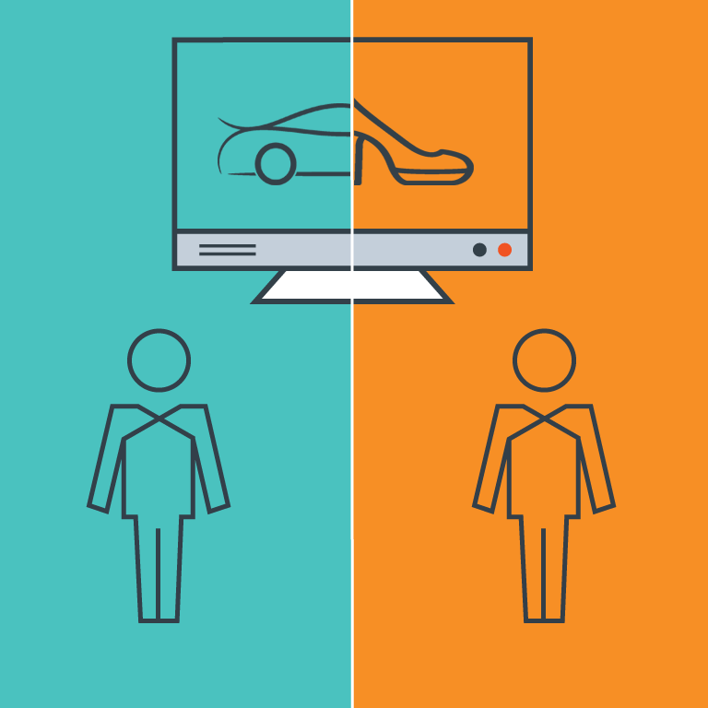

DVB Architecture for Targeted Advertising
HbbTV Extensions Place Broadcaster at the Controls
DVB and HbbTV released multipart specifications for signalling and insertion of Targeted Advertisements in 2019
  DVB A178 spec defines signalling based on SCTE 35
  HbbTV TA spec defines APIs for “fast switching”
DVB and HbbTV are now working to extend Targeted Advertising features to support ADB2 use cases

Slide 32
Questions?
Notes:
Thomas takes back control and puts up questions for presenters – placeholder slide only

Slide 33
Additional Reference Slides

Slide 34
ADB2 Limitations
Some HbbTV APIs are modified when Application Discovery over Broadband using watermarking is active
Some existing APIs are not available for use:
  selectComponent and unselectComponent
  setChannel / prevChannel / nextChannel
  release
Behavior is extended or changed for some objects and APIs
  Application
  Channel
  getCurrentActiveComponents
  fullscreen
  width / height
HbbTV application developers need to take this into account!

Slide 35
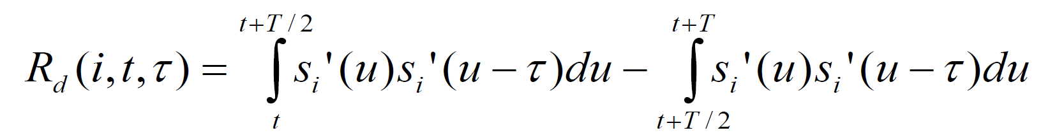
Audio Watermark Physical Layer
ATSC A/334: Audio Watermark Emission Specification
  Specifies modulation scheme and parameters to enable interoperability between conforming broadcasts and receivers
  Doesn’t specify design details of embedder or detector algorithms to enable innovation and competition in the market for implementations
  Publicly available example implementation
Technology details
  Differential autocorrelation modulation in 2.5 kHz-5 kHz frequency band
  106 bps raw transmission rate in a single watermark layer that must be
  consistent across all audio signals in a presentation
  Removable, modifiable, extensible via layering
ATSC performance evaluation results (Verance implementation)
  Perceptually transparent with EBU Broadcast Quality
  Reliable through cable / satellite / OTT redistribution channels to 32 kbps stereo, including during silence
  Supports timing recovery with 2ms accuracy

Slide 36
Audio Watermark Transport Layer
domain_type
(1b)
server_field
(var)
interval_field
(var)
query_flag (1b)
50-bit VP1 payload (1.5 seconds long)
VP1 Payload encodes an application server hostname, AIT URL, timecode, and a push notification.
  Domain type determines bits allocation between server field and interval field
  Server Code identifies a server hostname (allocated via registration authority, resolved via DNS)
  Interval code identifies the position of the payload on the watermark media timeline
  Query flag conveys a “push notification” from broadcaster
This payload is repeated continuously throughout the service, enabling the HbbTV terminal to:
  Identify when the service is tuned in and out
  Discover an AIT server
  Retrieve an AIT associated with the current playback position and other DVB-SI data
  Establish the Watermark Media Timeline and track the current playback position
  Receive push notifications

Slide 37
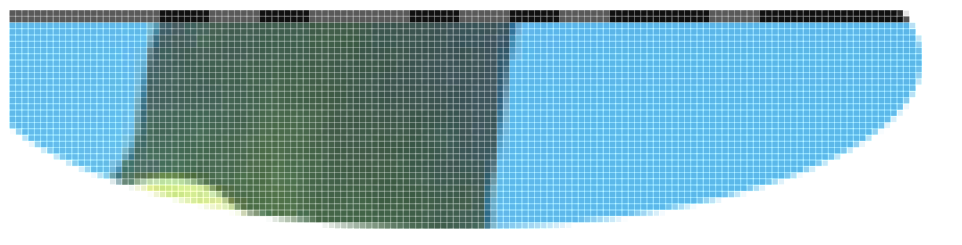

Video Watermark Physical Layer
ATSC A/335: Video Watermark Emission Specification
  Specifies modulation scheme and parameters to enable interoperability between conforming broadcasts and receivers
  Doesn’t specify design details of embedder or detector algorithms to enable innovation and competition in the market for implementations
  Publicly available example implementation
Technology details
  Low-energy luminance modulation in video lines
  1 and 2
  240 bits-per-video frame raw transmission rate in a single watermark layer
  Removable, modifiable
ATSC performance evaluation results (Sony implementation)
  Reliable through cable / satellite / OTT redistribution channels to 2.5 Mbps

Slide 38
Video Watermark Transport Layer
HbbTV ADB2 supports two video watermark message types
  VP1 message (A/336)
    Same format as VP1 payload in audio watermark (see Audio Watermark Transport Layer slide)
  HbbTV dynamic event message (HbbTV ADB2)
    protocol_type: identifies message format as HbbTV-defined
    event_name: event stream identifier (255 bytes maximum)
    data: stream event data (255 bytes maximum)
protocol_type (4)
event_name
(var)
data
(var)

Slide 39
Video Watermark Session Layer
Video Watermark Segment
HbbTV dynamic event messages (stream events) can be multiplexed with VP1 messages in the video watermark

Slide 40
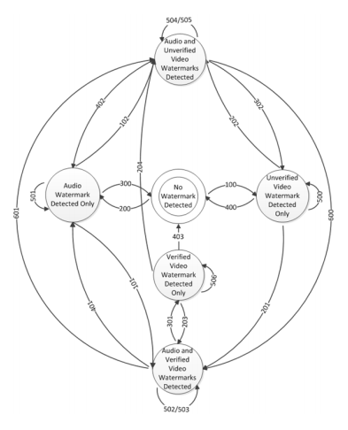
Watermark Technology
Application discovery lifecycle follows a state machine based on detection and loss of audio and video watermarks
An audio watermark must be present for an application to be launched
  Video watermarks provide supplemental timing and stream event information
  and enable lifecycle management during audio interruptions (e.g. audio mute)
The running application is hidden within 2 seconds when
watermarks are lost
  The hidden application is killed when watermarks indicate a channel
  change or, in any case, after 2 minutes
Video watermark embedding and detection are not currently mandatory
  Use of audio and video watermarks in combination enables improved
  user experience

Slide 41
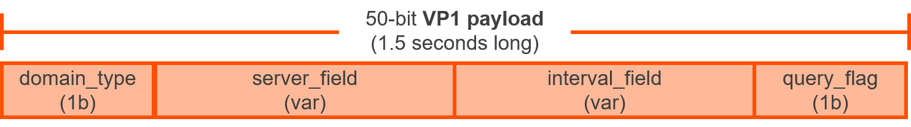
AIT Discovery
The HbbTV terminal detects VP1 Payload and converts into a time-dependent AIT URL.
The AIT Server returns a broadband AIT (with watermark extensions) that provides:
  Validity period for the AIT on the media timeline
  Application URL
  DVB triplet for the service
  Watermark Media Timeline mapping
  Component information
DNS Lookup
https://<domain-name>/xml.aitx?server_field=<server_field>&interval_field=<interval_field>

Slide 42
Watermark Media Timeline
A frame-accurate watermark media timeline is established by the Terminal using timing information conveyed in the audio and video watermarks
Applications can reference and access the watermark media timeline using the Media Synchronizer
  The watermark timeline selector is urn:hbbtv:sync:timeline:wm
  This timeline is accessed via MediaSynchroniser.currentTime()
  No synchronisation of other media elements to the watermark media timeline is currently mandated

Slide 43
Stream Events
Watermarking provides Terminals with two ways of receiving application stream events
  Stream events can be conveyed in the video watermark
    Applications “listening” to the urn:hbbtv:streamevent:a336:video
    event stream URL receive stream events sent in the video watermark
  Event notifications can be conveyed in the audio watermark
    Applications “listening” to the urn:hbbtv:streamevent:a336:audio
    event stream URL receive a stream event containing the latest audio watermark payload data whenever the broadcaster toggles the “query_flag” bit in the audio watermark payload
    This provides a “push notification” capability from broadcaster to application

Slide 44
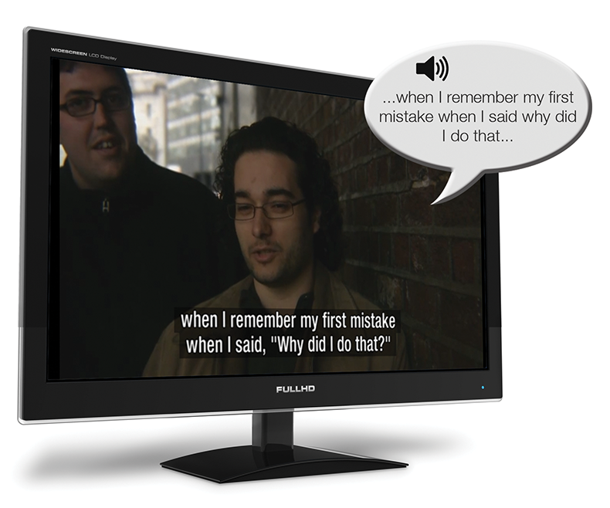

Spoken subtitles on mobile, not on shared TV
-Individually adapted for the visually impaired
-Not disturbing the shared experience on TV
-Could also be used for enhancing dialogue

