Slide 1

NorDig Technical group report to Excom
NorDig Excom meeting 14th March 2024
Early/preliminary report back from NorDig Excom
Marked as “Excom” in blue text is outcome from this Excom meeting (decision, comments, tasks, feedback etc)
NorDig T (Per Tullstedt) extra report back from NorDig Excom meeting, mainly NorDig T related issues, not the official NorDig Excom report (which will come from our Excom secretary)
Agenda (draft):
Place: Stockholm/Arlanda+webinar
1. Agenda and report, actions from previous meeting
2. Organizational matters
2.1. Selection of Excom and NorDig T chairman
2.2 Membership situation
2.3. Finance matters,
3. Report from NorDig/T (Per T/NorDig T)
3.1. Progress report,
3.2. NorDig specification - final draft NorDig spec: RoO v3.2.1 - waiting Excom approval
final draft proposal NorDig Unified IRD spec v3.2.1 - approved and published November 2023
NorDig Test Plan spec v3.2.1 - approved and published November 2023
NorDig Rules of Operation spec v3.2.1 draft016
4. (Lunch)
5. Report from Industry
6. Reports from members, DVB, EBU and other
6.1. DVB-I updates presentation by DVB Paul Higgs and Elfed Howells
7. Any other business
7.2. Accessibility (report of work from NorDig Accessibility group Peter Mølsted)
7.3. Report from WRC23 (Per Björkman/SVT)
8. Date and place for the meetings 2024/2025 (March physical, October online)
Green Text: text highlighted for Excom (waiting Excom decision/approval/comments)

Slide 2
NorDig T report - IRD, TestPlan and RoO spec, status current versions
NorDig Excom meeting 14th March 2024
Status specifications - current latest published
NorDig Unified IRD specification
  Latest published: NorDig IRD spec v3.2.1 (published November 2023)Final Draft ready v3.2.1waiting Excom approval 9 items in bug/item list, e.g. BMP/UTF-8 for Skolt Sami for SI and TTML subtitling
NorDig Test Plan
  Latest published: NorDig Test Plan v3.2.1 (published November 2023) Test streams [NGA/AC-4 + old LTE interference stream] (looking into a TTML stream)
    (follow IRD spec update)
NorDig Rules of Operation (RoO)
  Latest published: NorDig RoO v3.2.0 (published May 2022)
  Final draft NorDig RoO v3.2.1 draft015 was not approved/not consensus in Oct/Nov 2023
NorDig EPG/EIT metadata exchange format (5 documents)
  Latest published: NorDig Metadata Exchange format specification v1.3 (Oct 2019), Guidelines v1.4 (June 2022), Genre list v1.1, List of EPG/Event metadata in NorDig TVA format v.1.1 (Sep 2020) and List of EPG/Event metadata in NorDig TVA format ver. 1.1 (Oct 2020)
  Specs is up to date
Excom – no comments
IRD – NorDig Unified IRD specification
TestPlan – NorDig Unified Test Plan
RoO – NorDig Rules of Operation

Slide 3
NorDig T report - new RoO specifications v3.2.1
NorDig Excom meeting 14th March 2024
Status specifications (latest published and proposal for new updated version)
NorDig Unified IRD specification
  Latest published: NorDig IRD spec v3.2.1 (published November 2023)
  Future revision – drafting not started (9 items in bug list)
NorDig Test Plan
  Latest published: NorDig Test Plan v3.2.1 (published November 2023)
NorDig Rules of Operation (RoO)
  Latest published: NorDig RoO v3.2/3.2.0 (published May 2022)
  Updated final Draft016 ready v3.2.1 minor update – waiting Excom approval
    6 items in bug/item list, main items: BMP/UTF-8 for Skolt Sami for SI and TTML subtitling.
    Info - HbbTV section was not agreed in Oct/Nov 2023, too much demands from Manufactures upon Broadcasters/Operators. Late new input from 2rn.
    HbbTV section – Jan/Feb 2024 section now updated and agreed within NorDig/T
Excom – OK, no comments at the meeting, AP NorDigT/PerT send out final draft for a standard 2w final approval procedure, if no comments then publish at NorDig website.
Excom thanks NorDig T and subgroups for its work with the proposal
NorDig EPG/EIT metadata exchange format
  Latest published: NorDig Metadata Exchange format specification v1.3 (Oct 2019), Guidelines v1.4 (June 2022), Genre list v1.1, List of EPG/Event metadata in NorDig TVA format v.1.1 (Sep 2020) and List of EPG/Event metadata in NorDig TVA format ver. 1.1 (Oct 2020)
  Specs is up to date
IRD – NorDig Unified IRD specification
TestPlan – NorDig Unified Test Plan
RoO – NorDig Rules of Operation

Slide 4
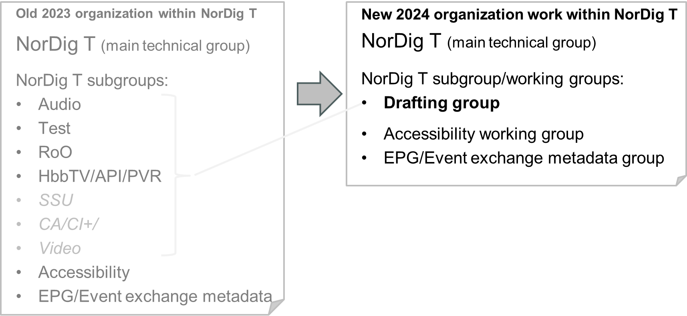
NorDig T report - NorDig T and subgroup re-organization 2024
NorDig Excom meeting 14th March 2024
NorDig T has less and less working items from NorDig Excom to handle in future (as right now no new major features/technology like video or audio and e.g. DVB-I waiting Excom decision and members real need/interest)
Specifications (IRD+Test+RoO) are now going more into maintenance mode
Most proposed changes lately in specs, needs to review impact on all three NorDig specs (IRD+Test+RoO)
Less active participation from (Broadcast and Operator) members last years
Several subgroups are less active last couple of years
Working Groups for
specific areas when topics are active or
separate group for separate areas (e.g. EPG)
Previous chairmen in NorDig subgroups remains as experts in areas:
Audio – Johan Lindroos, SVT
Test – Pasi Toiva, Labwise
RoO – Des Mac Giolla an Chloig, 2rn
HbbTV/API/PVR – Erik Vold, NRK
EPG/Event exchange metadata – Peter Mølsted,
Accessibility – Peter Mølsted
SSU – Per Tullstedt/NorDig T
Video – Per Tullstedt/NorDig T
Excom – OK

Slide 5
NorDig T report - NorDig/T subgroups
NorDig Excom meeting 14th March 2024
NorDig EPG group and Event exchange file format:
Keep TV Anytime spec up to date, work to promote NorDig EPG/event file format, exchange experience around EPG
Focus on implementation of NorDig TVA for on-demand cross platforms.
9th Open Workshop 2-3 May 2024 in Stockholm, agenda: metadata exchange for on-demand content, TVA implementation and handling of accessibility services.
Status of implementation and use of NorDig common EPG/Event metadata exchange format, done: NRK, TV2DK, TV2NO, DR, TDC, Red Bee Media, SimpleTV, InFlow media, SVT, Teracom.
Excom – work to also include IRD manufactures into this work, AP send invitation workshop to IRD manufactures
NorDig Accessibility group
NorDig Excom identified in 2023 accessibility as an important areas for NorDig work
Study - identifying and proposing working items for 2024, id if anything NorDig is missing &/or could add
  E.g. Universal remote control, easy-to-use user settings, HbbTV possibilities, high contrast…
Investigating and questionnaire to NorDig members and to some of the accessibility organisations.
Coming European Accessibility Act (EAA), UK U-book 2021
Study experience with HbbTV accessibility services implementation and developments (Finland, Spain, Germany ..)
Excom – no comments
<new> NorDig Drafting group
Ad-hoc working group for detailed drafting / deeper discussions
Jan-Feb2024 continued detailed discussions and managed to finalize drafting on RoO spec v3.2.1 after new inputs from 2rn in Dec2023 for the HbbTV part. Updated proposal for RoO draft sent back to NorDig/T group.
Excom – no comments

Slide 6
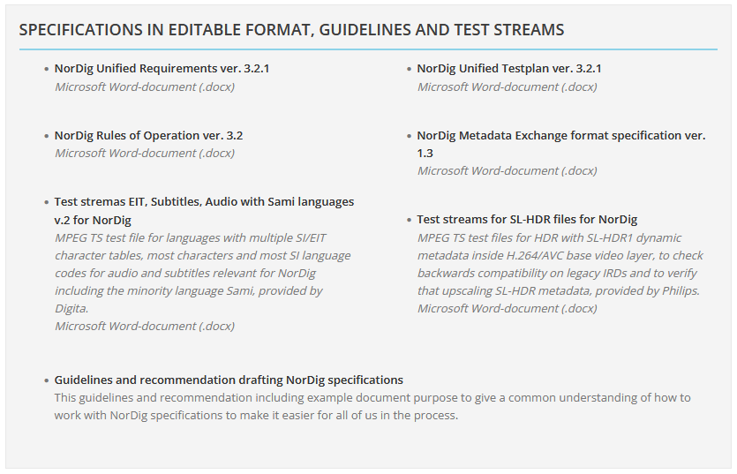
NorDig T report - Test files
NorDig Excom meeting 14th March 2024
NorDig Test files
Published2014/open section – NorDig LTE Interference IQ files
Published2019/open section - NorDig Audio Test Streams (NGA/AC-4)
Published2023/member section - Digita has made a test stream for testing Sami in SI/EIT and ISO10646 BMP/UTF-8 (test file also test audio language codes, all Nordig languages incl Sami) – added to member front page 2024
<New> Published2024/member section - Philips SL-HDR test streams – now available at NorDig website, member section (https://nordig.org/member-frontpage/). MPEG test streams containing 1080i/720p MPEG4/AVC/H.264 base video and within video stream additional SL-HDR dynamic metadata. Test legacy IRDs not disturbed by dHDR metadata and to verify that upscaling SL-HDR metadata results in full restoration of the original HDR version.
UnderProgress - Labwise plans to provide a NorDig adjusted version of the DVB’s TTML test streams, that they plans to share inside NorDig
UnderProgress - TV2 Norway has added TTML out of their playout. Has provided a number of MPEG recordings for NorDig with live morning news/talk-show live subtitling (so far, some issues that hopefully will be corrected before final version).
https://nordig.org/member-frontpage/
Excom – OK
NRK confirms that they have now added TTML in their playout, NRK is positive in helping creating a reference recording with TTML for NorDig

Slide 7
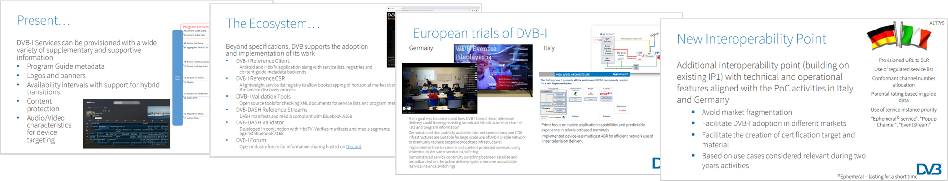
NorDig Excom actions/info to NorDig T
NorDig Excom meeting 14th March 2024
DVB-I
  Paul Higgs (DVB TM-I) and Elfed Howell (DVB PCM) made a presentation around latest updates in DVB-I
  Excom had some discussions around DVB-I.
  NorDig Excom made no decision around DVB-I.
  NorDig T – DVB-I still monitoring status, collect more info from members.
Deep linking Smart TVs
  Several members has noted issues with that some TV manufactures has restricted deep-linking between smart-tv apps resulting in poor viewing experience for the viewers.
  NorDig T – no action needed at this stage (topic handled by/discussed in Excom)
(Informative: in past normal procedure for Excom to add new main feature(s) is:
several members must have real need, then establish and agree upon commercial requirements, then drafting technical proposal according to commercial requirements with reasonable grace periods for the Industry for mandatory items and last Excom approval of updated specification)

Slide 8
NorDig T report –
NorDig Excom meeting 19th October 2023
NorDig Excom meeting, agenda item 3
END presentation
NorDig-T report

Slide 9
NorDig T report –
NorDig Excom meeting 19th October 2023
END presentation
from NorDig-T
After here some detailed informative slides
ANNEX
  Annex A: NorDig T mandates for 2023-2024 (informative)
  Annex B: NorDig T meeting calendar 2024 (informative)
  Annex C: NorDig T group new organization & subgroups (informative)
  Annex D: NorDig T list of countries referring to NorDig (informative)
  Annex E: NorDig website and e-mail reflectors (informative)

Slide 10
NorDig T report – Annex A - mandates and activities for NorDig T (1/2) Informative
NorDig Excom meeting 14th March 2024
NorDig T – mandates & items for period 2023-2024 (Excom approved March 2023)
General:
  Keep IRD, RoO and Test Plan in line with each other
  Maintain and keep NorDig spec up to date (debug, reference list to international spec is up to date etc)
  Monitor DVB, HbbTV and other relevant IRD specs changes and new technologies (e.g. DVB-I)
NorDig Unified IRD spec
NorDig RoO specification
  help broadcasting avoid issues for IRD/viewers (“tips and tricks”)
  Additions to DVB Guidelines
  minimize and shorten text that are mainly relevant for the IRD
NorDig Test and Test plan
  Maintain and update NorDig Test plan to match IRD spec
    Review and where possible combine similar test cases to make it easier and faster to test
    “minimize” redundant test cases if possible without compromising with test quality, to speed up time for verification testing.
    Update and improve test cases
NorDig EPG exchange file format
  Maintain NorDig spec. of common EPG/Event exchange file format and impl. Guidelines
  Work to promote NorDig TVA eg. via open Workshops and help impl. and use of NorDig EPG/event file format

Slide 11
NorDig T report – Annex A - mandates and activities for NorDig T (2/2) Informative
NorDig Excom meeting 14th March 2024
NorDig T – mandates & items for period 2023-2024 (Excom approved March 2023)
continue NorDig T mandates & items for period 2023-2024
Video, audio, subtitling
  monitor DVB specifications and recommendations and I/O (HDMI).
  NGA&TTML: monitor NGA&TTML audio usage and experience (in order to help NorDig member using/launching NGA &/or TTML).
HbbTV
  NorDig HbbTV test and test cases; maintain NorDig developed test cases. Propose new test cases if needed.
  NorDig HbbTV IRD requirements; maintain and update HbbTV requirements. Investigate, present and when confirmed by Excom draft proposal for new HbbTV requirement that are of interest for NorDig members
  HbbTV implementation: Monitor and report HbbTV implementation in NorDig networks & IRD side, exchange experience
Accessibility
  Work with harmonization of broadcast and better describe current broadcast for IRD manufactures
EPG/Event exchange file format:
  Promote use for NorDig members for example via open workshops to support promoting and implementation of NorDig TVA format.
  Maintain NorDig specification of common EPG/Event exchange file format and Guidelines, to be in line with TA Anytime specs

Slide 12

NorDig T report - Annex B - Meeting calendar 2024
NorDig Excom meeting 14th March 2024
NorDig T – meeting calendar 2024:
NorDig T, #1, Thursday 18th January 2024, webinar, 10:00-12:00 CET
NorDig T, #2, Thursday 22th February 2024, webinar, 10:00-13:00 CET
Informative Excom 14th March 2024
NorDig T, #3, Thursday 23th May 2024, physical+webinar, 10:00-12:00 CET,
NorDig T, #4, Thursday 5th September 2024, webinar, 10:00-12:00 CET
NorDig T, #5, Wednesday 2nd October 2024, webinar, 10:00-12:00 CET
Informative Excom proposed 17th October 2024
NorDig T, #6, Thursday 7nd November 2024, webinar, 10:00-12:00 CET

Slide 13
NorDig T report - Annex C - Work and subgroups
NorDig Excom meeting 14th March 2024
Previous -2023 organization within NorDig Technical group
NorDig T (technical group) – Per Tullstedt, Teracom
NorDig T subgroups – status
Audio – Johan Lindroos, SVT
Test – Pasi Toiva, Labwise
RoO – Des Mac Giolla an Chloig, 2rn and Peter Mølsted
HbbTV/API/PVR – Erik Vold, NRK
EPG/Event exchange metadata - Peter Mølsted,
Accessibility – Peter Mølsted
SSU – Per Tullstedt dormant, within NorDig T
CA/CI+/Sec – Per Tullstedt dormant, within NorDig T
Video – Per Tullstedt dormant, within NorDig T
However now 2023/2024,
NorDig T has less and less working items from NorDig Excom to handle in future (as right now no new major features/technology like video or audio and e.g. DVB-I waiting Excom decision and members real need/interest)
Specifications (IRD+Test+RoO) are now going more into maintenance mode
Less active participation from (Broadcast and Operator) members last years
Several subgroups not been/less active last couple of years (among things due to lack of resources)
Most drafting has last years been taken care of by the remaining active groups/RoO groups (IRD+RoO)
NorDig intension to keep all 3 main specifications (IRD+Test+RoO) in-line with each other, harmonise updates when possible.

Slide 14
NorDig T report - Annex C - Work and subgroups
NorDig Excom meeting 14th March 2024
Old 2023 organization within NorDig T
NorDig T (main technical group)
NorDig T subgroups:
Audio
Test
RoO
HbbTV/API/PVR
SSU
CA/CI+/
Video
Accessibility
EPG/Event exchange metadata
New 2024 organization work within NorDig T
NorDig T (main technical group)
NorDig T subgroup/working groups:
Drafting group
Accessibility working group
EPG/Event exchange metadata group

Slide 15
NorDig T report - Annex C - Work and subgroups
NorDig Excom meeting 14th March 2024
New idea for organization work within NorDig T
NorDig T (technical group) – main group
  General discussions all topic, simple drafting (corrections, debugs…), exchange experience,
  review and approve at NorDig/T level all text proposals for NorDig specifications/documents from drafting group and others,
NorDig T subgroup/working groups 2024:
Drafting group
WG - Accessibility group
WG - EPG/Event exchange metadata group
NorDig contacts/experts for areas
Audio – Johan Lindroos, SVT
Test – Pasi Toiva, Labwise
RoO – Des Mac Giolla an Chloig, 2rn
HbbTV/API – Erik Vold, NRK
EPG/Event exchange metadata – Peter Mølsted,
Accessibility – Peter Mølsted
SSU – Per Tullstedt/NorDig T
CA/CI+/Sec – Per Tullstedt/NorDig T
Video – Per Tullstedt/NorDig T
Working Groups for
specific areas when topics are active or
separate group for separate areas (e.g. EPG)

Slide 16
NorDig T report - Annex C - Work and subgroups
NorDig Excom meeting 14th March 2024
New idea for organization work within NorDig T
NorDig T (technical group) – main group
  General discussions all topic, simple drafting (corrections, debugs…), handle AP & working items from Excom within mandate, review and approve at NorDig/T level all text proposals for NorDig specifications/documents from drafting group and others, gather and share information and exchange experience among members
  In order to keep NorDig/T meeting efficient and valid for all participants - deeper discussions within certain areas not applicable to all in NorDig/T is typically handled in separate subgroups which report back, drafting text proposals (others than simple ones) handle in drafting group which report back.
  NorDig T set the intension/context for items to drafting group or other working subgroup and guide drafting through the development
NorDig T subgroup/working groups 2024:
Drafting group
  detailed drafting of requirement text proposals for NorDig specifications IRD+TestPlan+RoO.
  for proposed changes, normally study and draft text for all three specifications (IRD+TestPlan+RoO)
  drafting based upon inputs/intension/context from NorDig T , continuously report back status and plans to NorDig/T for guidance.
Working group - Accessibility group (NorDig Excom has 2023 id this as key area for NorDig)
  Identify and propose relevant improvement and/or new accessibility features and handling for NorDig (IRD, video, audio, subt, menus, EIT…).
Working group - EPG/Event exchange metadata group
  Separate area, working group and drafting of EPG exchange file documents
NorDig experts for the areas
Audio – Johan Lindroos, SVT
Test – Pasi Toiva, Labwise
RoO – Des Mac Giolla an Chloig, 2rn
HbbTV/API/PVR – Erik Vold, NRK
EPG/Event exchange metadata – Peter Mølsted,
Accessibility – Peter Mølsted
SSU – Per Tullstedt/NorDig T
CA/CI+/Sec – Per Tullstedt/NorDig T
Video – Per Tullstedt/NorDig T

Slide 17
NorDig T report – Annex D - NorDig countries/networks
NorDig Excom meeting 14th March 2024
List of Countries using or referring to NorDig specifications
Several IRD manufactures and other mentions that several other territories and DVB networks refers or uses NorDig as basis for their IRD specs (especially “newer” networks). Among reasons seems open spec and content (T2, HbbTV, subtitling etc).
Country / Network | Status
Turkey DTT | Confirmed via Vestel
Several eastern Europe countries | Indications, not confirmed
Malaysia (blue copy) | Digita
German DTT (Media broadcast/TDF) | Based on/reference to NorDig IRD
Georgia DTT | Based on/reference to NorDig IRD (v2.2)
French DTT/FAVN ?? | Based on/reference to NorDig IRD v??
Italien DTT + Satellite | Partly based on/reference to NorDig IRD (v2.5, RF), partly own requirements (e.g. SI)
Poland DTT | Might be based on/reference to NorDig IRD
Standard Australia | Copyright agreement w NorDig

Slide 18
NorDig T report - Annex E - Website & admin
NorDig Excom meeting 14th March 2024
NorDig Website and admin
  E-mail reflector: Implemented for NorDig Excom, NorDigT and all NorDigT subgroups and it works fine.
    NorDig via NorDig Excom group <excom_group@nordig.email>
    NorDigT group <nordigt_group@nordig.email>
    NorDig Drafting group drafting_group@nordig.email
    NorDig EPG group <epg_group@nordig.email>
    NorDig Accessibility group <accessibility_group@nordig.email>
    (NorDig RoO group <roo_group@nordig.email> inactive group)
    (NorDig Test group <test_group@nordig.email> inactive group)
    (NorDig API group <api_group@nordig.email> inactive group)
    (NorDig Audio group <audio_group@nordig.email> inactive group)
    (NorDig Video group <video_group@nordig.email> inactive group)
    (NorDig Accessibility group <accessibility_group@nordig.email> inactive group)
      HowTo: When you send an email to your group mail ex. epg_group@nordig.email , every member of the list will get the email. Reply only to the sender: in the bottom of the mail you find a link “reply to sender”. Changes your settings: You can change the email address where you receive the group mail by using the “My settings” link in the bottom of all mails send using the group mail address. The is a quick start guide for more information at this link: https://gaggle.email/quick-start-for-members. If need to get a overview over which groups you member of you can see it here: https://gaggle.email/find. NorDig admin contact Peter Molsted (peter@ moelstedconsulting.dk)
  History page with old versions of our specifications implemented (https://nordig.org/specifications/specifications-archive/)
  Website, e-mail notifications for changes and new uploaded documents on NorDig website, (see https://nordig.org/wp-content/uploads/2016/11/Change-your-mail-notification-.pdf same as before)

