Slide 1
Saorview and DVB-I
PoC progress

Slide 2
Initial PoC
Initial PoC was developed in 2023 to test the technology and generate management interest
Purpose - to enhance existing Free DTT offering with a next-gen product
Address growing IP content consumption
Serve viewers in IP-only homes
Add value to DTT with IP-delivered features
Create a long-term development path for Saorview
Serve OOH viewers
While continuing to meet public service obligations

Slide 3
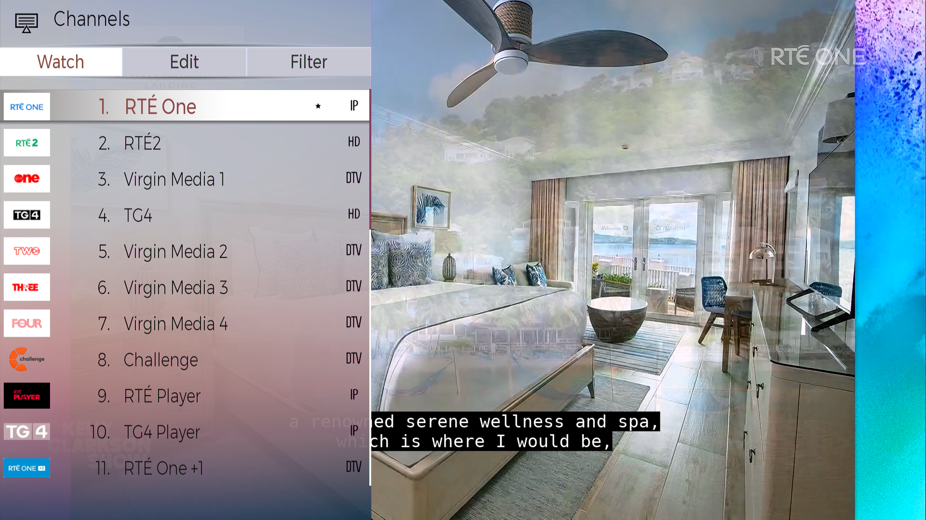
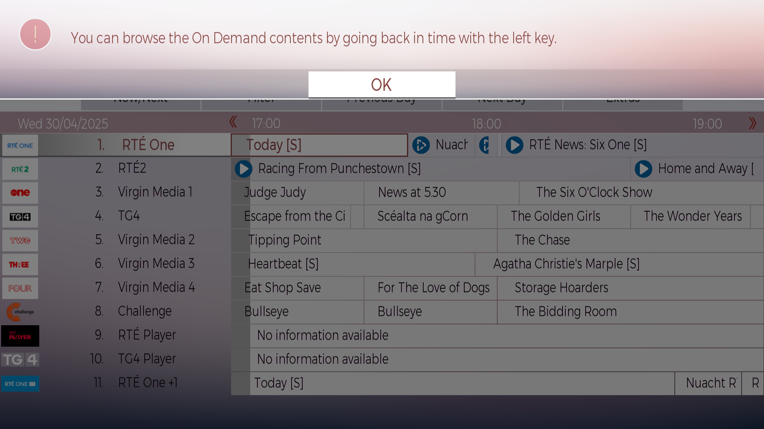
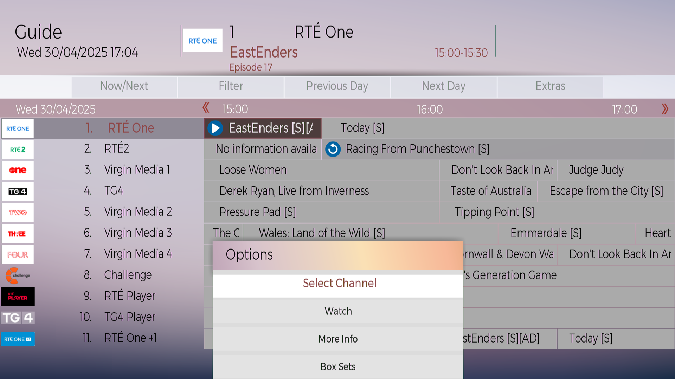
Where we are now - PoC Phase two
Ongoing development in preparation for an initial trial
Working with OSP
IP schedule delivery, CUTV and restart
More Episodes
Content imagery enhances user experience
Accessibility services signalling
Prominence signalling
Channel logos
Boxed sets demo
  Boxed sets are linked to individual channels
RTÉ Player and TG4 Player in EPG
Bilingual capability
CM-I-ITF; working on DRM, Player version management and user install journey

Slide 4
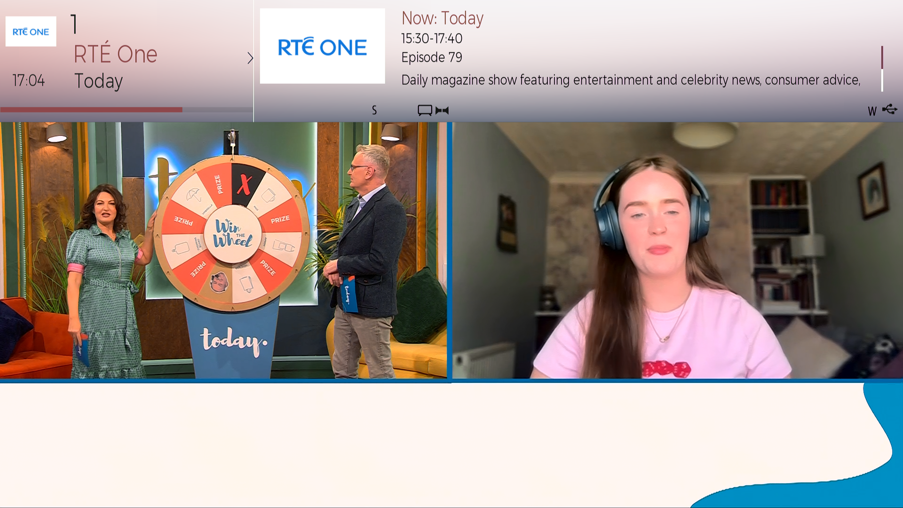
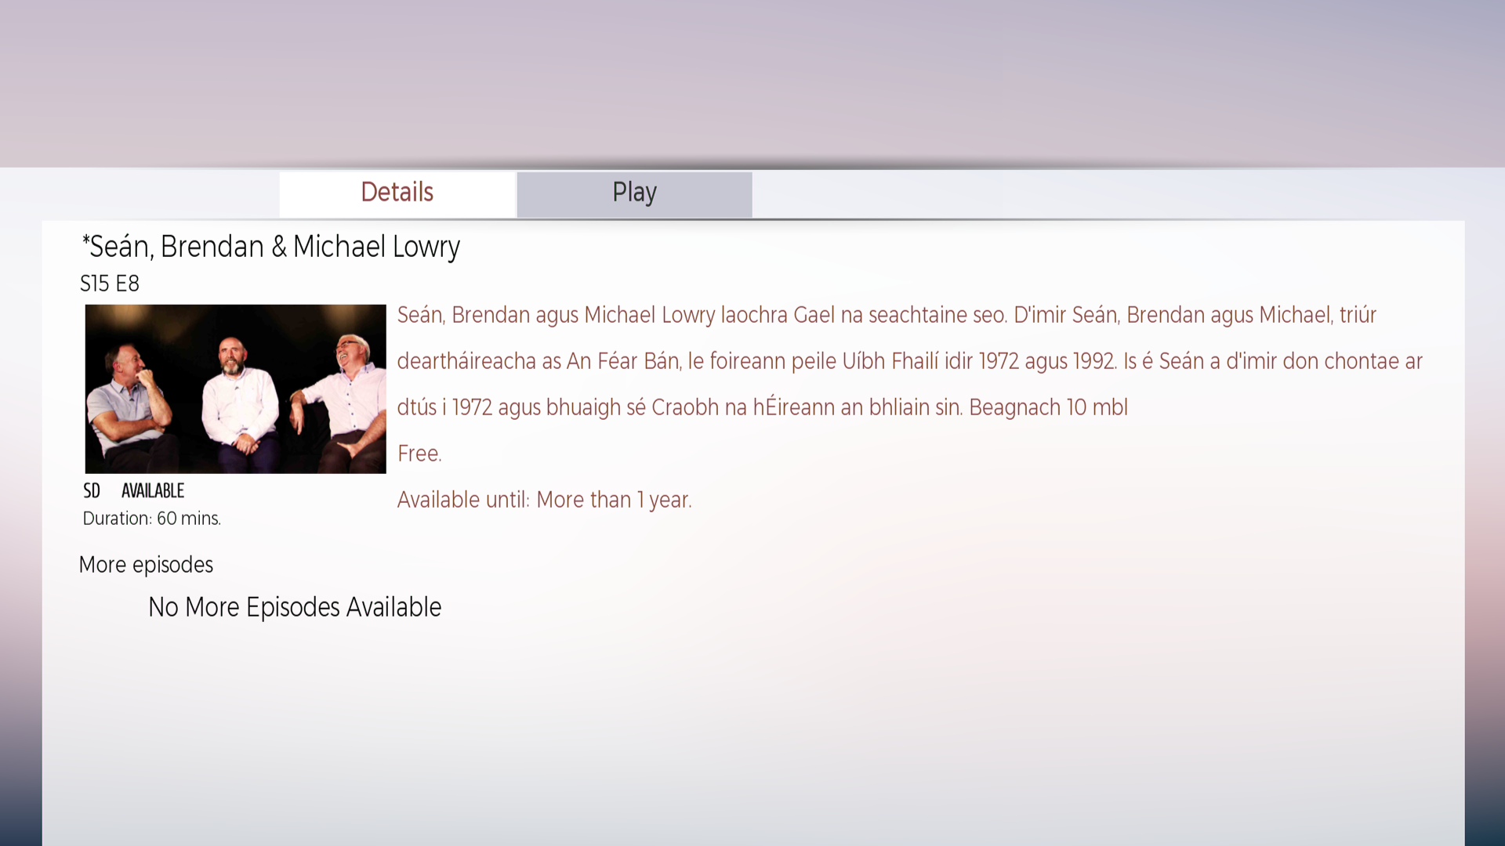
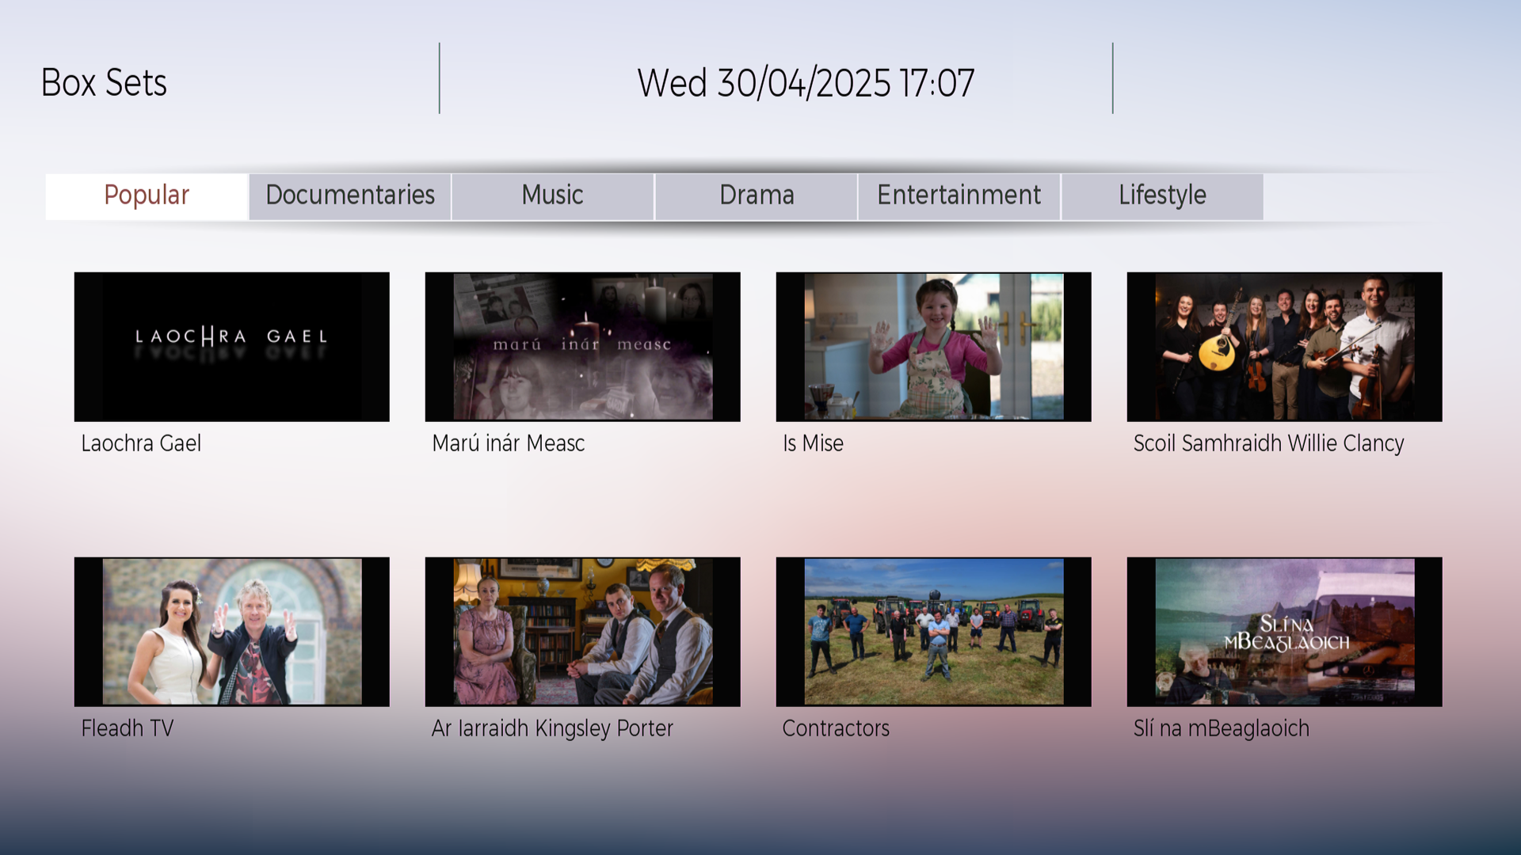
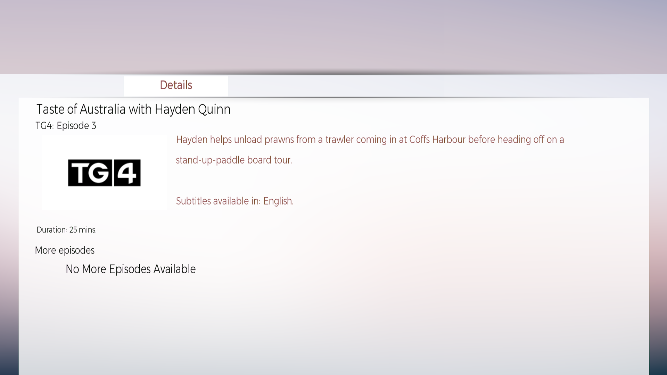

Slide 5

Lessons learned
DVB-I facilitates our ‘Smart Follower’ strategy
Low risk, high impact
Incremental product and feature development
Facilitates broadcaster application discovery and prominence
Box sets, CUTV and restart
Important to implement according to common profile
Especially true for small markets such as Ireland
Technical standards compliance
Communication with manufacturers – vital
Implementation group
Offers a path to further product development
Future options for enhanced UI, OOH content discovery, FAST / event channels, local content
Important to serve homes with legacy devices

Slide 6

To be done
NGP Business case (corporate strategy)
Regulatory engagement
DRM protected streams
HbbTV applications
Search, findability – metadata specs
Privacy and GDPR
part of install journey
Player version management
NorDig
Share MVP specification with manufacturers
Launch pilot phase 1
Approval of pilot phase 1

Slide 7
DVB-I in Ireland
NOW
2025
Phase 2 pilot approval
Pilot partners
Build for rollout
Final test/verification
‘Soft’ launch
2023
2024
Develop business case for NGP
Identify path to MVP
Pilot featureset
Work closely with manufacturers
Seek approval for Pilot phase 1
2026
Evolve DTT Platform
IP Future
Open standards v. proprietary options
‘Smart Follower’
Leadership approval for next phase
Working with OSP
Develop PoC2
Add value
Automate IP schedule delivery
Initial PoC
PoC 2
Pilot phase 1
Pilot phase 2
Baseline Requirements
Common
Profile
NorDig

Slide 8
Proposed pilot phase 1 goals – expert pilot
Expert feedback on user experience
Testing and verification
Device farm
NorDig inclusion – ‘Saorview Approved’ listings
Regulatory input and approval

